Slide 1
JoVE 50392
Fetal Echocardiography and Pulsed-wave Doppler Ultrasound in a Rabbit Model of Intrauterine Growth Restriction

Slide 2
I. Elements to be illustrated
Rabbit
Positioned belly up (ventral side up)
Ideally, this would be of a style that is compatible with JoVE’s existing stock illustrations of rodent organs (see section III)
Rabbit uterus
It would be nice to have one layer with just the uterus, and then a layer with fetuses that can be brought up on top of it, so we can use it for both pregnant and non-pregnant bunnies.

Slide 3
II. Storyboard
Notes:
The full schematic script is as follows:
The overall goal of this procedure is to surgically induce intrauterine growth restriction, or IUGR in a rabbit fetus, and examine the fetal cardiovascular response to placental insufficiency (Intro).
This is accomplished by first _performing a midline laparotomy at gestational age day 25, and carefully exposing the rabbit bicornuate uterus (P1, Editor, begin with the rabbit in P1 without the brackets).
Next, 40-50% of the uteroplacental vessels supplying each gestational sac in one uterine horn are surgically ligated and the fetuses in the second uterine horn are left as controls. (P2, Editor, bring in the brackets and the illustration in P2).
At gestational age day 30, a repeat midline laparotomy is then performed using an intravenous infusion of ketamine and xylazine anesthesia to minimize fetal cardiac effects (P3, Editor, use P3 here. If possible, add the layers: first the rabbit, then opening the abdomen, then the white box with the blood vessels).
Finally, fetoplacental Doppler ultrasound and fetal echocardiography are carried out to obtain measurements of fetal hemodynamics, and cardiac function and structure in IUGR and control fetuses (P4, Editor, add the brackets and the setup in P4).
Ultimately results can be obtained that show the fetal cardiovascular response to increased placental resistance through biometric analysis, fetoplacental Doppler ultrasound and novel fetal echocardiography (P5, Editor, scroll through Figures 2, 3, and 4 here).

Slide 4
Notes:
The overall goal of this procedure is to surgically induce intrauterine growth restriction, or IUGR in a rabbit fetus, and examine the fetal cardiovascular response to placental insufficiency (Intro).
This is accomplished by first _performing a midline laparotomy at gestational age day 25, and carefully exposing the rabbit bicornuate uterus (P1).
P1.1: Show a rabbit, lying ventral side up (belly up).
P1.2: Show a dotted line representing an incision down the middle of the rabbit’s abdomen.

Slide 5
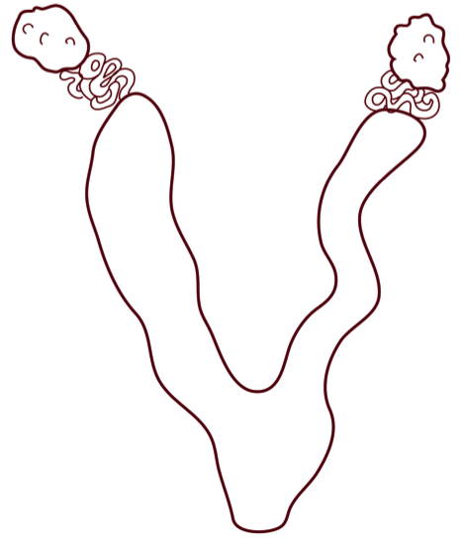
Notes:
The overall goal of this procedure is to surgically induce intrauterine growth restriction, or IUGR in a rabbit fetus, and examine the fetal cardiovascular response to placental insufficiency (Intro). This is accomplished by first _performing a midline laparotomy at gestational age day 25, and carefully exposing the rabbit bicornuate uterus (P1).
P1.1: Show a rabbit, lying ventral side up (belly up).
P1.2: Show a dotted line representing an incision down the middle of the rabbit’s abdomen.
P1.3: Fade on the uterus overlay on the rabbit’s abdomen.

Slide 6
Notes:
Next, 40-50% of the uteroplacental vessels supplying each gestational sac in one uterine horn are surgically ligated and the fetuses in the second uterine horn are left as controls. (P2)
P2.1: When the VO describes the ligated vessels, bring up the “zoomed in inset” of the ligated vessel (shown here on the right). Then bring up the control vessel on the left. [Note to the Illustrator: The blood vessels are already in JoVE’s stock, you do NOT need to draw them.]

Slide 7

Notes:
At gestational age day 30, a repeat midline laparotomy is then performed using an intravenous infusion of ketamine and xylazine anesthesia to minimize fetal cardiac effects (P3)
P3.1: Show the spinning clock animation over the rabbit’s abdomen to suggest passage of time. [Note to the illustrator: The clock is a JoVE stock graphic and you do NOT need to illustrate it.]

Slide 8
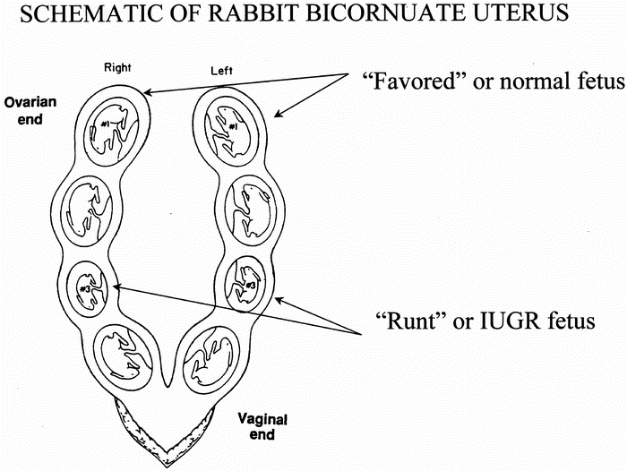
Notes:
At gestational age day 30, a repeat midline laparotomy is then performed using an intravenous infusion of ketamine and xylazine anesthesia to minimize fetal cardiac effects (P3)
P3.1: Show the spinning clock animation over the rabbit’s abdomen to suggest passage of time. (Illustrator: this is a JoVE stock graphic and you do NOT need to illustrate it.)
P3.2: Repeated the dotted line and fade up of the uterus as before.

Slide 9
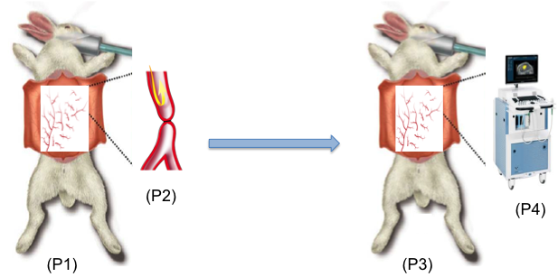
Notes:
Finally, fetoplacental Doppler ultrasound and fetal echocardiography are carried out to obtain measurements of fetal hemodynamics, and cardiac function and structure in IUGR and control fetuses (P4)
P4.1: Bring up a “zoomed in” inset of the rabbit uterus with some little bunny fetuses, along with an inset of the machine.
[Note to illustrator: You do NOT need to draw the ultrasound machine.]

Slide 10
[Authors’ figures 2-4]
Notes:
Ultimately results can be obtained that show the fetal cardiovascular response to increased placental resistance through biometric analysis, fetoplacental Doppler ultrasound and novel fetal echocardiography (P5, Editor, scroll through Figures 2, 3, and 4 here).
[Note to the illustrator: You do not need to draw anything for this step, the authors’ figures will be shown.]

Slide 11
III. Appendix: Reference images and supplemental material

Slide 12

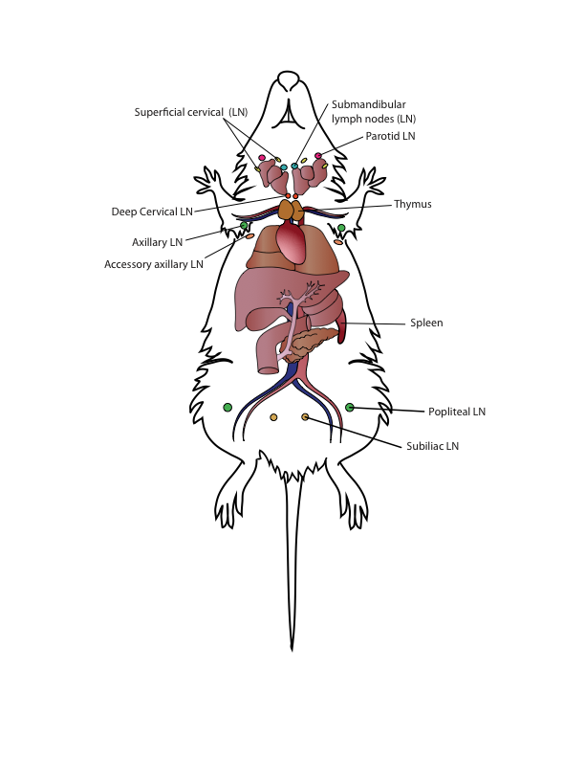
This is a JoVE stock illustration of a mouse which we have being gradually adding to as time goes on; we started with the animal’s body, and then we commission additional organ systems as needed when different articles come up. For instance, we had the urinary tract overlay done for one article, and the lymphatic system for another. We would like to begin building a stock illustration like this for rabbits.
Indeed, many of the organ systems may be similar enough in rabbits and mice that we could use the same overlays, so if the rabbit illustration can be compatible in style with these images it would be very helpful. We can provide the layered file for the mouse illustration if needed.

Slide 13
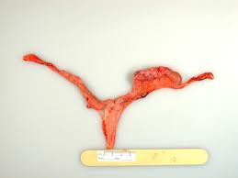
Some additional rabbit uterus images
A rabbit uterus (this one has a mass on the right side, it was hard to find real images of a healthy rabbit uterus)

