Slide 1
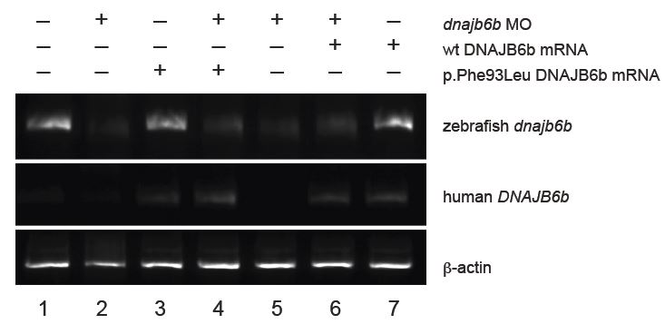
Supplemental Figure 5a
Nat Genet. 2012 Feb 26;44(4):450-5, S1-2. doi: 10.1038/ng.1103.

