Slide 1
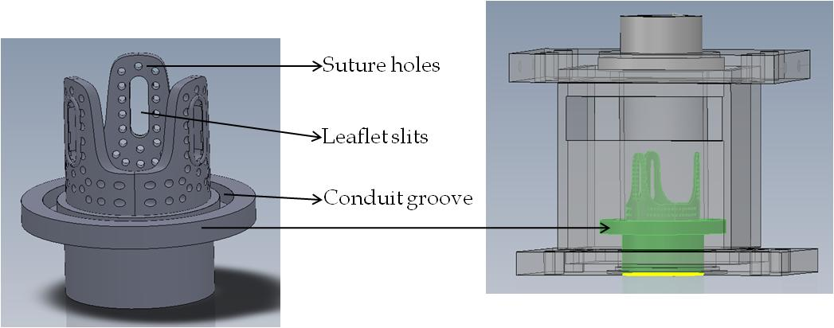
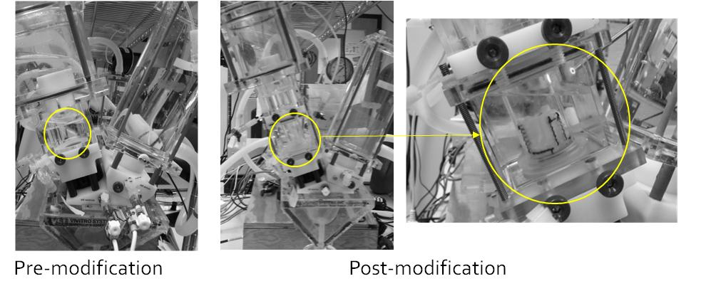
(a)
Figure 1
(b)
(c)

Slide 2
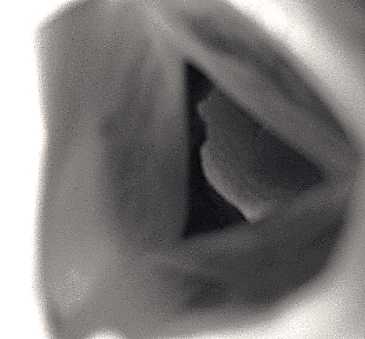
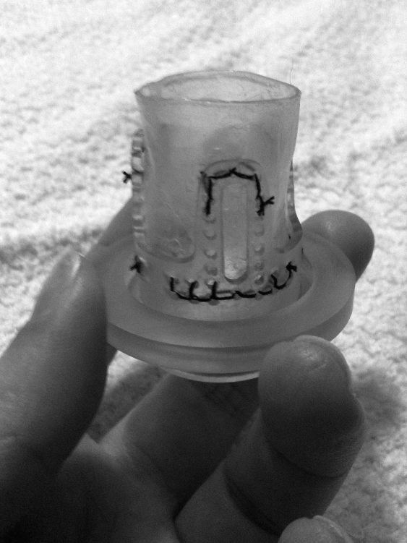
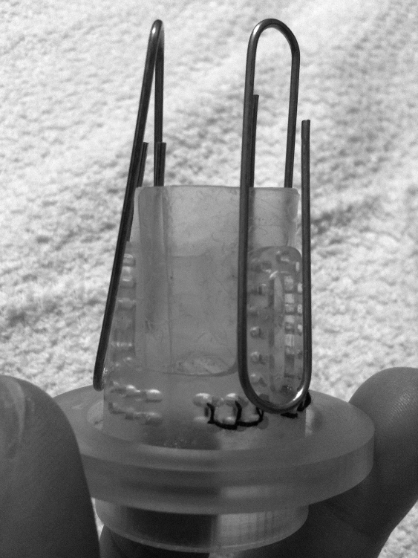
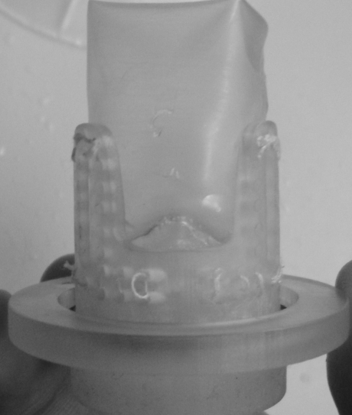
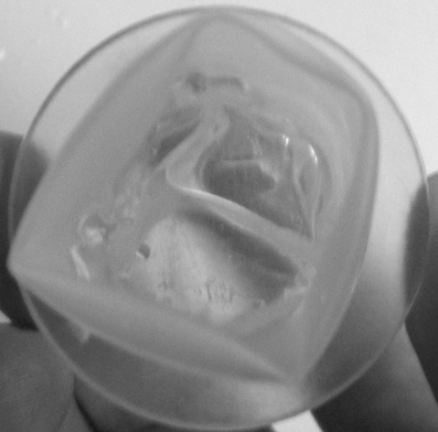
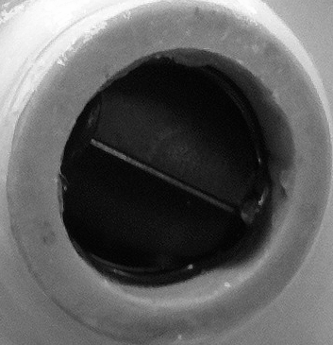
leaflet
clips
Figure 2
(a)
(b)
(c)
sutures
(d)
leaflet
(e)
(f)
leaflet

Slide 3
Figure 3

Slide 4
Figure 4

Slide 5
Figure 5

Slide 6
Table 1
 | Bileaflet (n=2) |  | (Polymer n=5) |  | Porcine (n=4)
Data Description | Mean | SEM | Mean | SEM | Mean | SEM
Aortic Orifice Area [P] (cm2) | 3.143 | 2.697 | 2.920 | 1.306 | 2.516 | 1.258
Aortic Orifice Area [F] (cm2) | 7.940 | 1.286 | 4.613 | 2.063 | 3.975 | 1.988
Aortic Orifice Area [H] (cm2) | 7.516 | 1.633 | 4.575 | 2.046 | 3.942 | 1.971
Forward Flow Pressure Drop [P] (mmHg) | 17.000 | 0.054 | 22.284 | 12.007 | 40.795 | 11.670
Forward Flow Pressure Drop [F] (mmHg) | 0.410 | 0.210 | 30.424 | 9.235 | 29.766 | 9.733
Forward Flow Pressure Drop [H] (mmHg) | 26.520 | 0.120 | 50.790 | 4.230 | 5.610 | 4.970
Trans-Aortic Max Pressure (mmHg) | 15.850 | 12.400 | 60.930 | 20.470 | 75.250 | 17.470
Aortic RMS Forward Flow Rate [P] (ml/s) | 88.280 | 11.110 | 162.120 | 24.970 | 189.080 | 32.610
Aortic RMS Forward Flow Rate [F] (ml/s) | 193.570 | 3.820 | 204.560 | 6.680 | 177.310 | 2.630
Aortic RMS Forward Flow Rate [H] (ml/s) | 197.790 | 0.630 | 174.760 | 11.530 | 182.680 | 3.160
Aortic Forward Volume (ml) | 68.180 | 6.430 | 55.390 | 3.660 | 64.200 | 1.750
Aortic Closing Volume (ml) | 62.260 | 0.860 | 32.990 | 9.820 | 45.260 | 11.990
Aortic Leakage Volume (ml) | 60.140 | 3.470 | 33.090 | 9.220 | 56.130 | 11.260
Total Regurgitant Volume (ml) | 122.400 | 4.320 | 66.080 | 17.200 | 101.390 | 23.160
TransAortic Forward Flow Energy Loss (mJ) | 80.321 | 4.65 | 115.287 | 17.354 | 184.325 | 12.354
TransAortic Closing Energy Loss (mJ) | 25.231 | 0.589 | 29.52 | 6.872 | 12.354 | 4.874
TransAortic Leakage Energy Loss (mJ) | 87.219 | 13.242 | 84.02 | 12.205 | 97.029 | 25.047
TransAortic Total Energy Loss (mJ) | 192.771 | 23.51 | 228.827 | 47.254 | 293.708 | 36.483

