Slide 1
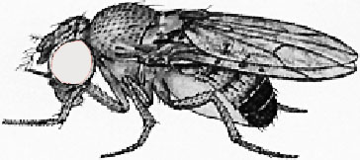

Perform genetic cross to label desired cells or tissues in progeny with GFP
X
Dissect tissues under study at desired developmental stage
Dissociate tissues in solution with DNA dye
Perform flow cytometry to obtain cell cycle profiles

