Slide 1
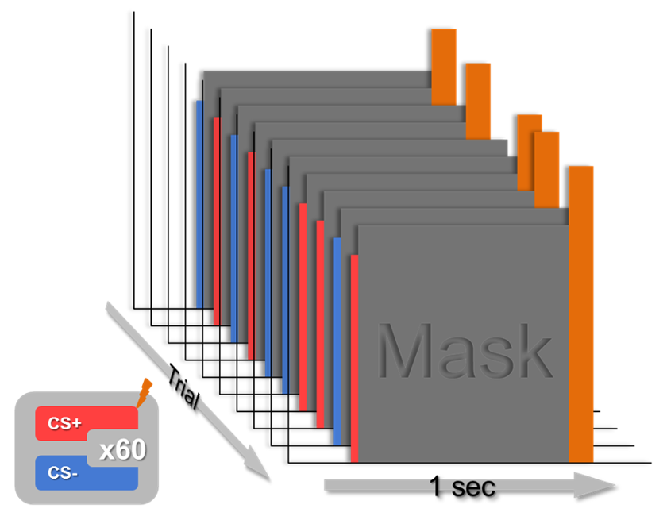
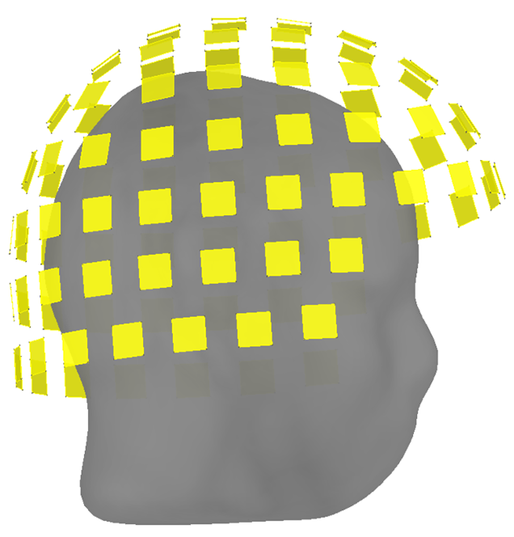
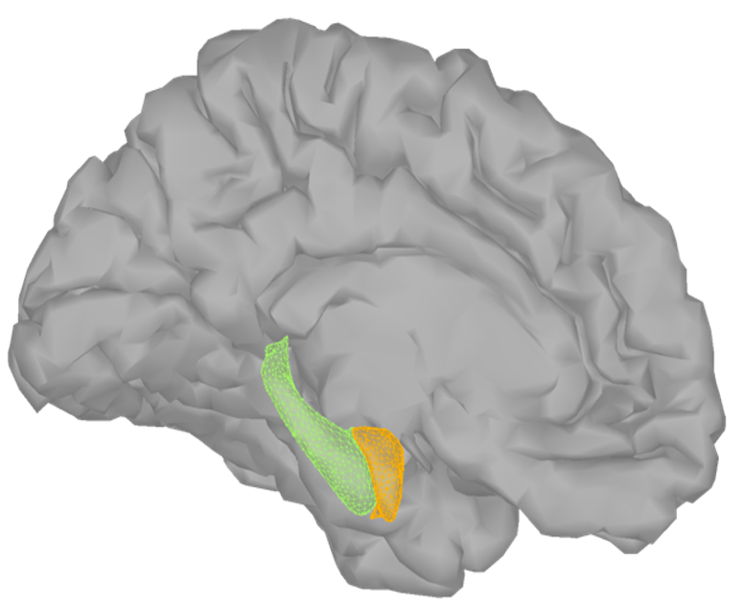
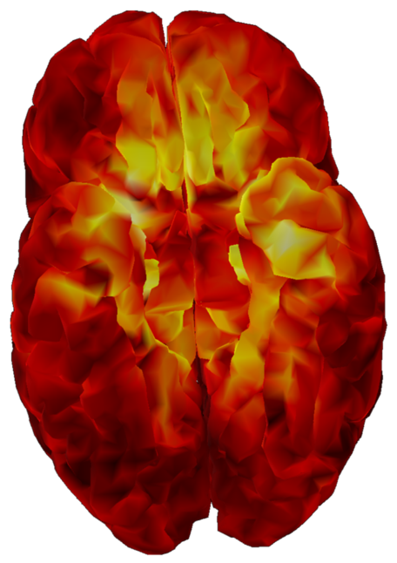
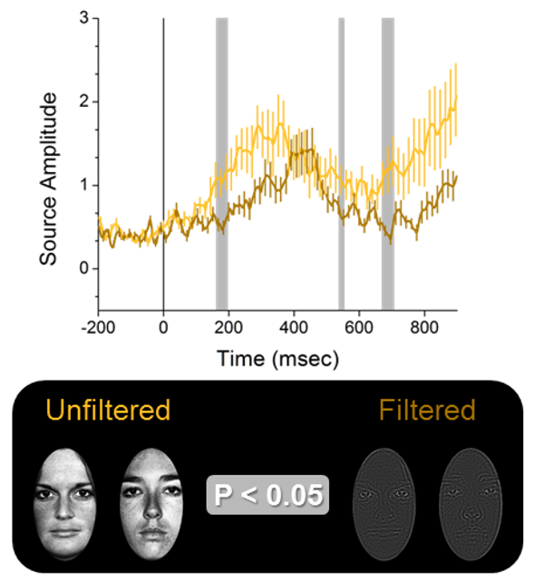
P1
P2
P3
Amygdala
MEG sensors
P5
P4
Amygdala activity
Sources

Slide 2
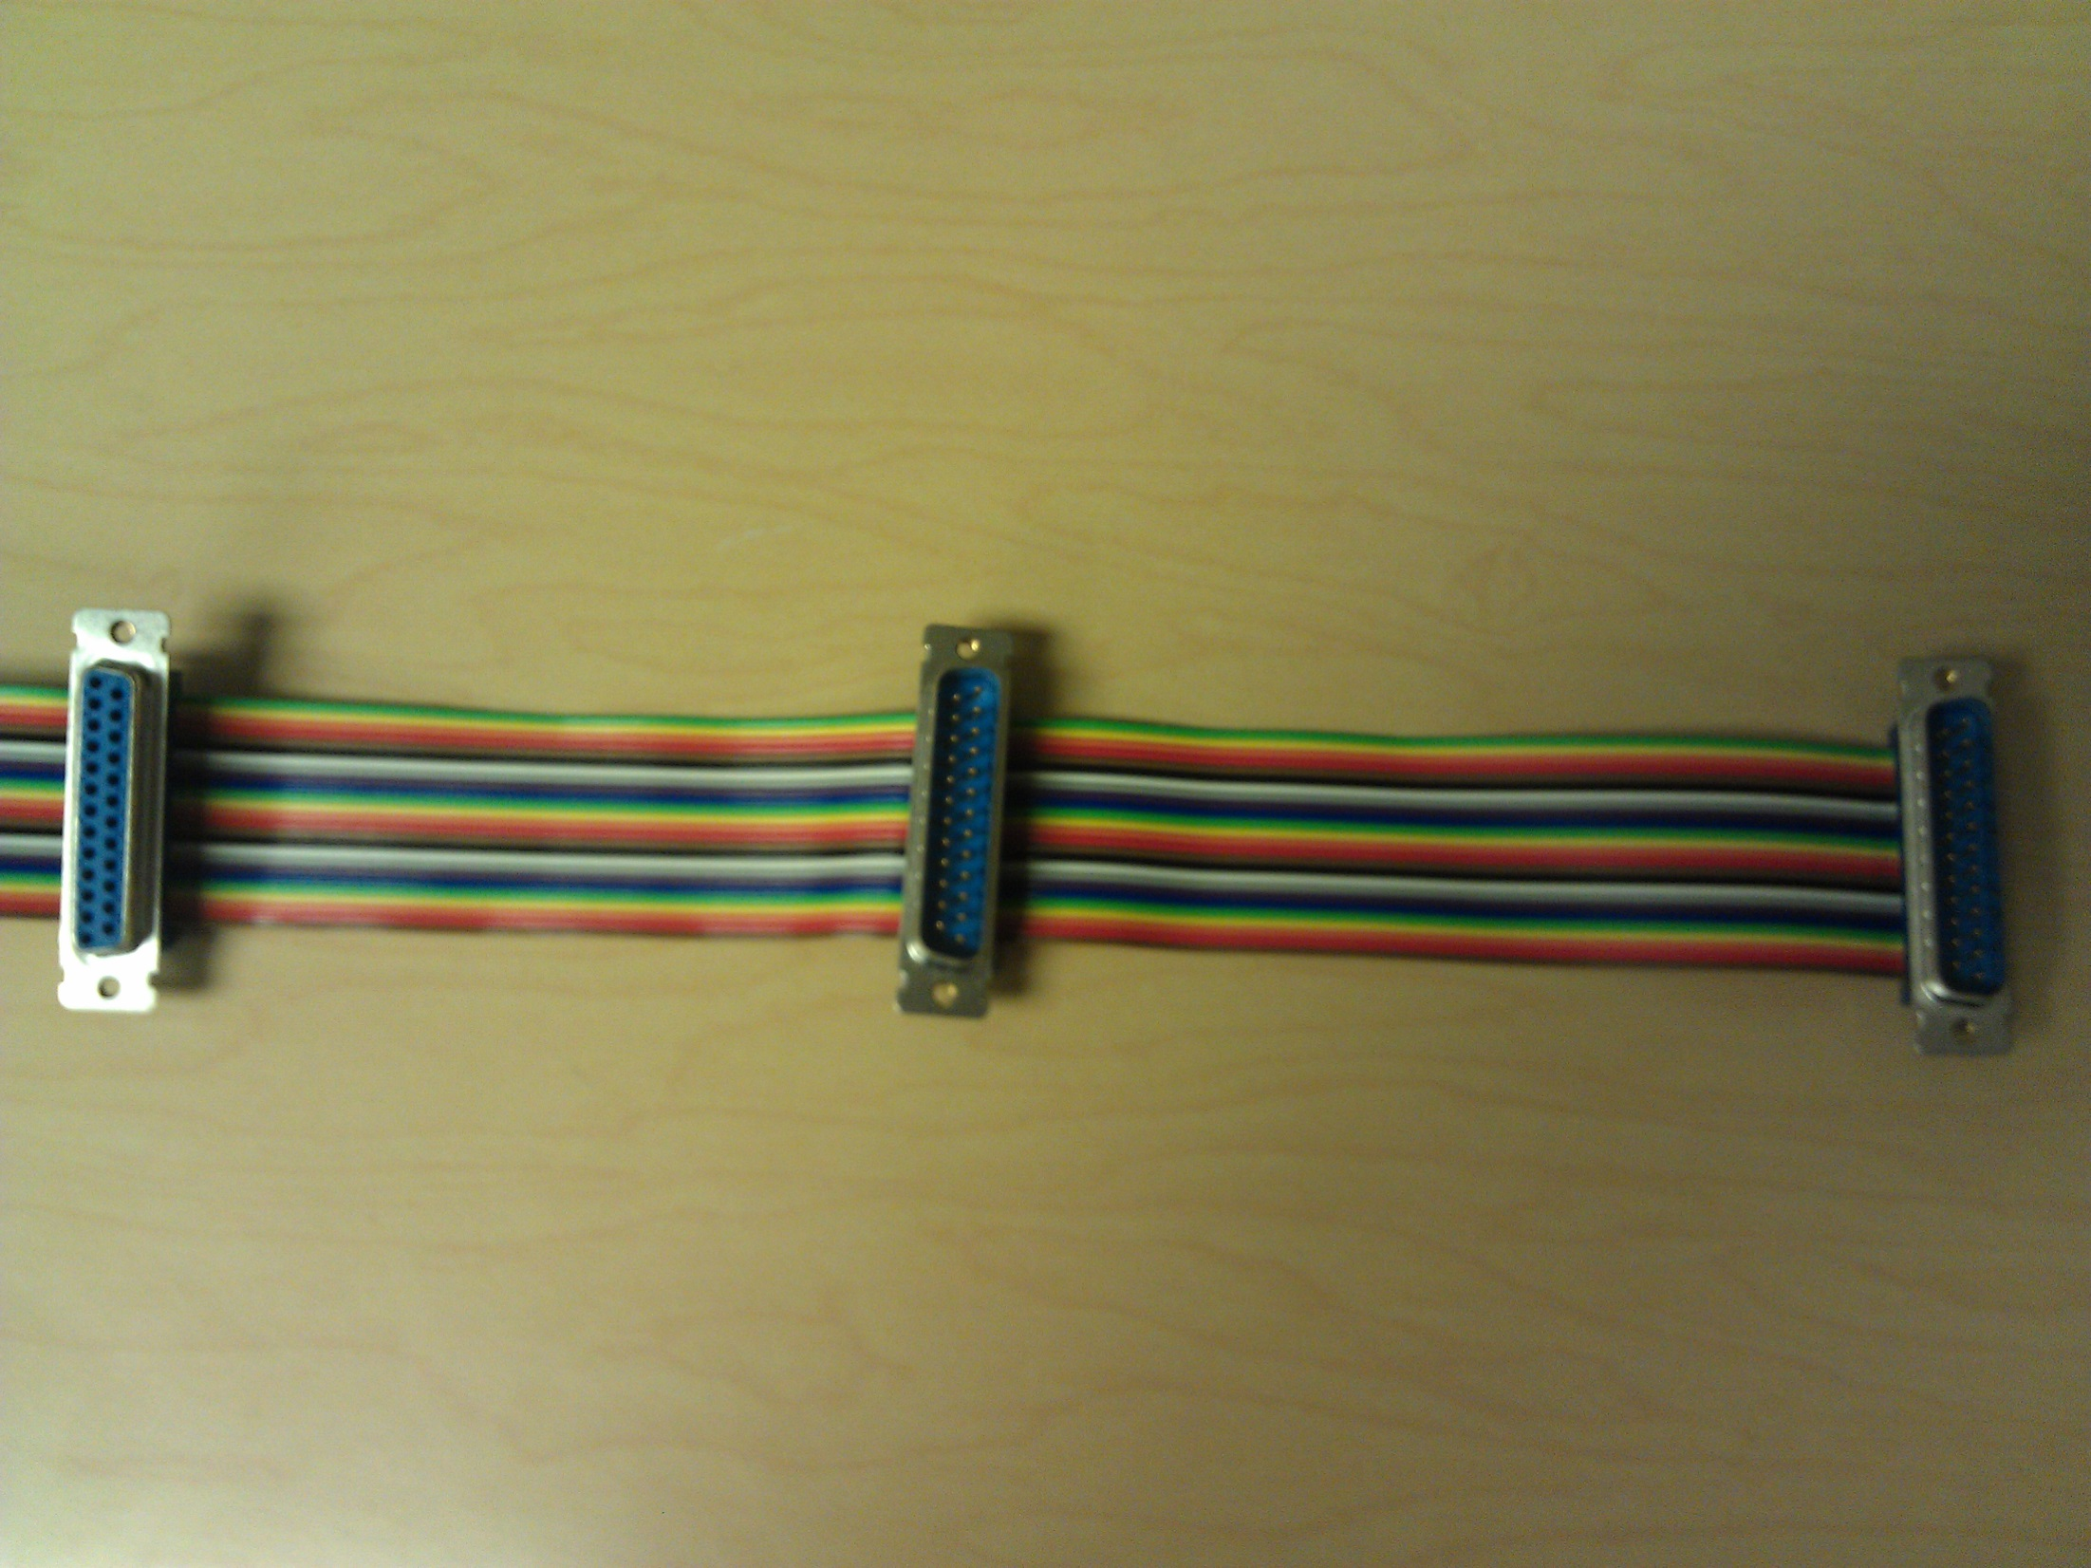
Isolation Adapter
Bits sent to
MEG system
Bits sent to
SAM unit
Bits isolated
from SAM unit
Cut here
Output from presentation computer
Input to MEG system
Input to SAM unit

Slide 3


Trial
CS+
x60
CS-
1 sec
Notes:
Figure 1. Schematic depicting a typical training session. Present 60 trials of a CS+ and 60 trials of a CS-, in psuedorandom order, such that there are 4 blocks of 15 trials each. Present the CSs for 30 msec, immediately followed by an 870 msec mask that coterminates with the shock UCS on CS+ trials.

Slide 4
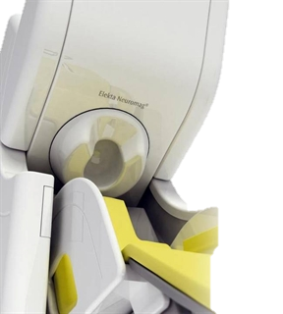
Magnetically Shielded Room
Control Room
Elekta Neuromag System
MEG Acquisition
SAM
Presentation Computer
Dial
Shock
Shock
UCS Expectancy
Event Codes
Notes:
Figure 2. Schematic depicting the equipment used in a typical conditioning experiment. This setup makes it possible to: 1) present visual stimuli via the Presentation software, 2) administer an electrical stimulation UCS via the Psylab hardware (SAM), 3) record UCS expectancy using an axis device (dial) attached to the presentation computer, and 4) synchronize the stimulus presentations and responses with the MEG recordings via the MEG acquisition system interface.

Slide 5
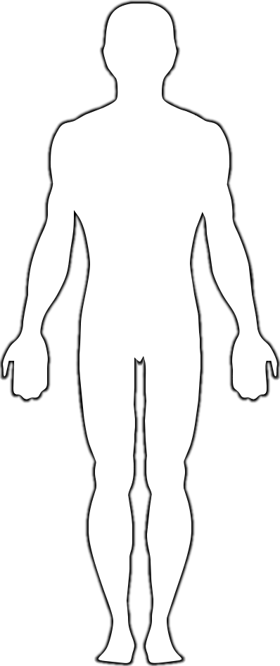
HPI Coils
Eye Blinks
Heart Rate
Amplifier
Front
Back
Fiducial Points
Digitized Scalp Points
Shock
Notes:
Figure 3. Illustration showing the location of each of the sensors and fiducial points described in Section 5. Dots with attached lines correspond to the labeled sensors and leads. Blue arrows represent the fiducial points used to register the MEG recordings with the MRI anatomical volume. Purple points represent digitized scalp points used to further refine the MEG-MRI coregistration.

Slide 6
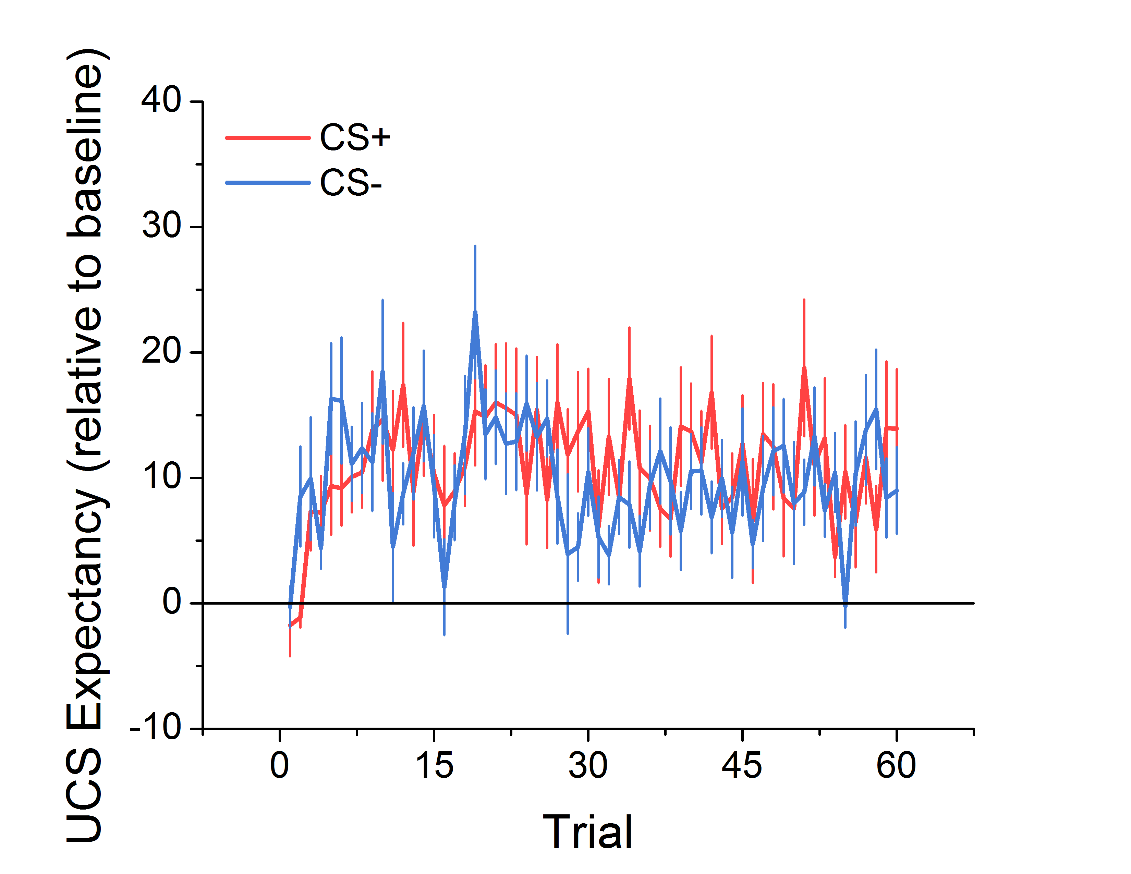
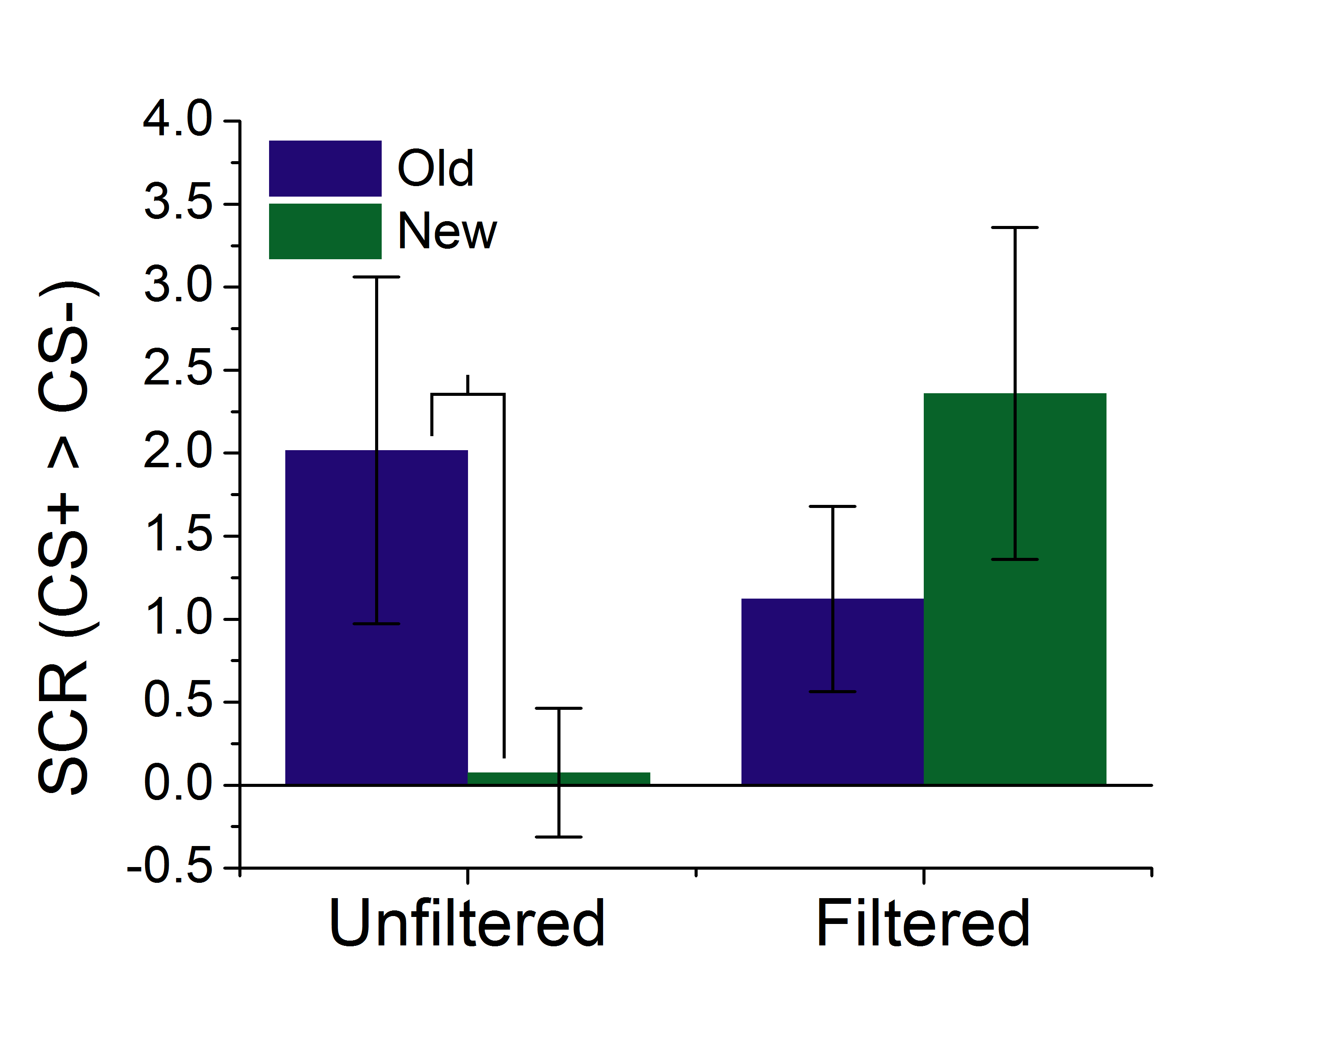
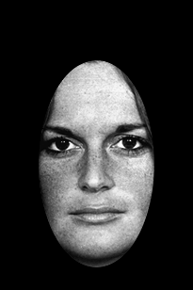
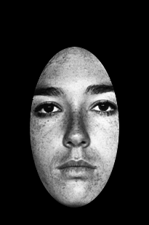
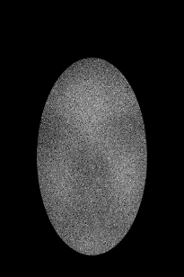
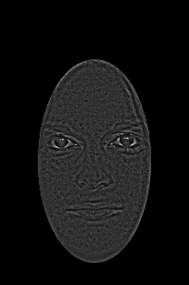
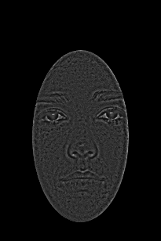
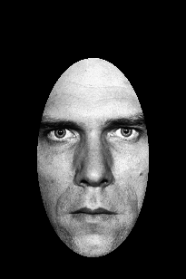
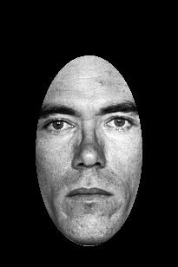
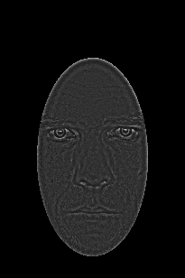
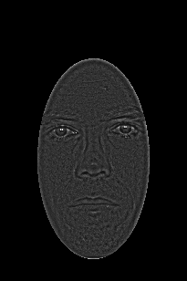
Training
Testing
*
Unfiltered
Mask
Filtered
Unfiltered
Filtered
Old
New
Notes:
Figure 4. Behavioral results from a typical conditioning study. The graph on the left shows UCS expectancy across the training session, collapsed across the Unfiltered and Filtered groups. Notice that subjects are showing similar levels of UCS expectancy for the CS+ and CS- across the 60 trials, suggesting that the masking procedure blocked their ability to discriminate between the CSs. The graph on the right shows the differential SCRs during the testing session. Notice that the Unfiltered, but not the Filtered group seems to be showing larger differential SCRs to the Old stimuli than the New stimuli, suggesting that the training leads to better reacquisition of the CS-UCS associations for these subjects. (*p < 0.05)

Slide 7
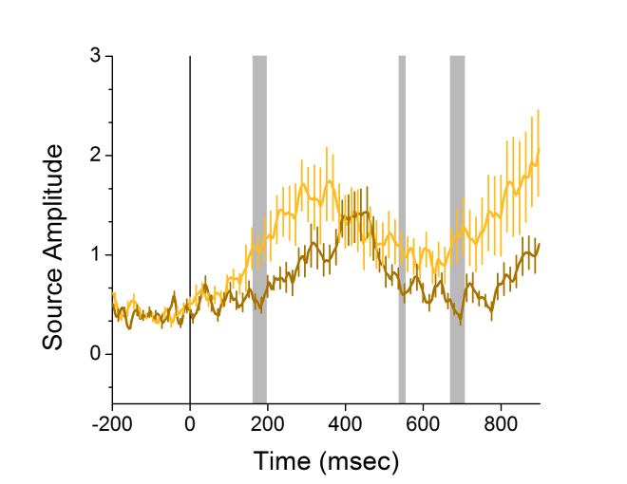
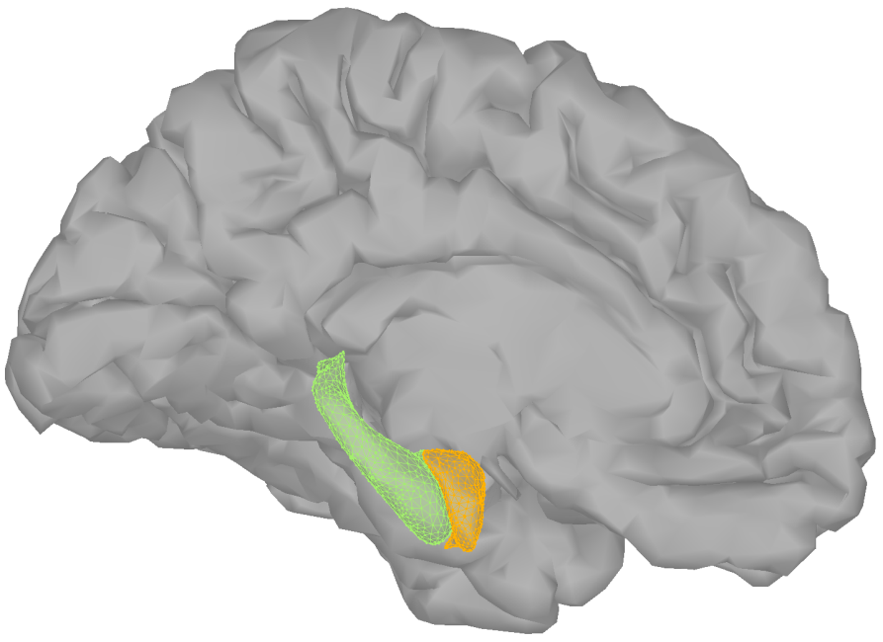
Unfiltered
Filtered
P < 0.05
Notes:
Figure 5. MEG results from a typical conditioning experiment. The figure on the left shows the 3d models of the amygdala (orange), hippocampus (hippocampus), and cerebral cortex used to model the sources of the MEG signal. The graph on the right represents activity from an amygdala cluster modeled from the MEG recordings. The light colored line represents the activity evoked by Unfiltered faces, while the dark colored line represents the activity evoked by Filtered faces. Vertical gray shaded sections represent time intervals where Unfiltered faces evoke significantly larger responses than Filtered faces.

Slide 8
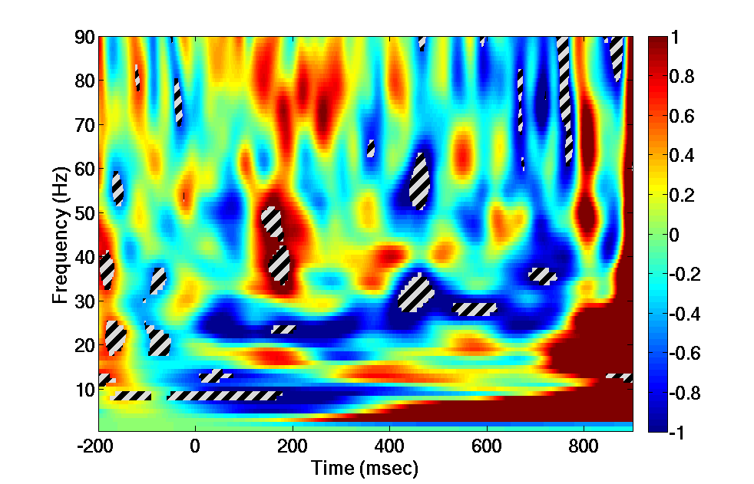
Unfiltered
Filtered
P < 0.05
Notes:
Figure 6. Amygdala time frequency results from a typical conditioning experiment. The figure on the left shows the 3d models of the amygdala (orange), hippocampus (green), and cerebral cortex used to model the sources of the MEG signal. The graph on the right represents the MEG signal recorded from the amygdala broken down by time and frequency. Warm colors represent regions in the spectrograph that show significantly more power for unfiltered faces than for filtered faces. Cool colors represent the opposite. Regions with the striped overlay represent significant differences across the groups.

Slide 9
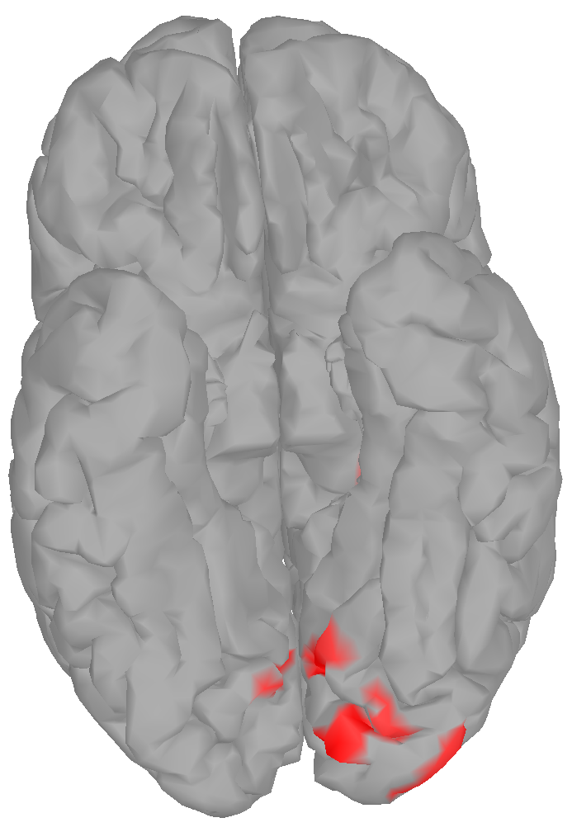
z > 2
Unfiltered > Filtered
Filtered > Unfiltered
130 ms
z > 2
Notes:
Figure 7. Figure showing occipital face area activation in a typical conditioning experiment. Colors represent the magnitude of the Unfiltered > Filtered t-test at the corresponding dipole. Warm colors represent larger responses to Unfiltered faces than to Filtered faces. Cool colors represent larger responses to Filtered faces than to Unfiltered faces.

Slide 10
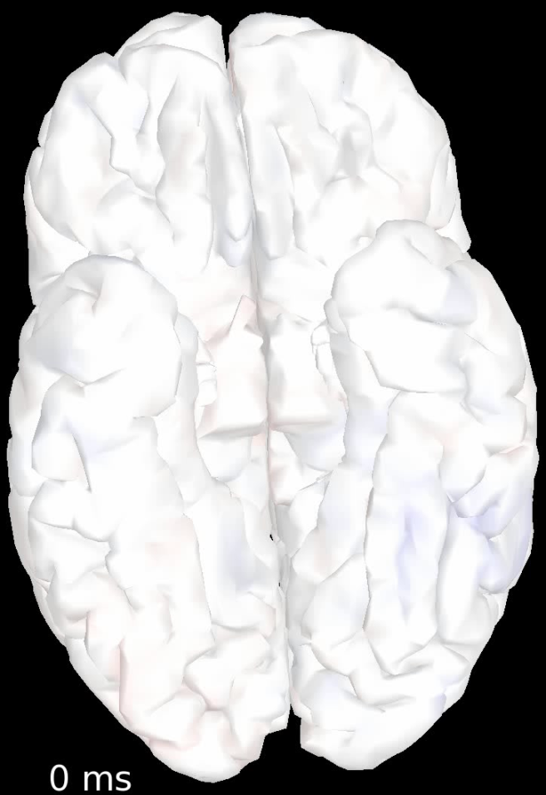
z > 2
Unfiltered > Filtered
Filtered > Unfiltered
z > 2
Notes:
Supplemental Video. Video showing cortical responses in a typical conditioning experiment. Colors represent the magnitude of the Unfiltered > Filtered t-test at the corresponding dipole. Warm colors represent larger responses to Unfiltered faces than to Filtered faces. Cool colors represent larger responses to Filtered faces than to Unfiltered faces.

