Slide 1
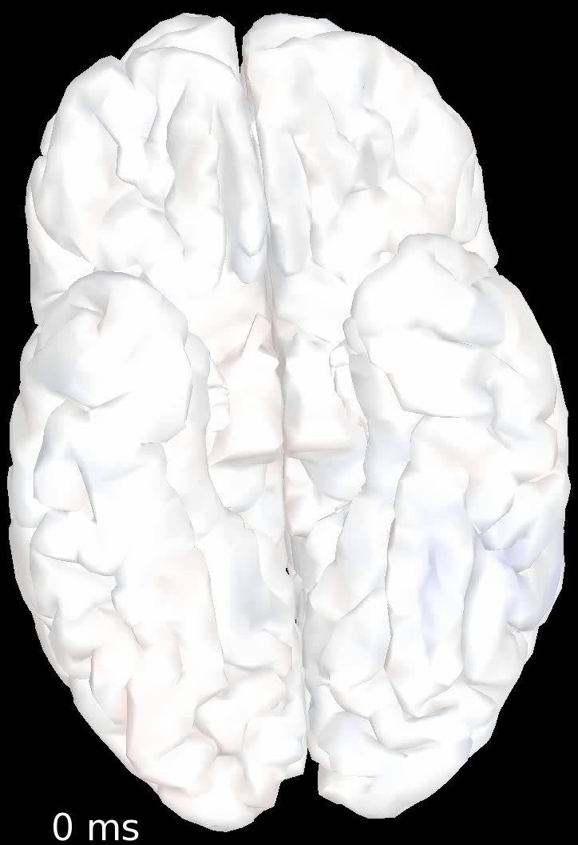
z > 2
Unfiltered > Filtered
Filtered > Unfiltered
z > 2

