Slide 1
Schematic overview
Procedural overview
50146_Korth

Slide 2
Intro
The overall goal of this procedure is to select successfully in utero electroporated rat pups for further analysis as adults, like behavioral testing or neuropathological investigations

Slide 3
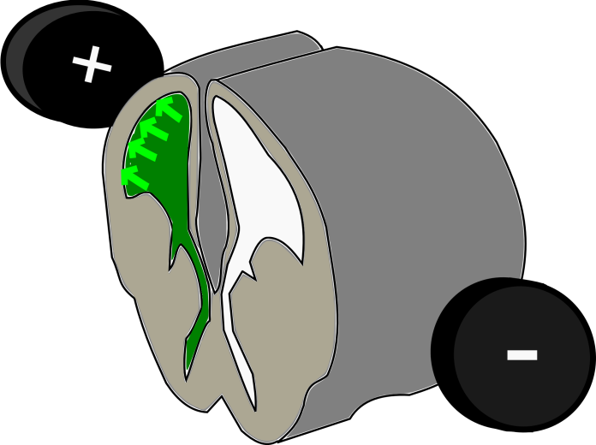
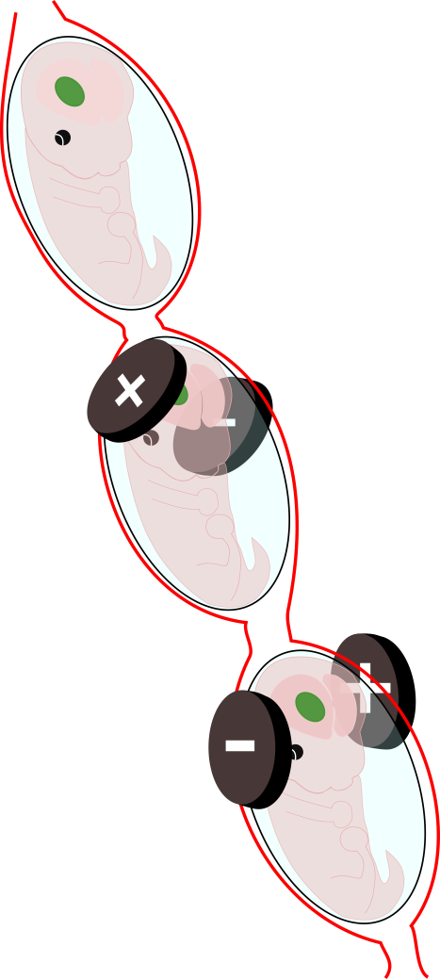
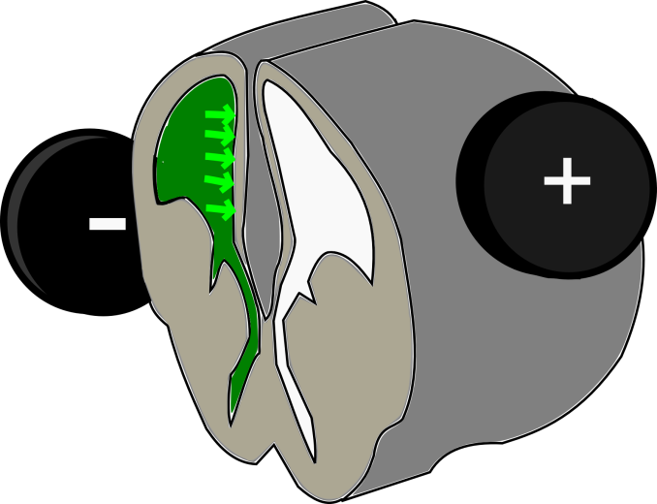
P1
This is accomplished by first performing an in utero electroporation at a defined developmental stage and with precise electrode positioning selected for the target area within the brain.
Cortical
electroporation
Hippocampal
electroporation

Slide 4
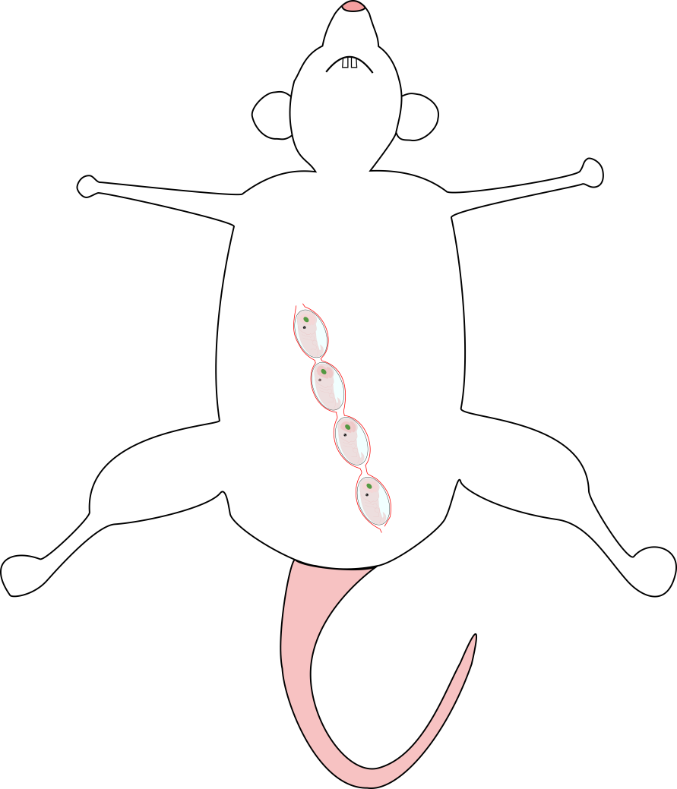
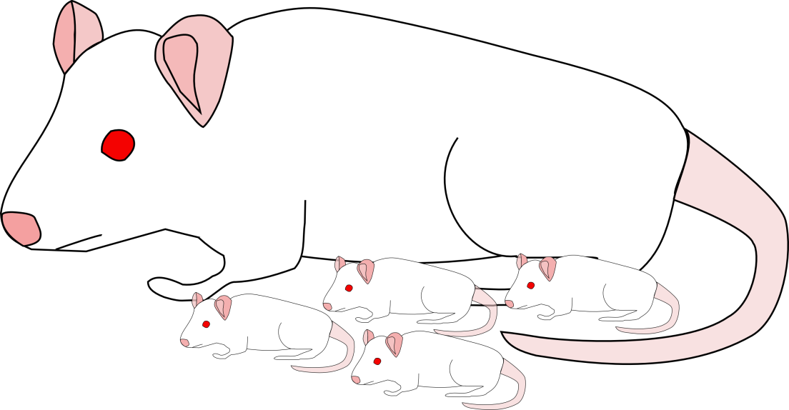
P2
The electroporated embryos develop further within the mother’s uterus and are born just like normal pups

Slide 5
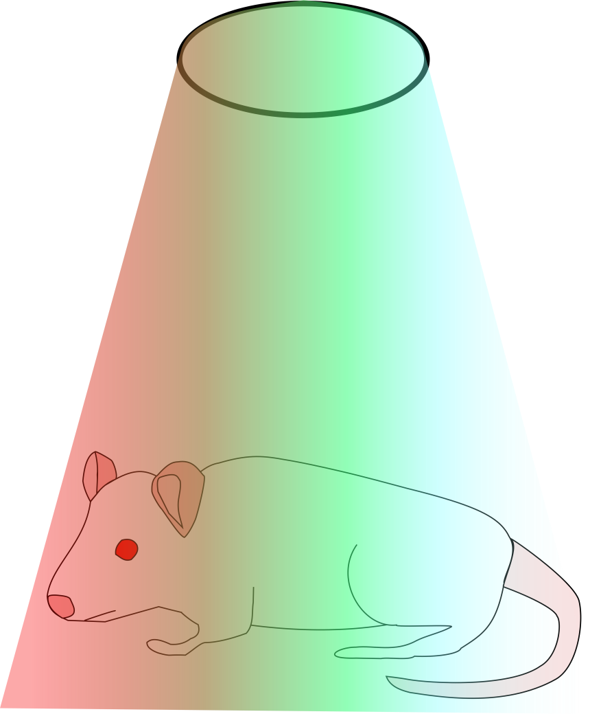
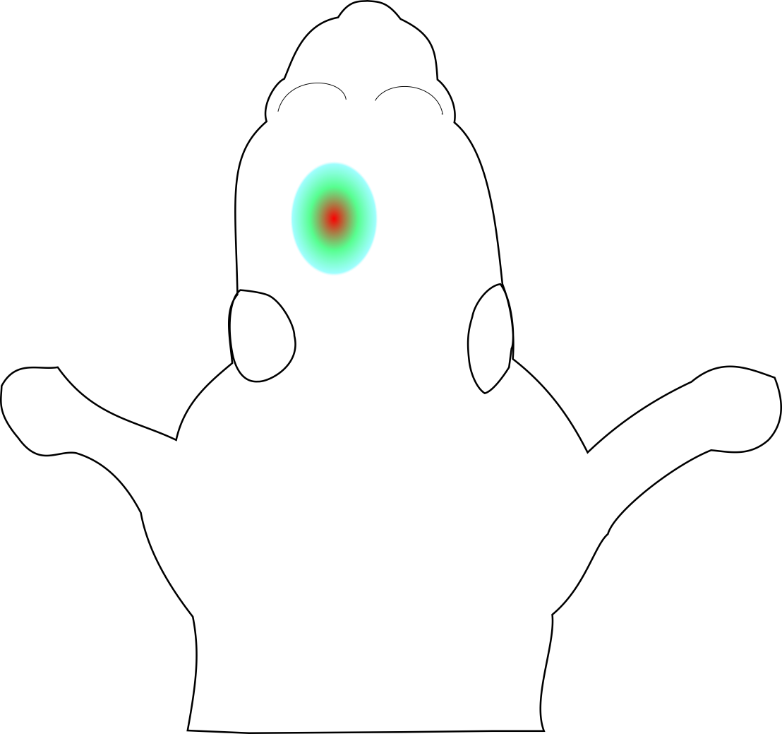
P3
In the second step the in utero electroporation success is controlled via 2D measurements of luciferase bioluminescence signal with the IVIS live imaging system at defined postnatal time points.

Slide 6
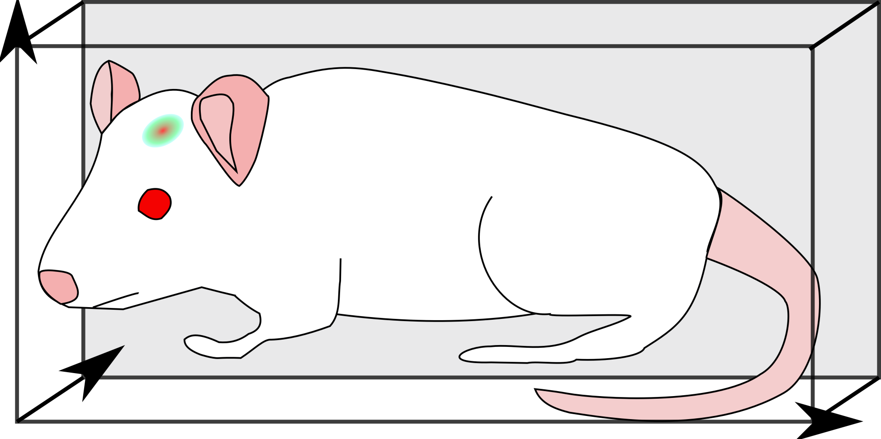
P4
The final step is the localization and quantitation of the targeted area of the in utero electroporation via 3D imaging.

Slide 7
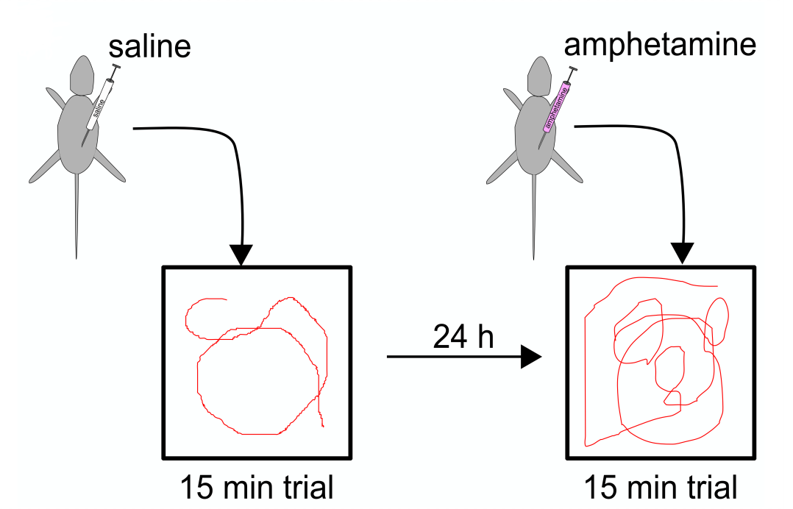
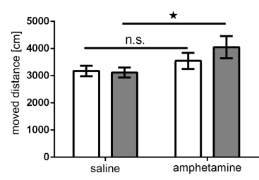
P5
Ultimately, further analysis of the then adult, topically transgenic rats, for example by behavioral testing, can be performed to show the consequences of disturbed neurodevelopment on adult behavior,, in vivo electrophysiology or neuropathology.

