Slide 1
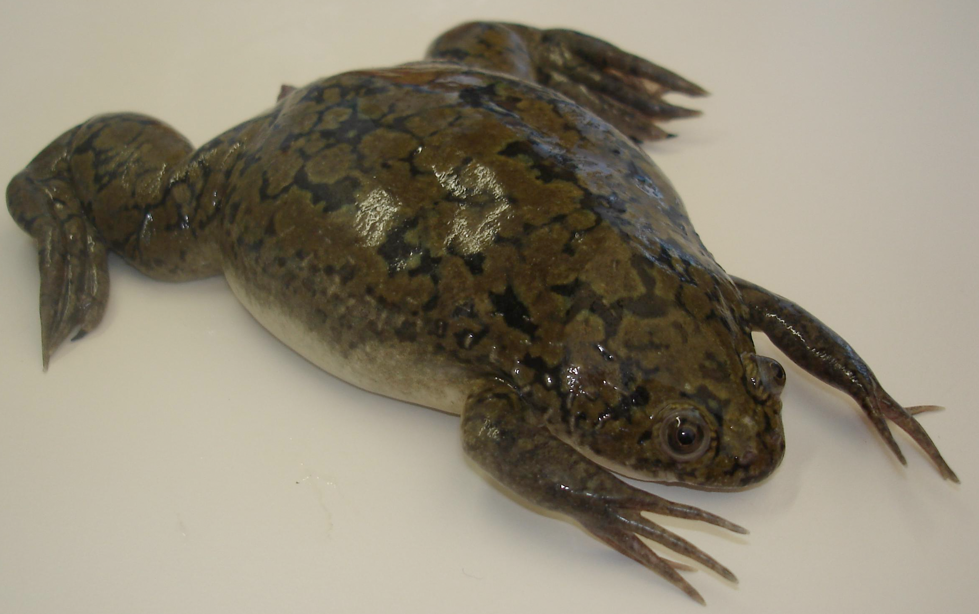
Schematic overview
Lipid
LSE
Yolk/pigment
LSE
+
A70
T70
AT70
Immunoblotting

