Slide 1
LabVIEW-operated novel nanoliter osmometer for ice binding protein investigations Ido Braslavsky^{1,2}, Ran Drori¹
¹Institute of Biochemistry, Food Science, and Nutrition ,
The Robert H. Smith Faculty of Agriculture, Food, and Environment, The Hebrew University of Jerusalem, Rehovot, Israel,
²Department of Physics and Astronomy
Ohio University, Athens, Ohio, USA,

Slide 2
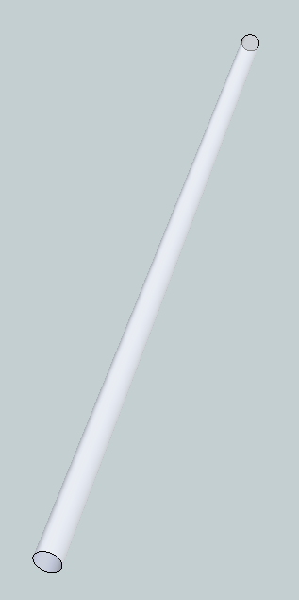
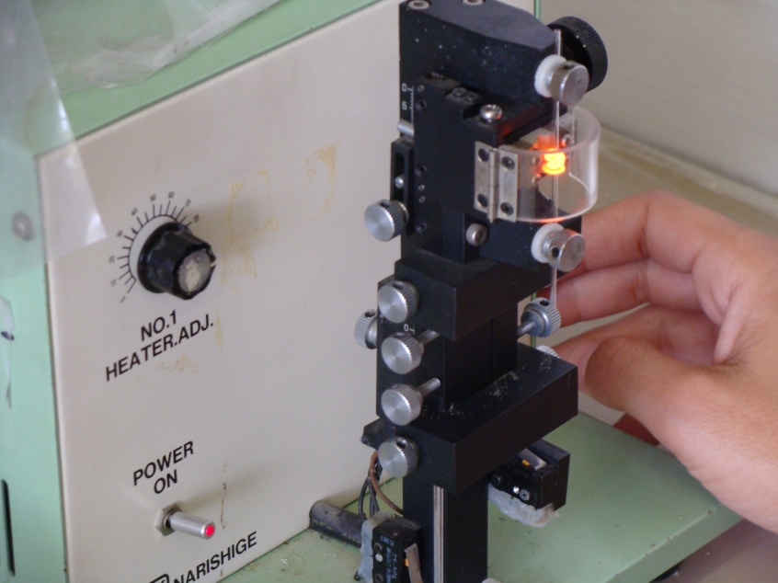
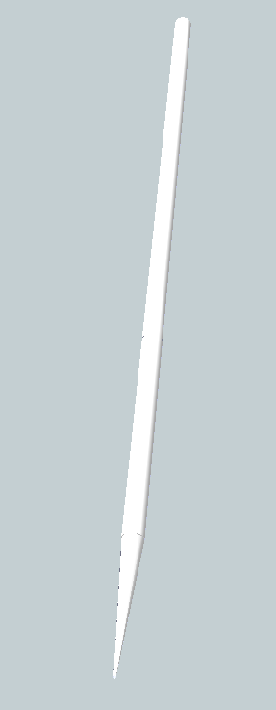
Capillary pulling

Slide 3
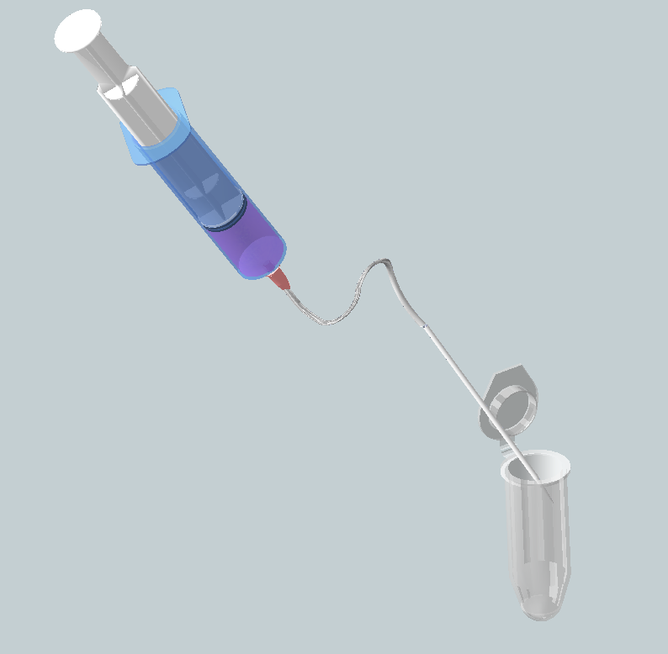
P1: Sample loading

Slide 4
P1: Sample loading

Slide 5
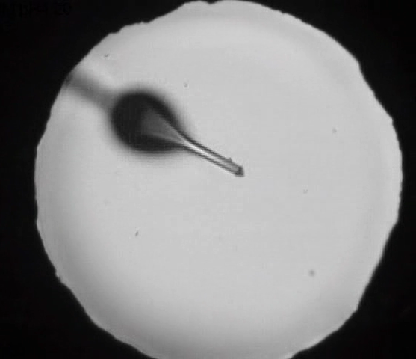
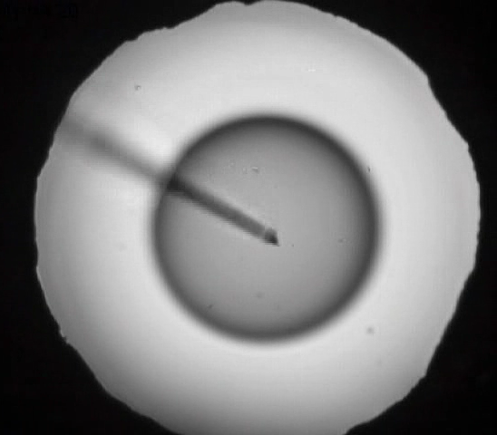
P1: Sample loading

Slide 6
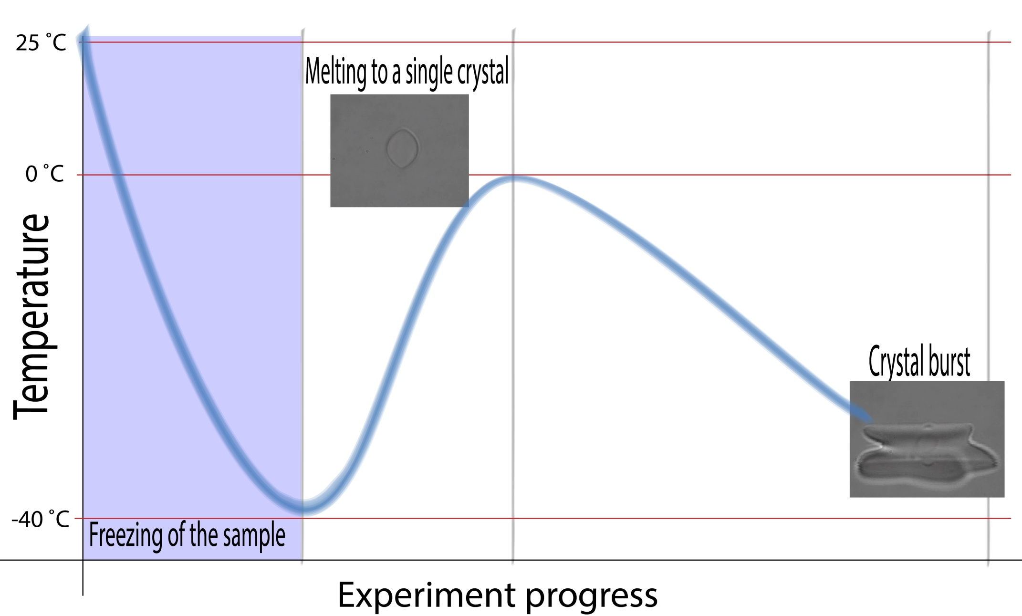
P2: Freezing the droplet

Slide 7
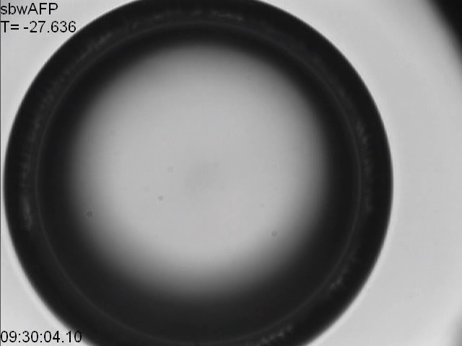
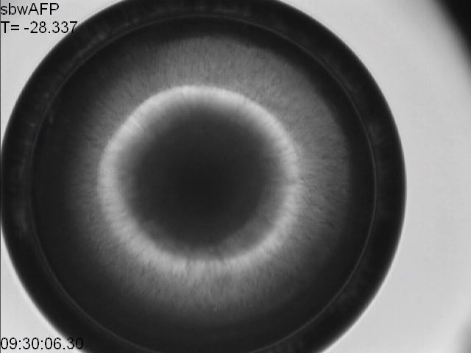
P2: Freezing the droplet
Sudden change in color
indicate freezing

Slide 8
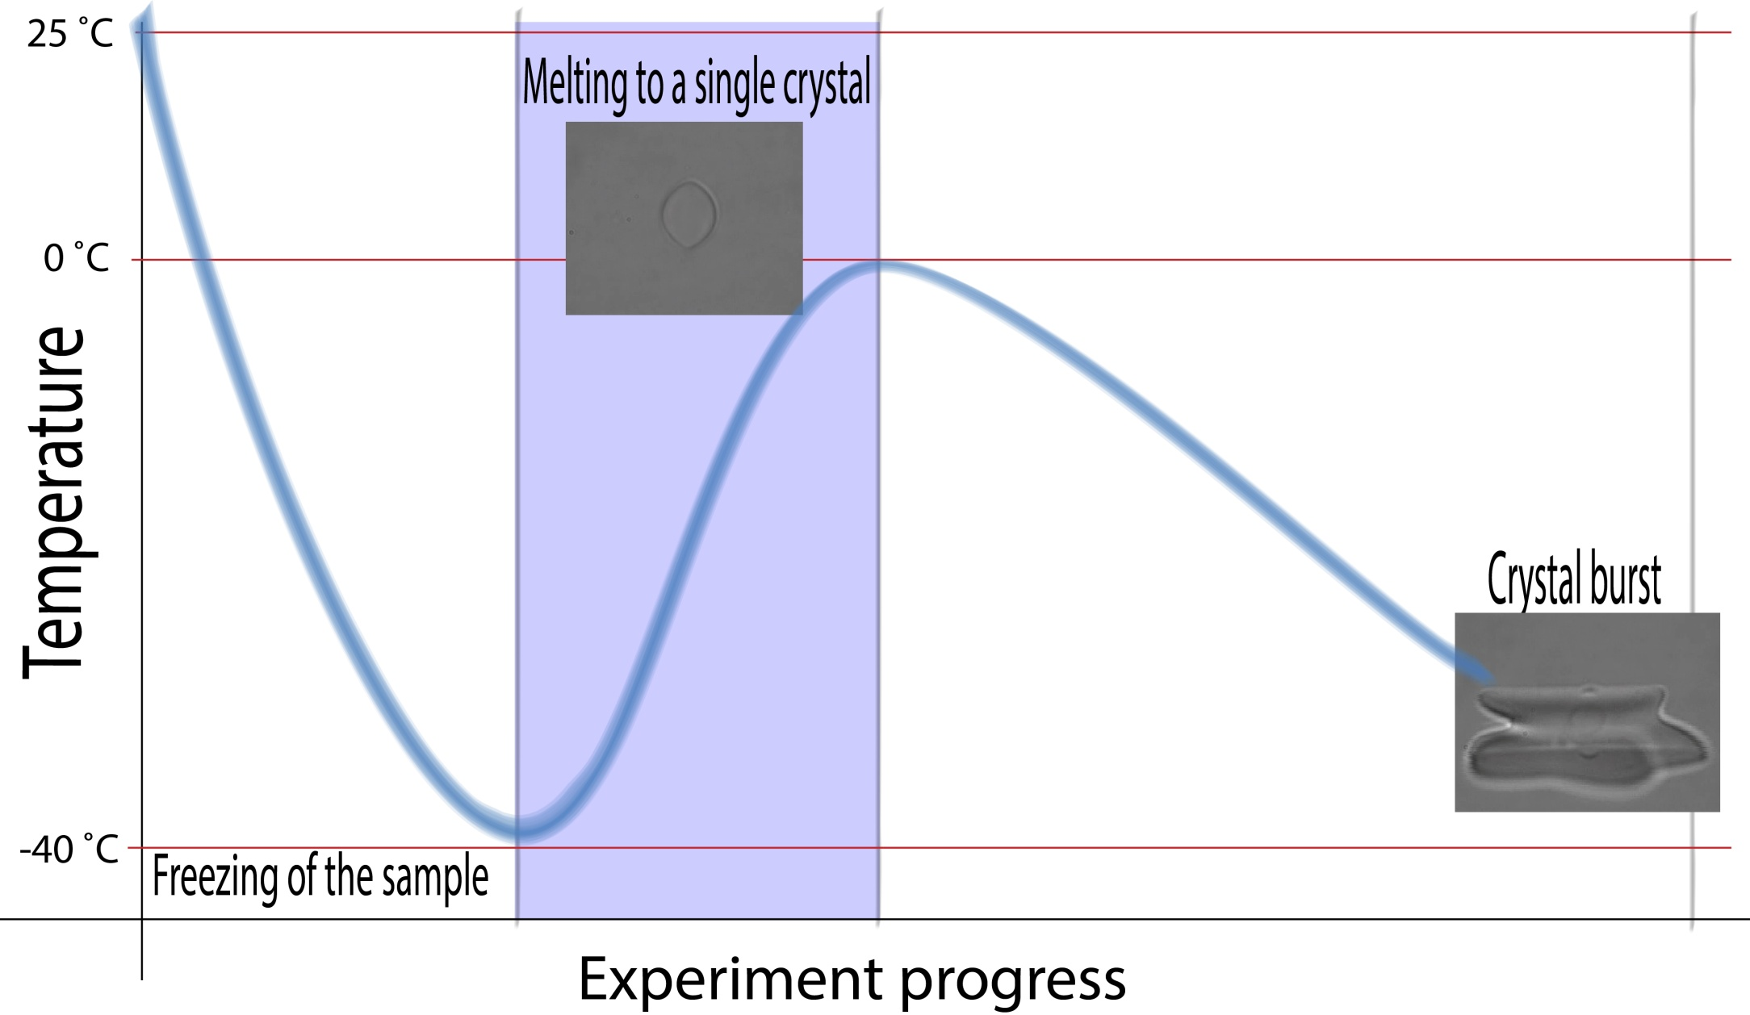
P3: creating a single crystal

Slide 9
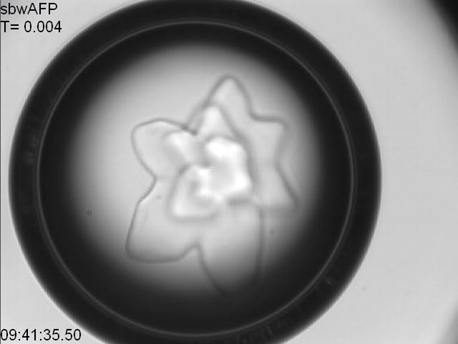
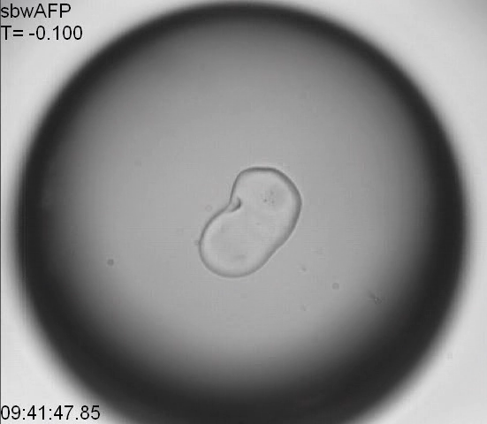
P3: Creating a single crystal
The drop is warmed to melt most of the ice

Slide 10
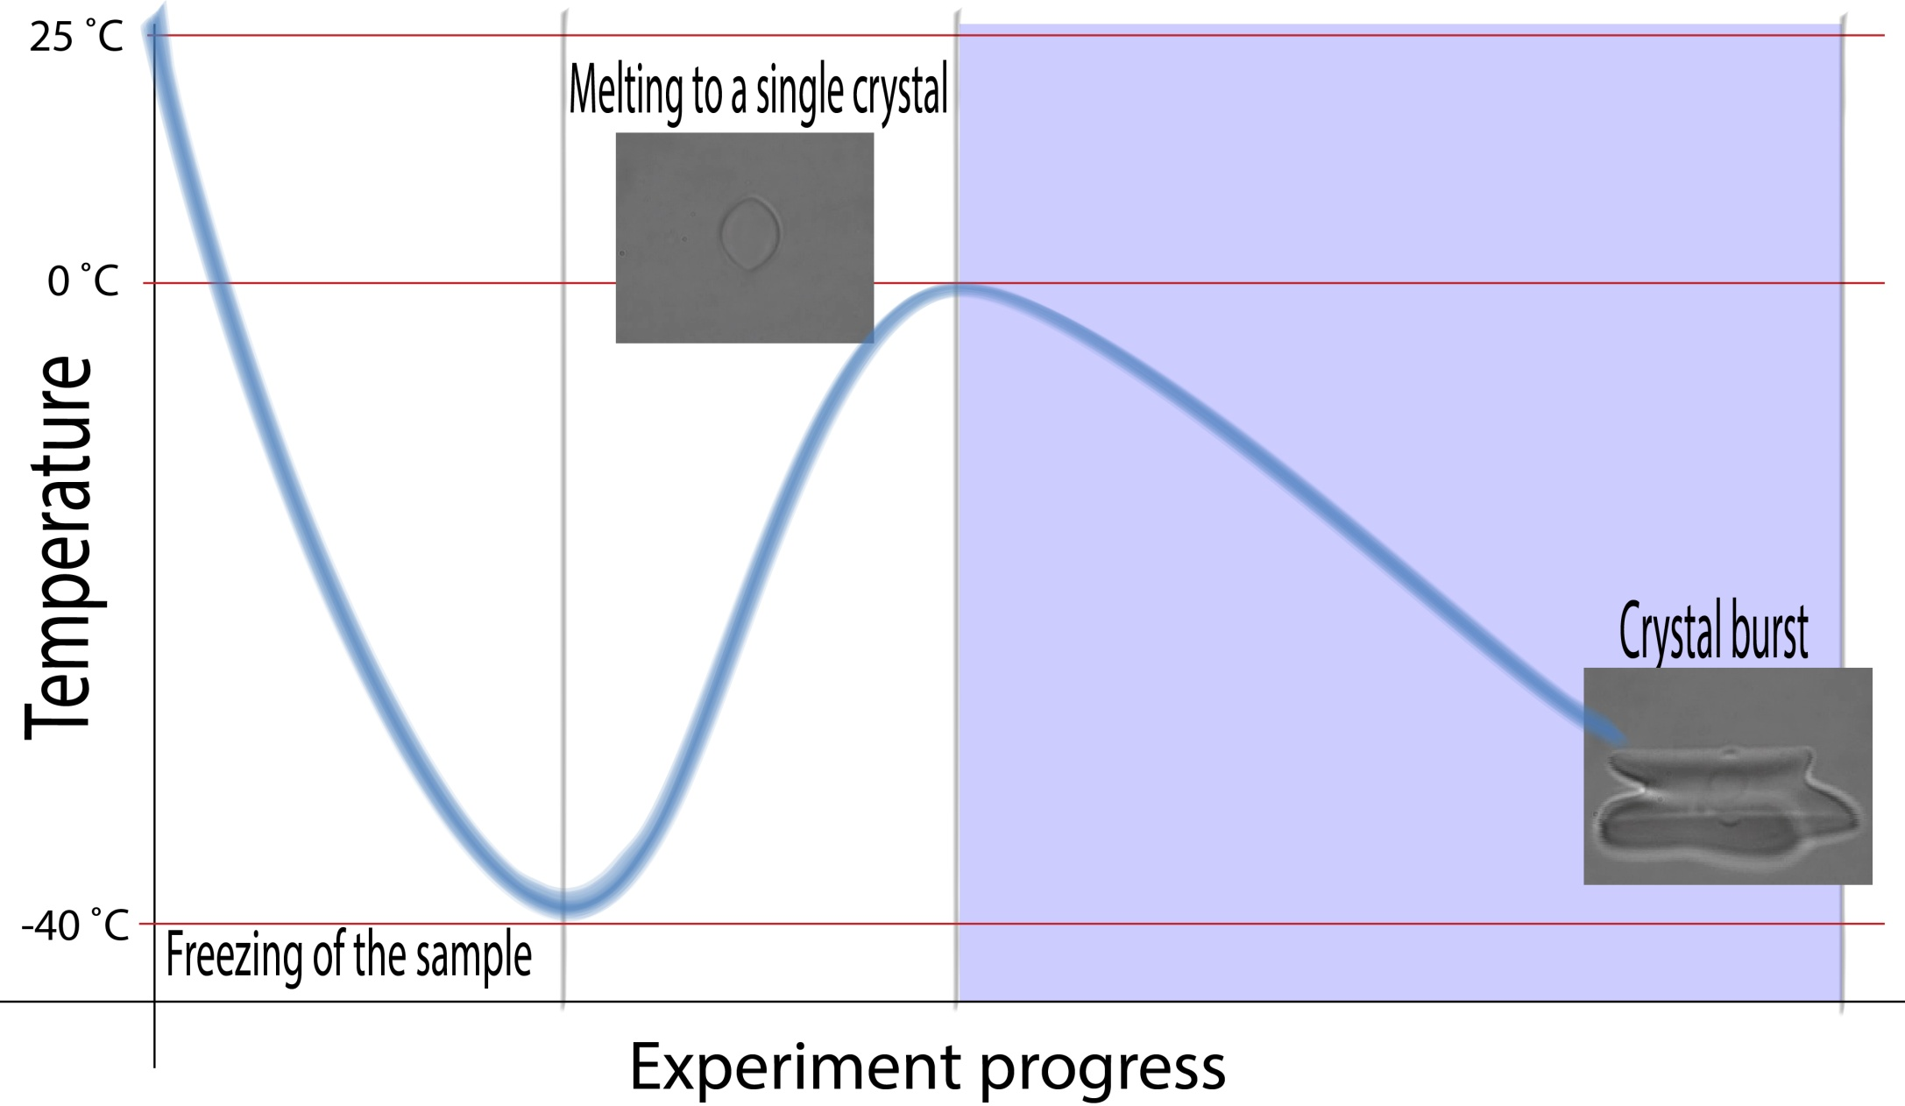
P4: Cooling the crystal till burst

Slide 11
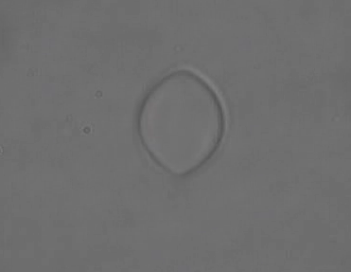
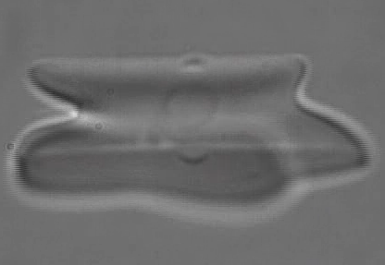
P4: Cooling the crystal till burst
Tm
Tb
Sudden burst indicates the non-equilibrium freezing point
Tm-Tb=TH

Slide 12
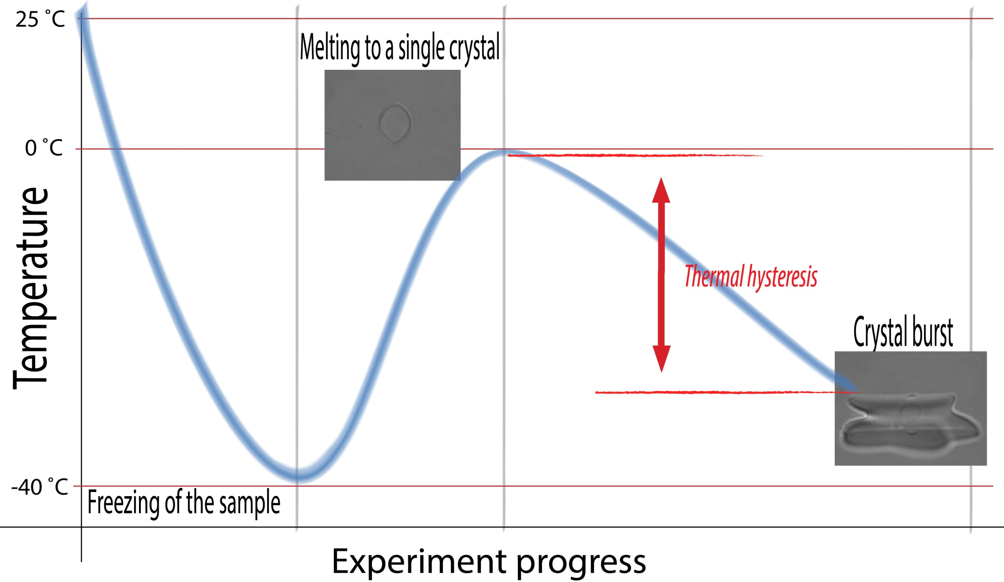
TH measurement

