Slide 1
Figures for manuscript JoVE 4189

Slide 2
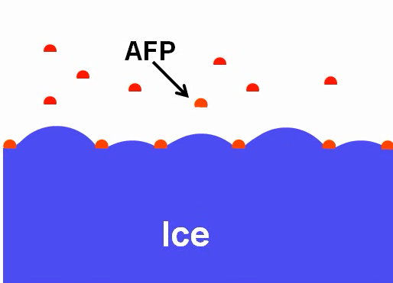
Fig 1

Slide 3
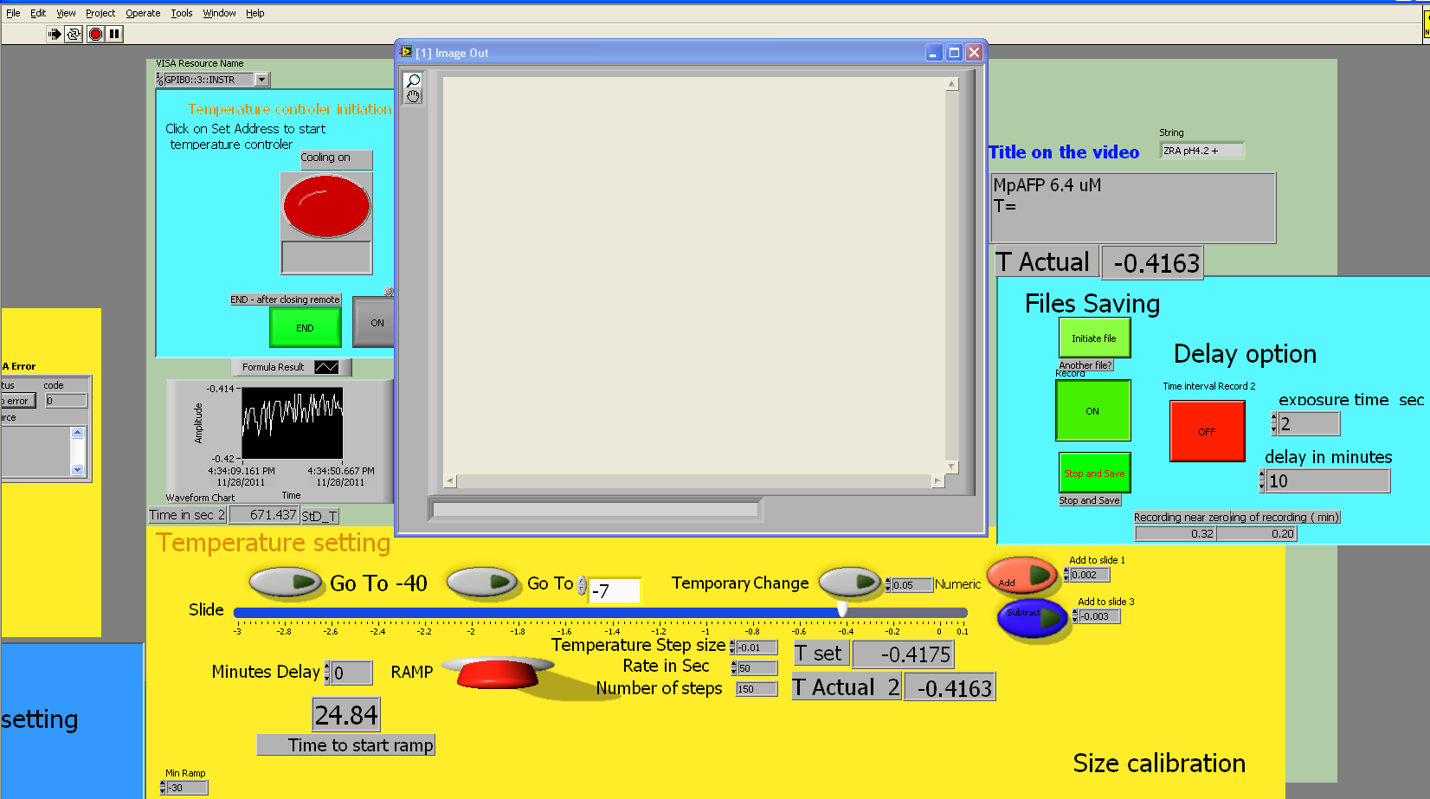
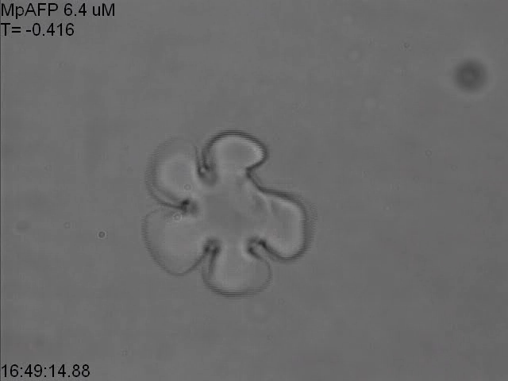
Fig 2

Slide 4
Fig 3

Slide 5
Temperature stability
Fig 4

Slide 6
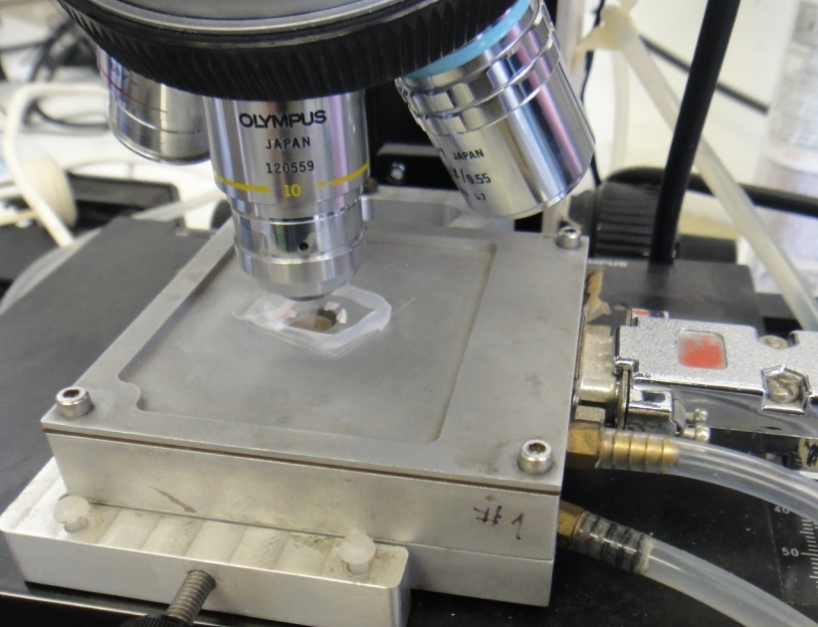
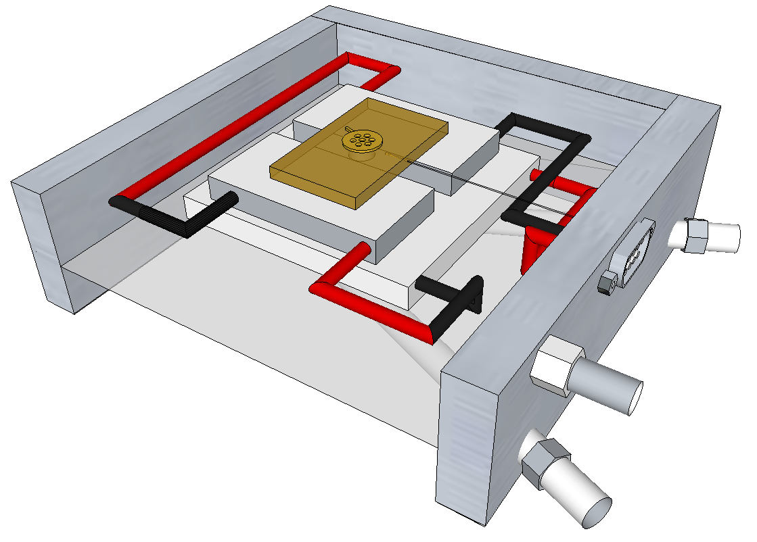
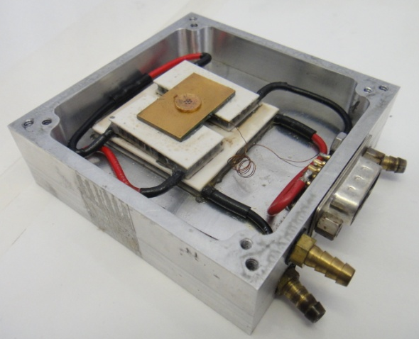
Fig 5
A
C
Thermistor
Copper disc
Water outlet
B
Thermoelectric
coolers
Copper plate
Water Inlet
Dry air Inlet

