Slide 1
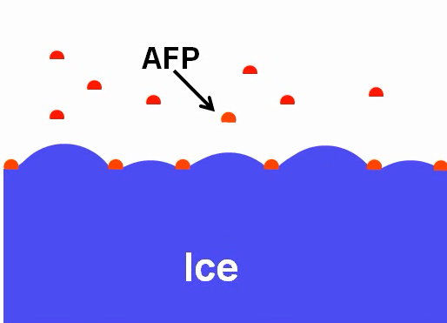
Fig 1. Mode of action of ice binding proteins. Adopted from (Celik, Graham et al. 2010)

Slide 2
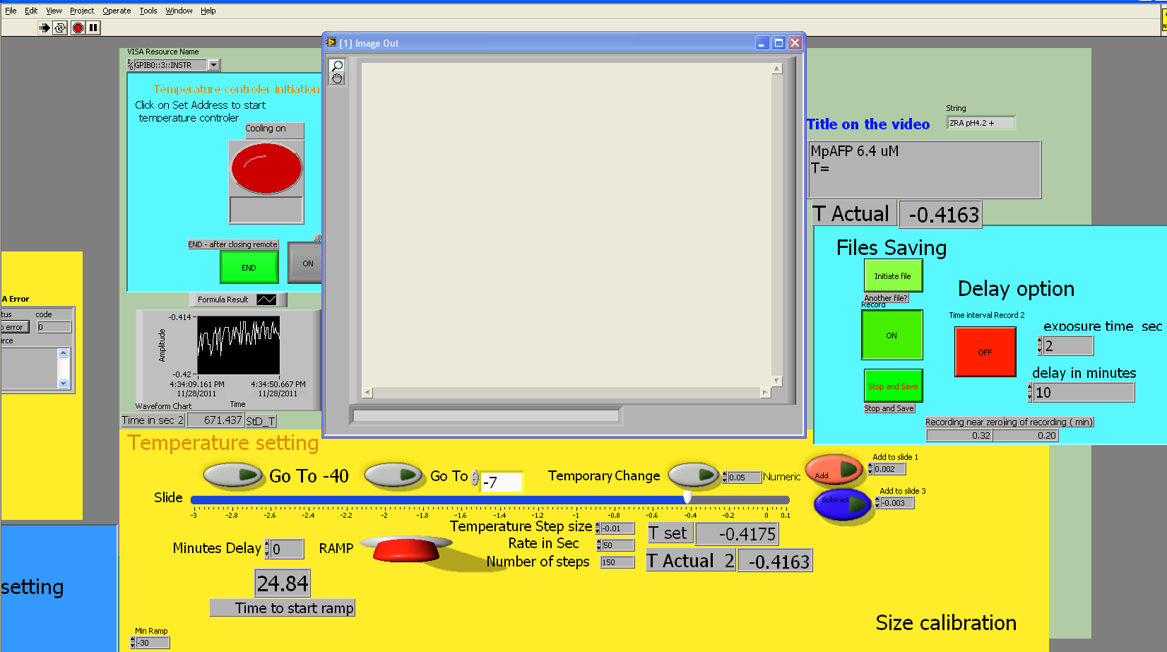
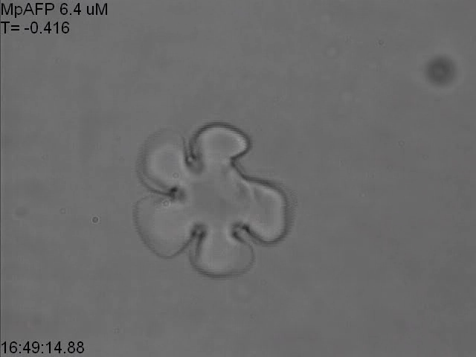
Fig 2. The Labview interface

Slide 3
Fig 3. Thermal hysteresis of MpIBP over time

