Slide 1
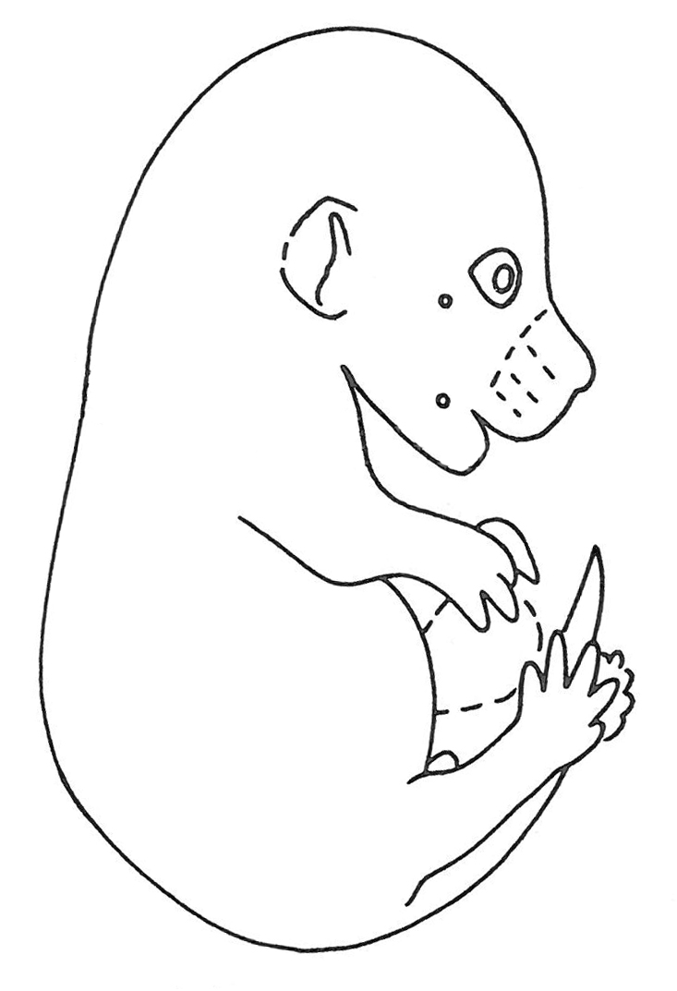
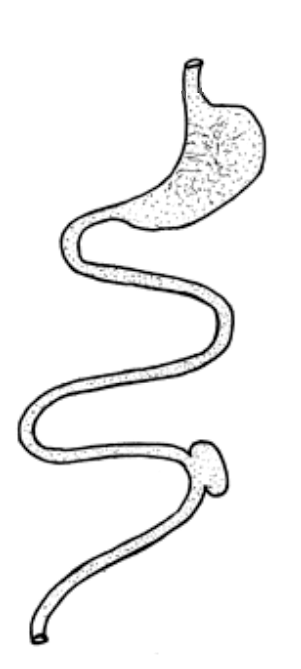
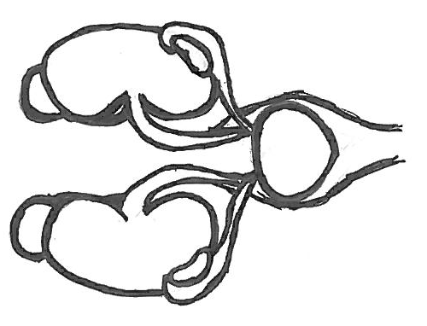
15.5 dpc mouse
Fetal intestine
Fetal urogenital tract
Notes:
Need to get a little better drawing of UGT in here that includes celiac ganglia -

Slide 2
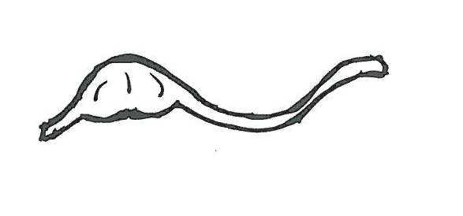
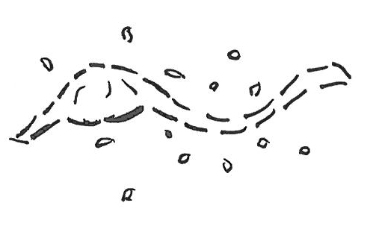
enzymatic dissociation

Slide 4
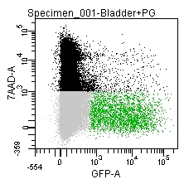
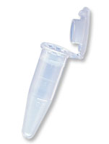
LUT Viability
14.5 dpc Sort Profiles
Notes:
Need to put an image of RNA in the tube – not quite sure how to do this?

Slide 5
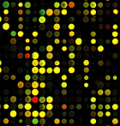
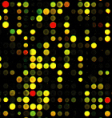
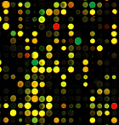
Microarray Expression Patterns differ between Populations of Neuronal Progenitors Isolated from different stages of development

