Slide 1
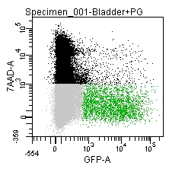
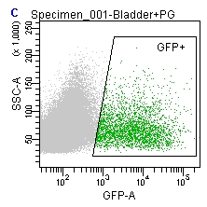
LUT Viability
EGFP+ Gated Population
14.5 dpc Sort Profiles
Notes:
Figure$.
FACS profiles of dpc14.5 (a) and dpc15.5 (b) TH-EGFP Bladders showing
Black - Correct size based on FSC,SSC, but nonViable based on exclusion by expressing 7aad
Grey - Viable, not expressing GFP
Green - Viable, expressing GFP
7AAD vs GFP – only showing events of correct size based on exclusion by FSC, SSC
SSC vs GFP – only showing viable cells based on 7aad staining

