Slide 1
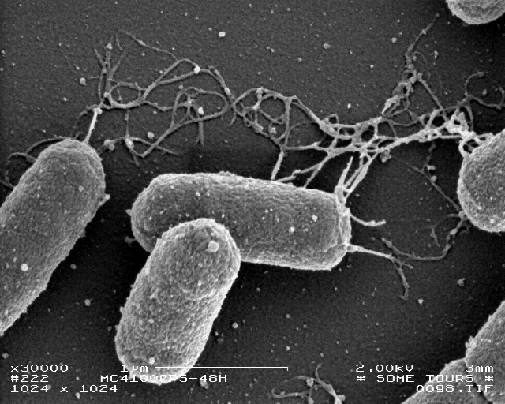
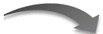
PrcnA
E X
S P
rcnR
csgB
csgA
csgE
csgF
csgG
RBS
RBS
.
.
.
.
RcnR inactive
cobalt/nickel

