Slide 1
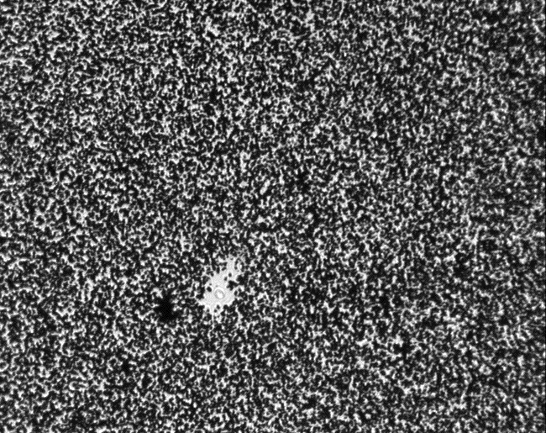
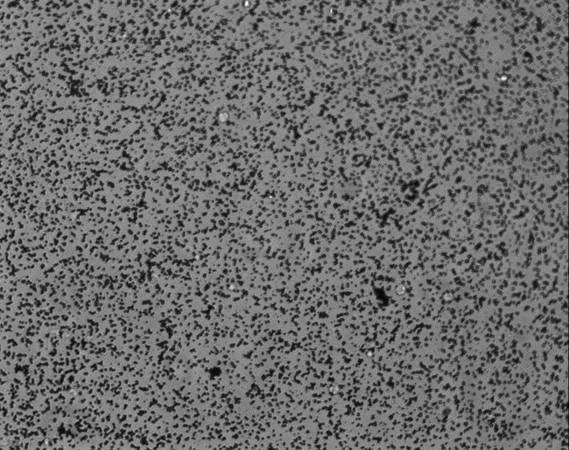
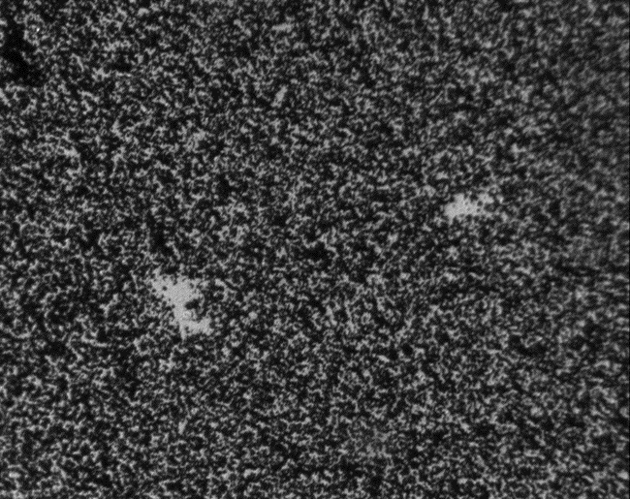
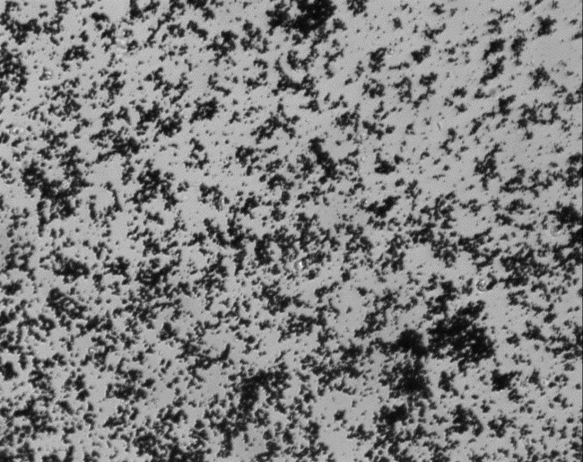
Figure 1.
A.
C.
B.
D.
Too High Density
Too Low Density
Figure 1. Potential Problems with the Density of Colloidal Gold on the Coverslips. Shown in this figure are examples of colloidal gold-coated coverslips with either a too high (Panels A and B) or a too low (Panels C and D) density of gold nanoparticles. Both of these examples will lead to poor data collection and statistical analyses. Note: Inappropriate concentrations of chloroauric acid or sodium citrate, as well as prolonged boiling of the reaction solution, may cause these undesirable results. Pictures were taken by using a 20X objective. Note: Panel D also depicts undesirable aggregates of gold nanoparticles on the glass coverslips. Size bar corresponds to 50 μm in length.

Slide 2
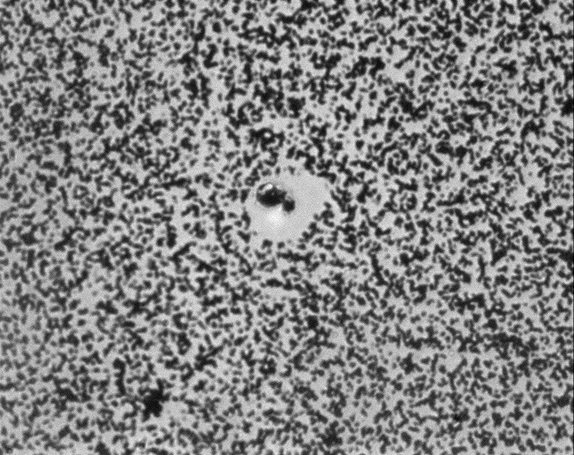
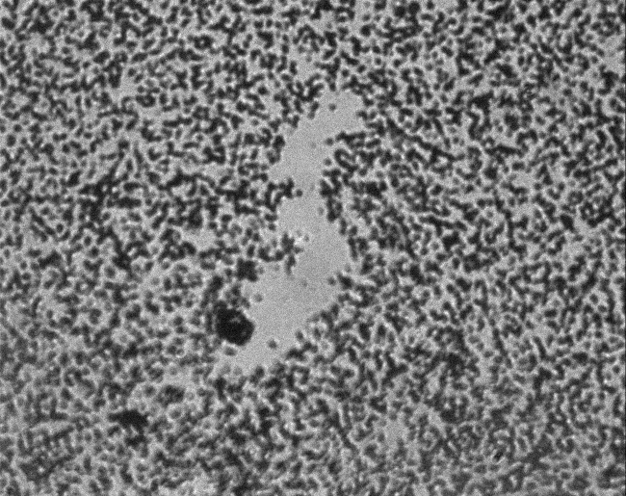
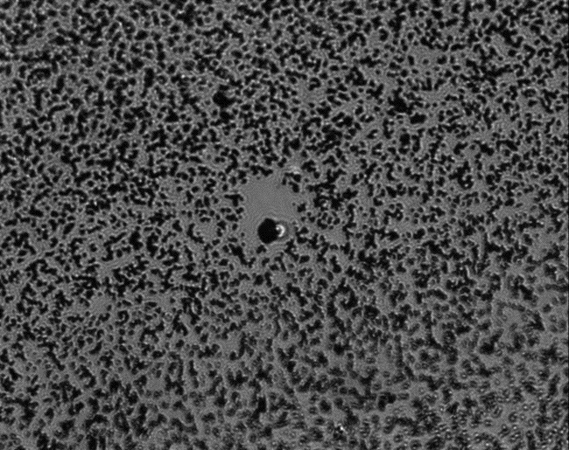
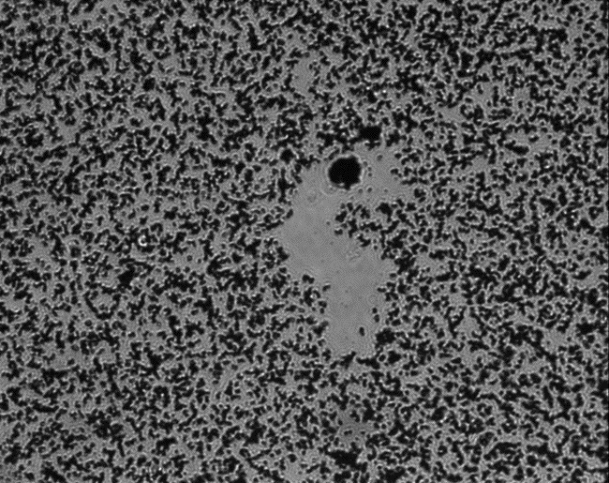
Figure 2.
A.
C.
B.
D.
Mock-Infected
HCMV-Infected
Figure 2. Examples of tracks created by non-motile (Panels A and B) and motile (Panels C and D) cells on colloidal gold-coated coverslips. Virus-free media (mock-infected) or media containing viral particles (HCMV-infected) were added to isolated peripheral blood monocytes^{10,18-22}. Monocytes were incubated at 37ºC/5%CO₂ for 1h and then plated onto colloidal gold-coated coverslips for 24h at 37ºC/5%CO₂. Pictures were taken by using a 40X objective. White arrows mark monocytes in their final location. As we have demonstrated previously^{10,18-22}, uninfected monocytes are characterized by a low basal level of motility, while HCMV-infected cells show characteristics of high motility. Size bar corresponds to 25 μm in length.

Slide 3
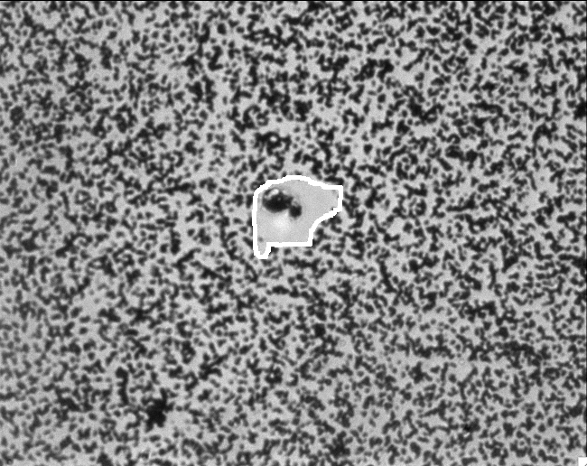
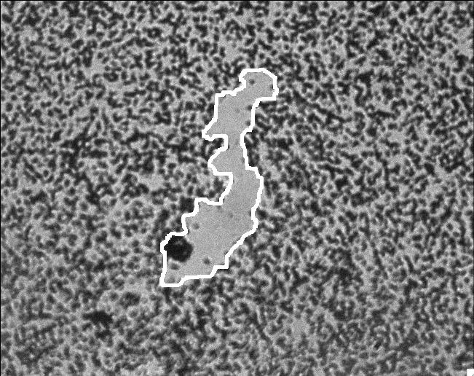
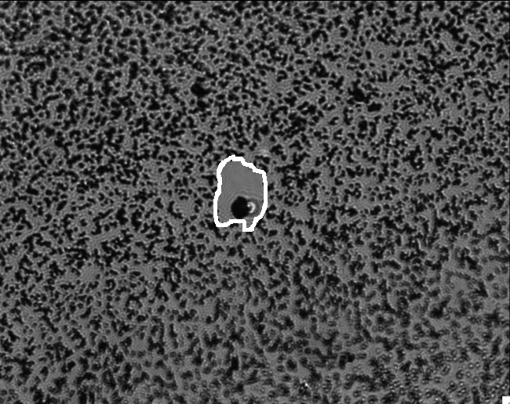
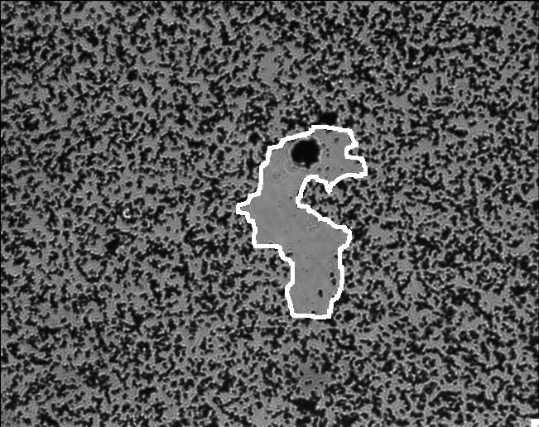
Figure 3.
A.
C.
B.
D.
Mock-Infected
HCMV-Infected
Figure 3. Marking the Area of the Cellular Tracks Using ImageJ software. Examples shown are snapshots of tracks, in which the Image J software was used during the analysis of the tracks created by non-motile (Panels A and B) and motile (Panels C and D) cells on colloidal gold-coated coverslips (Note: Tracks are circled by a white line using the ImageJ freehand tool). The sample pictures, the same as those shown in Figure 2, were used in this figure to measure track areas cleared by a single cell. These are representative images of mock- and HCMV-infected monocytes, however, usually 10-20 images are analyzed per sample. Size bar corresponds to 25 μm in length.

Slide 4
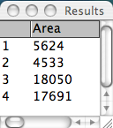
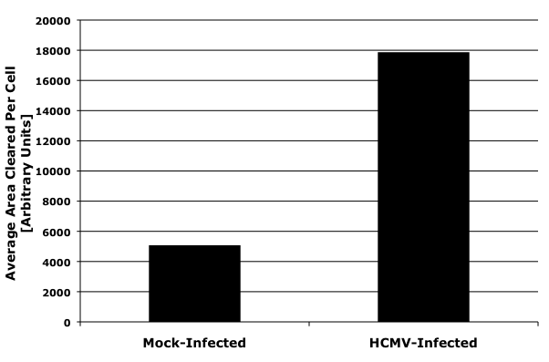
Figure 4.
A.
B.
Figure 4. The Quantitative Evaluation of Cell Motility Using ImageJ Software and Spreadsheet. A) Measured track areas cleared by cells, as depicted in the sample pictures (Figures 2 and 3), using the ImageJ software. The calculated results #1, #2, #3 and #4 correspond to Panels A, B, C and D in Figures 2 and 3, respectively. B) A graphical representation of average areas (means; in arbitrary units) cleared by cells and analyzed by the ImageJ software. In this example, the standard error of the mean is not shown, because in the example an insufficient number of replicates is analyzed. Note: The ImageJ software provides the measured area of tracks in arbitrary units; therefore, it is critical to compare pictures of tracks taken under the same magnification. The simplest method to compare results from separate experiments is to compare fold changes between examined samples.

