Slide 1
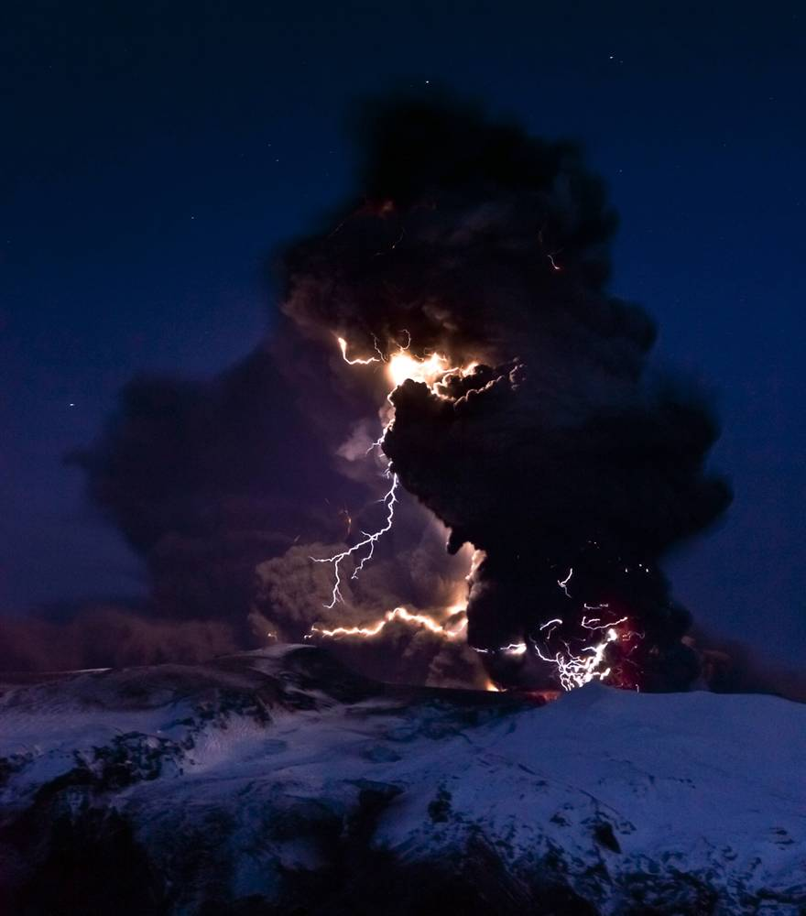
ThunderStorm Workflow and UI
Thursday July 28th, 2011

Slide 2
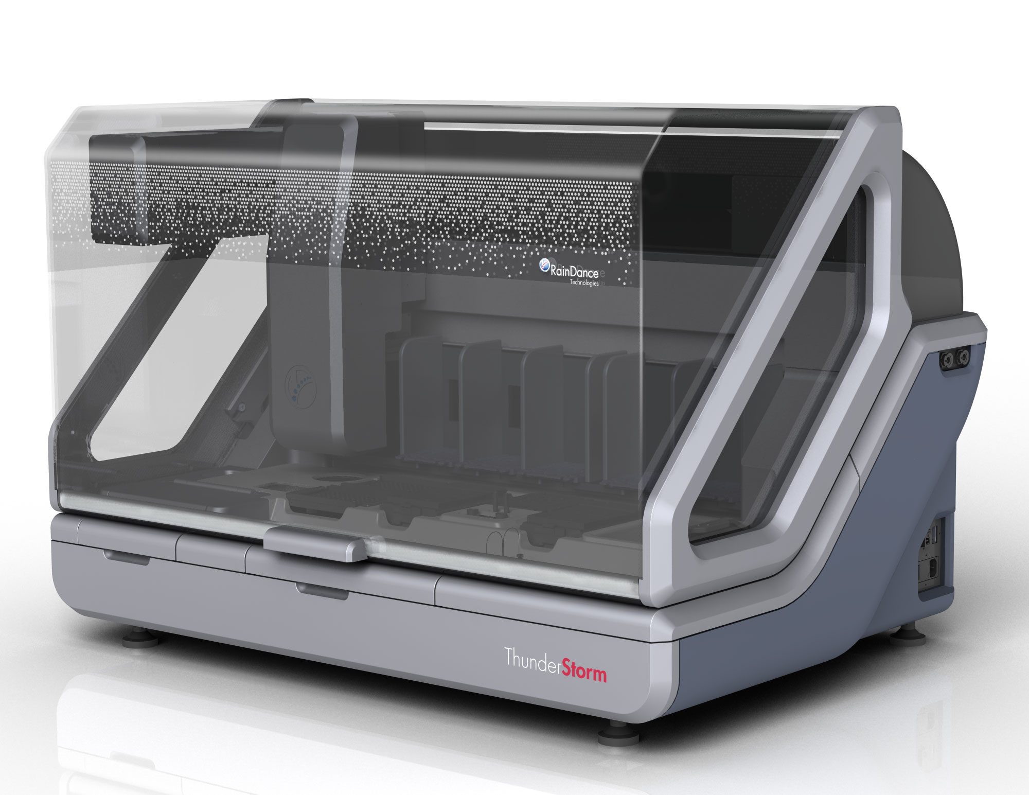
ThunderStorm
ThunderStorm
  96 samples in ~24 hours
Primer Library flexibility
  Random access
  Up to 8 primer libraries
Reliability
  New SONY DADC chips
Improved economics
  2 samples per chip

Slide 3
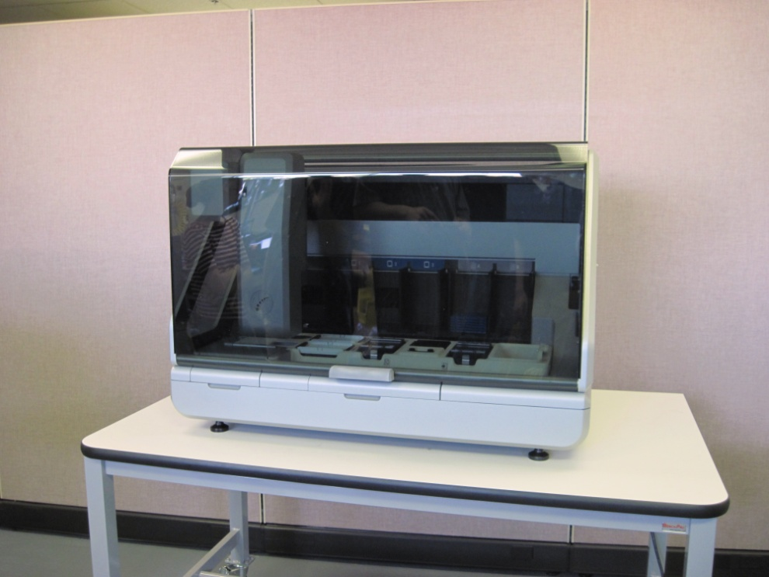
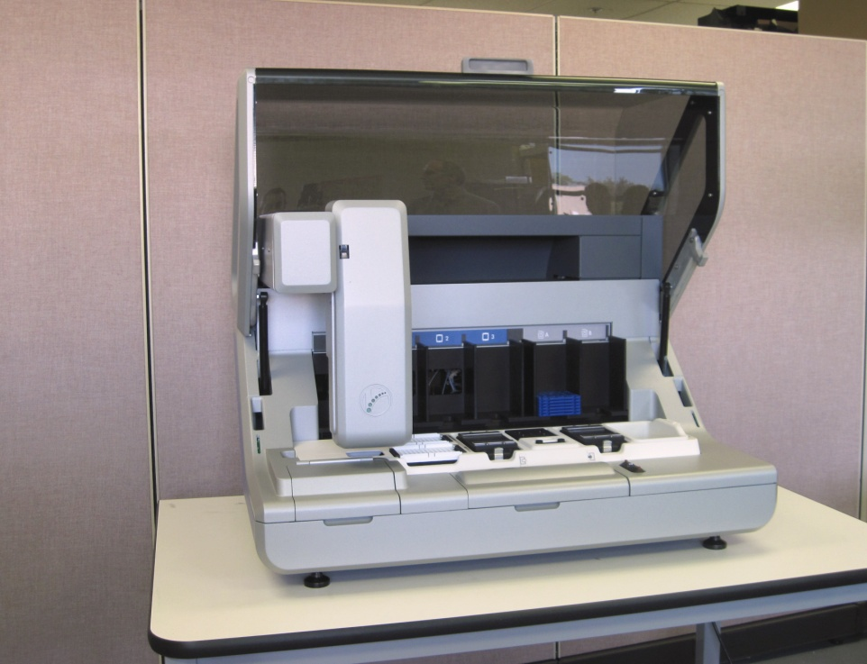
ThunderStorm
Width ~ 41.2 in.
Depth ~ 30 in.
Height ~ 29.2 in.
Weight <400 lb.

Slide 4
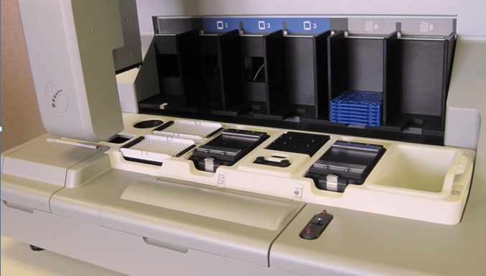
ThunderStorm: Deck Layout

Slide 5
ThunderStorm: Deck Layout
Oil Reservoirs

Slide 6
ThunderStorm: Deck Layout
Gantry

Slide 7
ThunderStorm: Deck Layout
Bar Code Reader

Slide 8
ThunderStorm: Deck Layout
Oil Drip Pan

Slide 9
ThunderStorm: Deck Layout
Template tips

Slide 10
ThunderStorm: Deck Layout
Collect tips

Slide 11
ThunderStorm: Deck Layout
Input Plate

Slide 12
ThunderStorm: Deck Layout
Tip Detector

Slide 13
ThunderStorm: Deck Layout
Sample Merge Position

Slide 14
ThunderStorm: Deck Layout
Output Plate

Slide 15
ThunderStorm: Deck Layout
Tip Waste Position

Slide 16
ThunderStorm: Deck Layout
Primer Library Oil Removal

Slide 17
ThunderStorm: Deck Layout
Unused Chip Position

Slide 18
ThunderStorm: Deck Layout
Used Chip Position

Slide 19
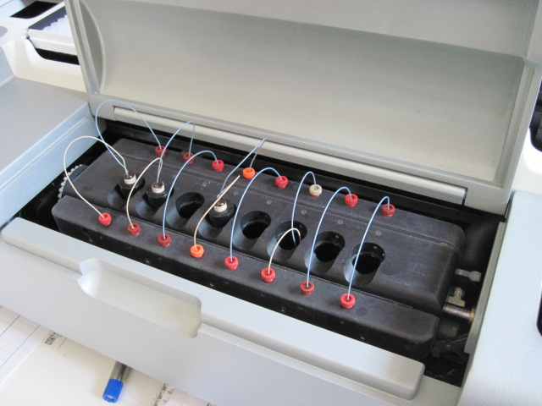
ThunderStorm: Deck Layout
Primer Library Position

Slide 20
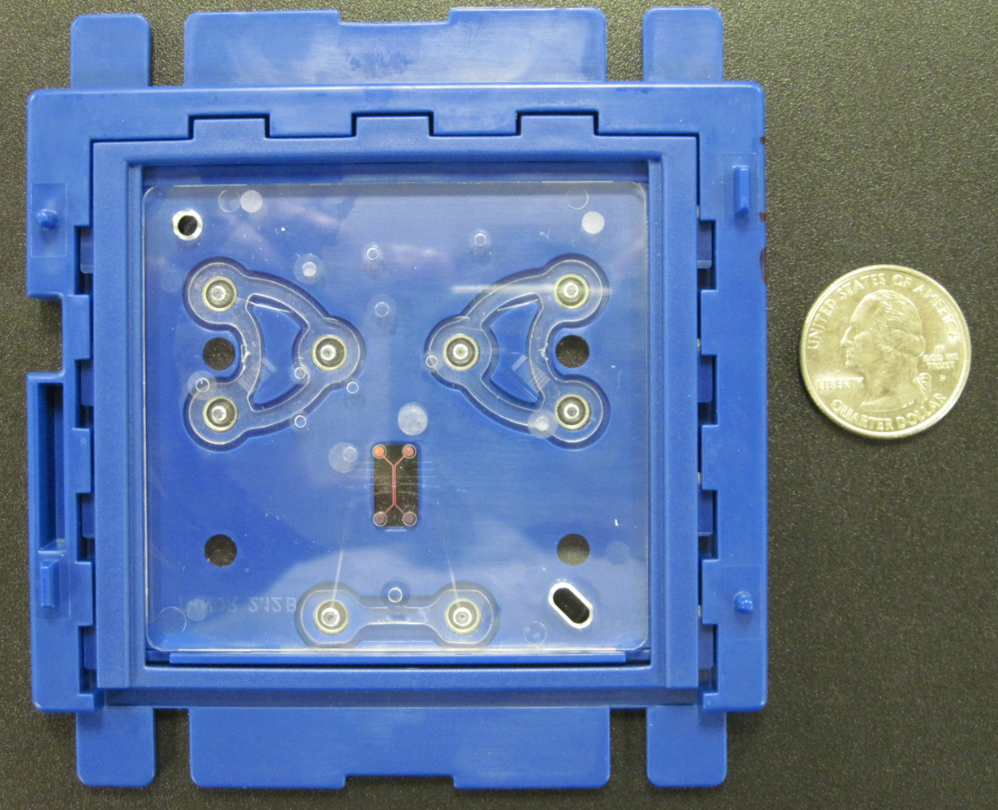
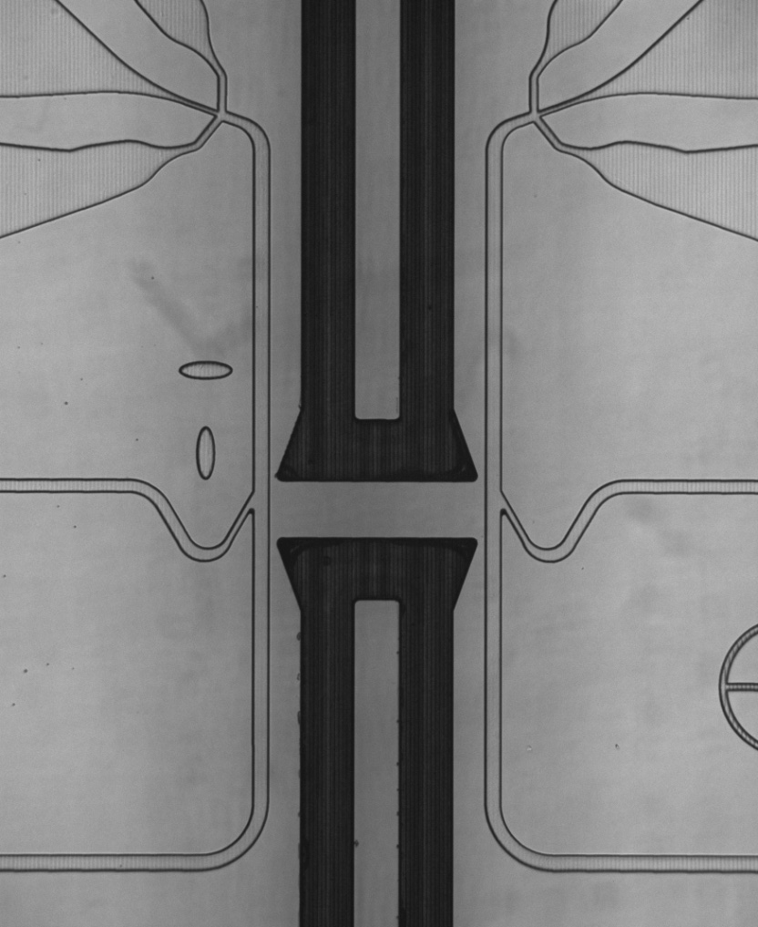
ThunderStorm: SONY DADC Chip
Primer
Library
gDNA
Template
Merge

Slide 21
RainDance ThunderStorm Workflow - Simplicity
Run Queue
RDT001
RDT002
RDT003
RDT004
RDT005
Define Run
Start Run

Slide 22
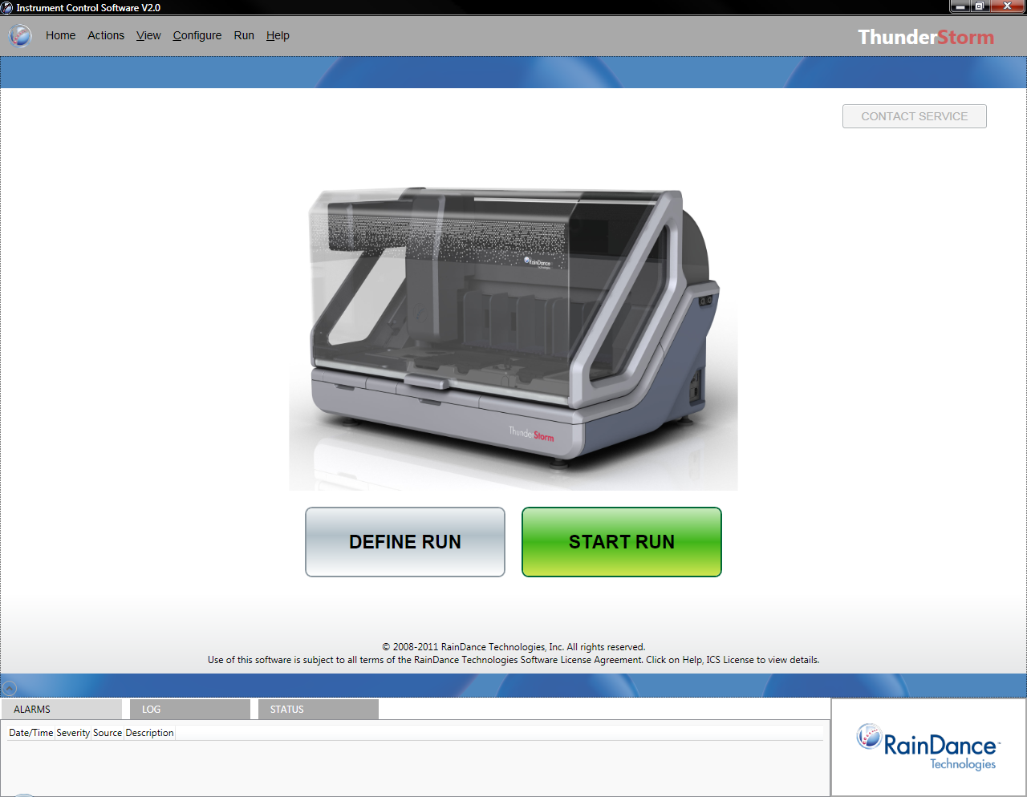
RainDance ThunderStorm Workflow - Simplicity

Slide 23
ThunderStorm: Define Run
4 Steps to define a ‘Run’
Assign Run Name
Define Samples
  Ability to import sample plate definition from a text file
Define Primer Libraries (8 maximum)
Map Samples to Primer Libraries
Save Run Definition
Ability to import Run Definition from a text file

Slide 24
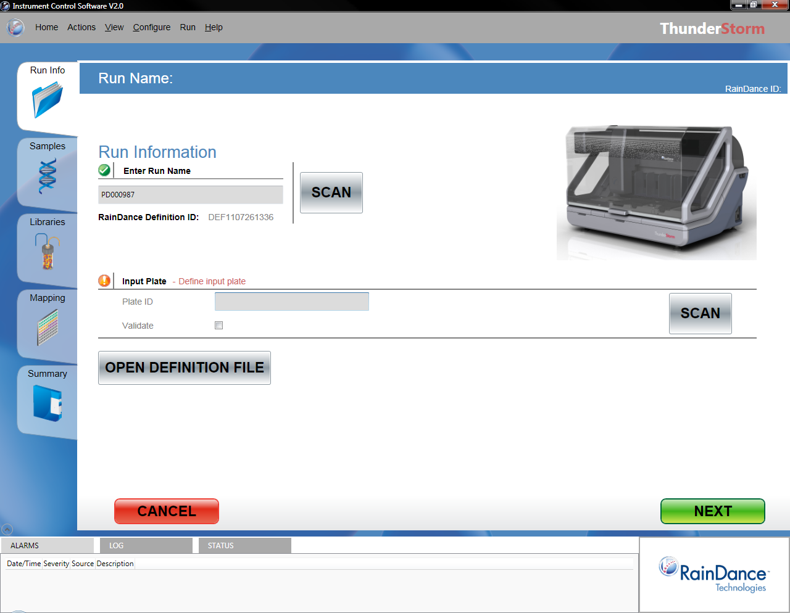
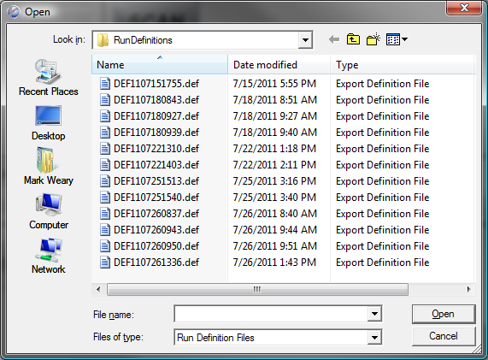
ThunderStorm: Define Run – Assign RunID

Slide 25






ThunderStorm Tab View
Run Info,
  Define Run Name
Samples,
  Define plate name, SampleIDs and position
Libraries
  Define Primer Libraries (up to 8 Primer Libraries)
Mapping
  Map SampleIDs with Primer Library
Summary
Tab Indicators:
Ready
Warning, run will proceed
Error, run will not proceed

Slide 26
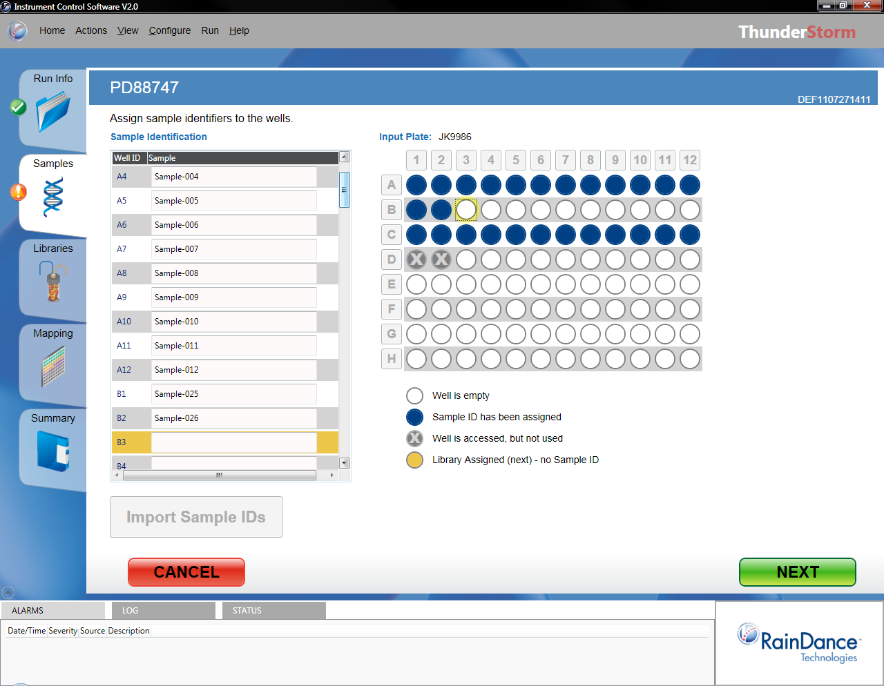
ThunderStorm: Define Run – Define Samples

Slide 27
Sample Plate Loading Pattern
Sample ID
1
3
5
7
9
11
13
15
17
19
21
23
1 – 24 (odd)
25
27
29
31
33
35
37
39
41
43
45
47
1 – 24 (even)
2
4
6
8
10
12
14
16
18
20
22
24
25 - 48 (odd)
26
28
30
32
34
36
38
40
2
44
46
48
25 - 48 (even)
49 - 72 (odd)
49 - 72 (even)
73 - 96 (odd)
73 - 96 (even)

Slide 28
ThunderStorm: Define Run – Define SampleIDs

Slide 29
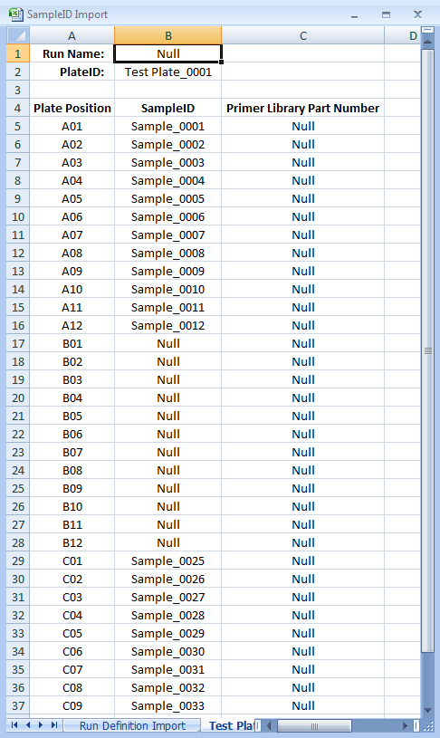
Import Sample ID from an External File

Slide 30
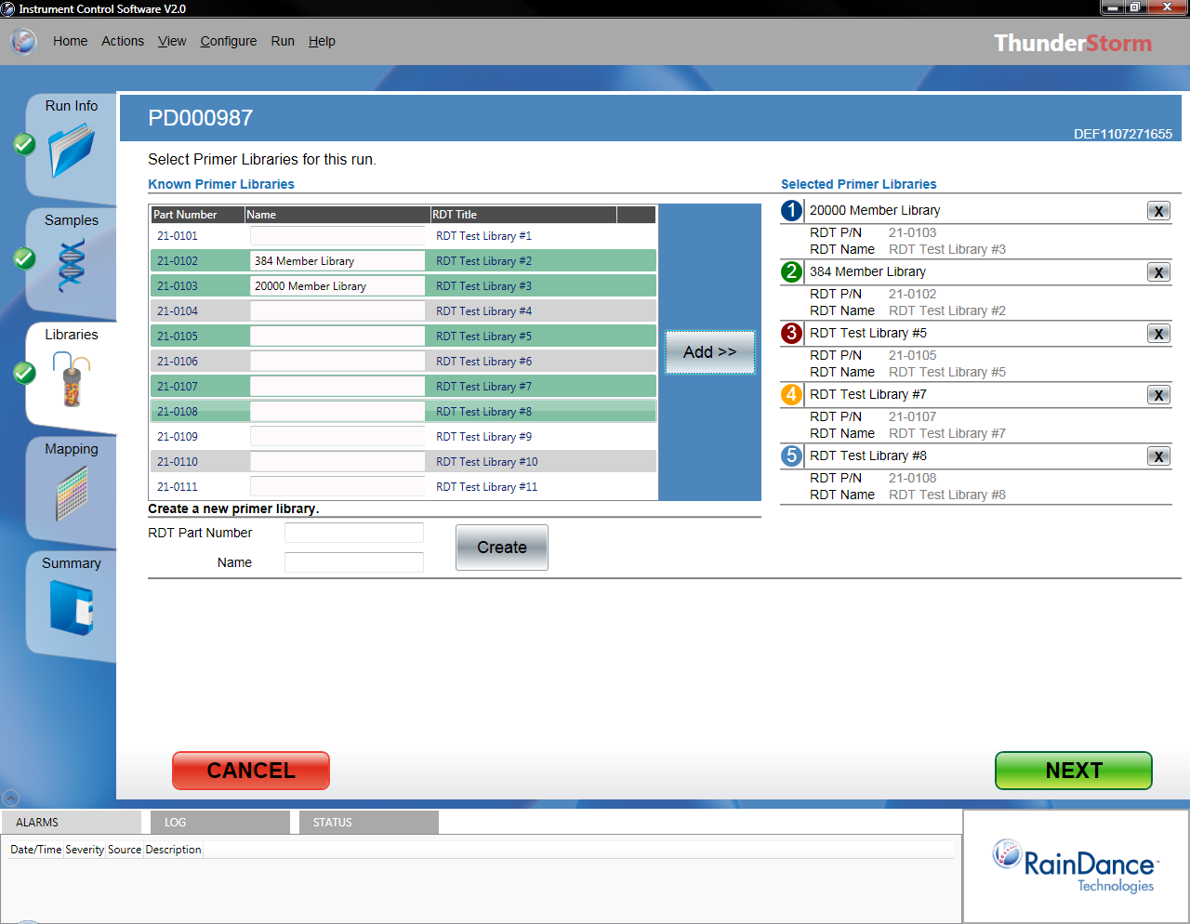
ThunderStorm: Define Run – Define Libraries

Slide 31
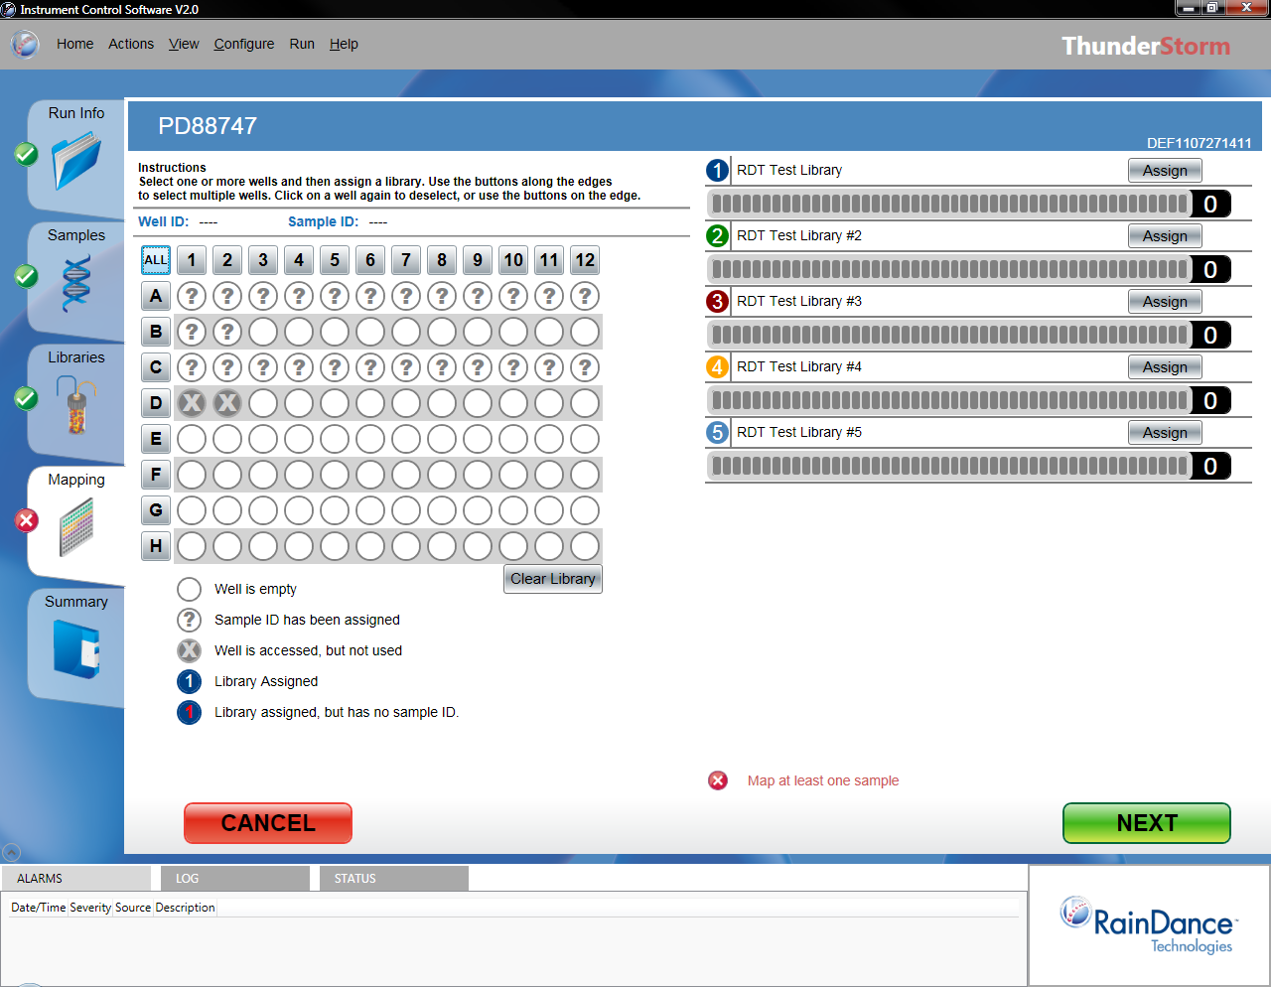
ThunderStorm: Define Run – Mapping

Slide 32
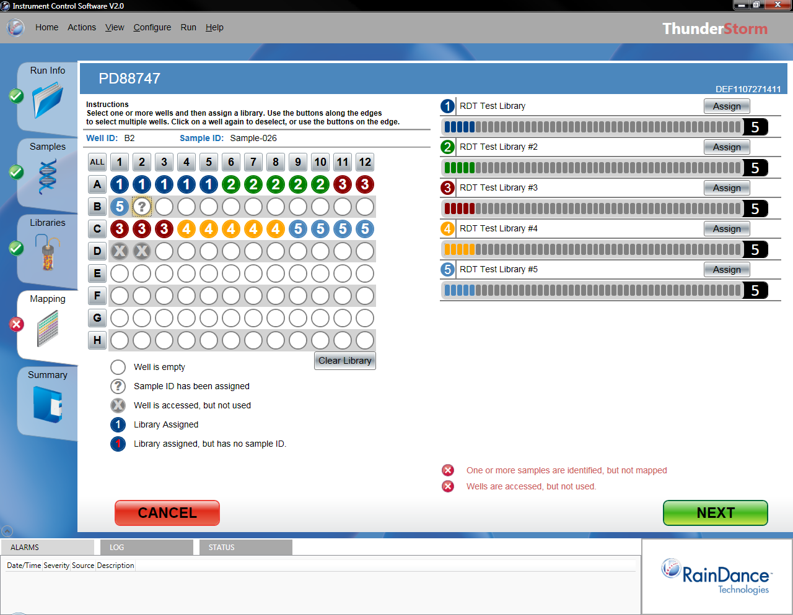
ThunderStorm: Define Run – Mapping

Slide 33
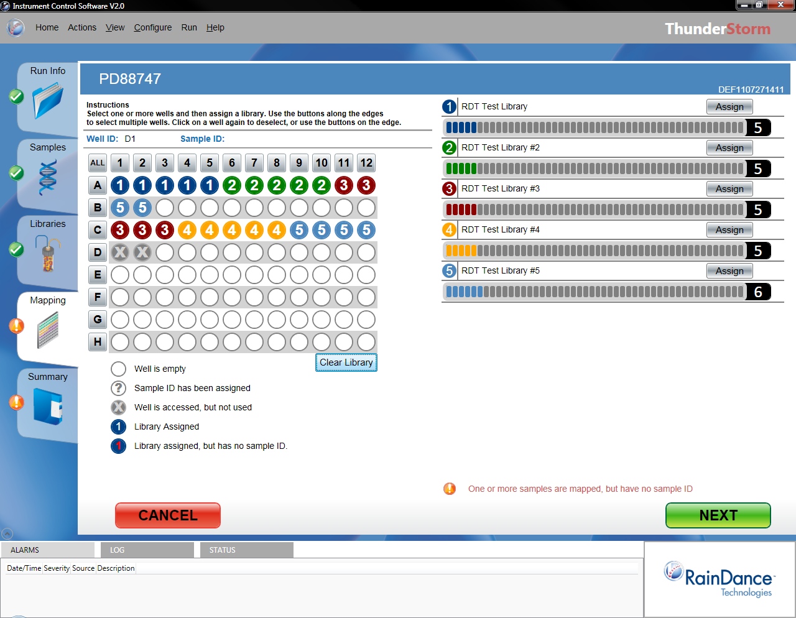
ThunderStorm: Define Run – Map Samples -> Primer Libraries

Slide 34
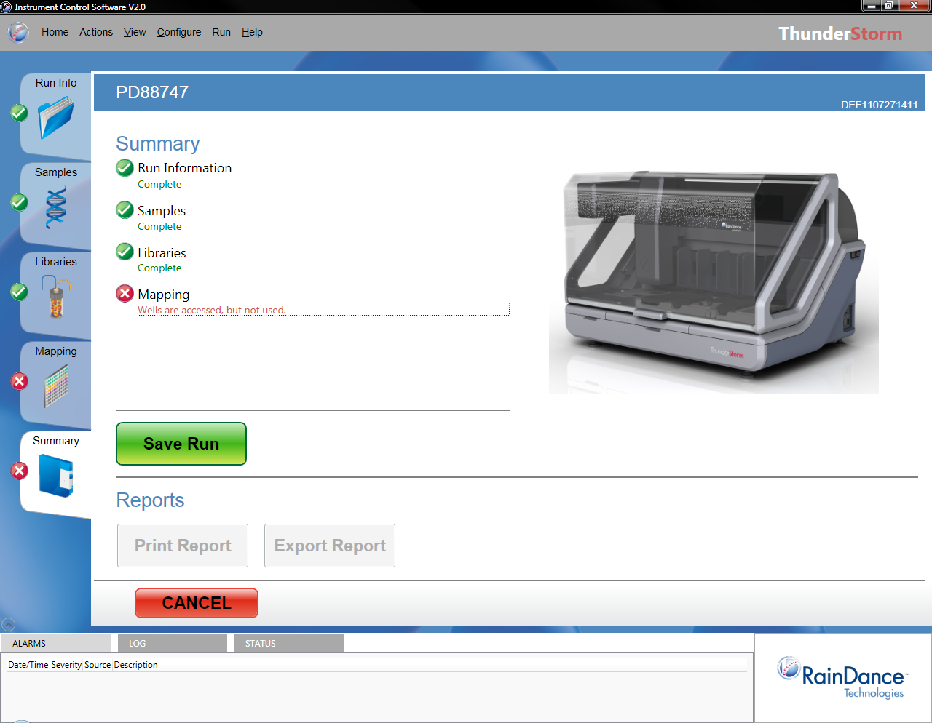
ThunderStorm: Define Run – Run Summary

Slide 35
ThunderStorm: Define Run – Define SampleIDs
Not using these two positions will cause only one sample per chip to be run

Slide 36
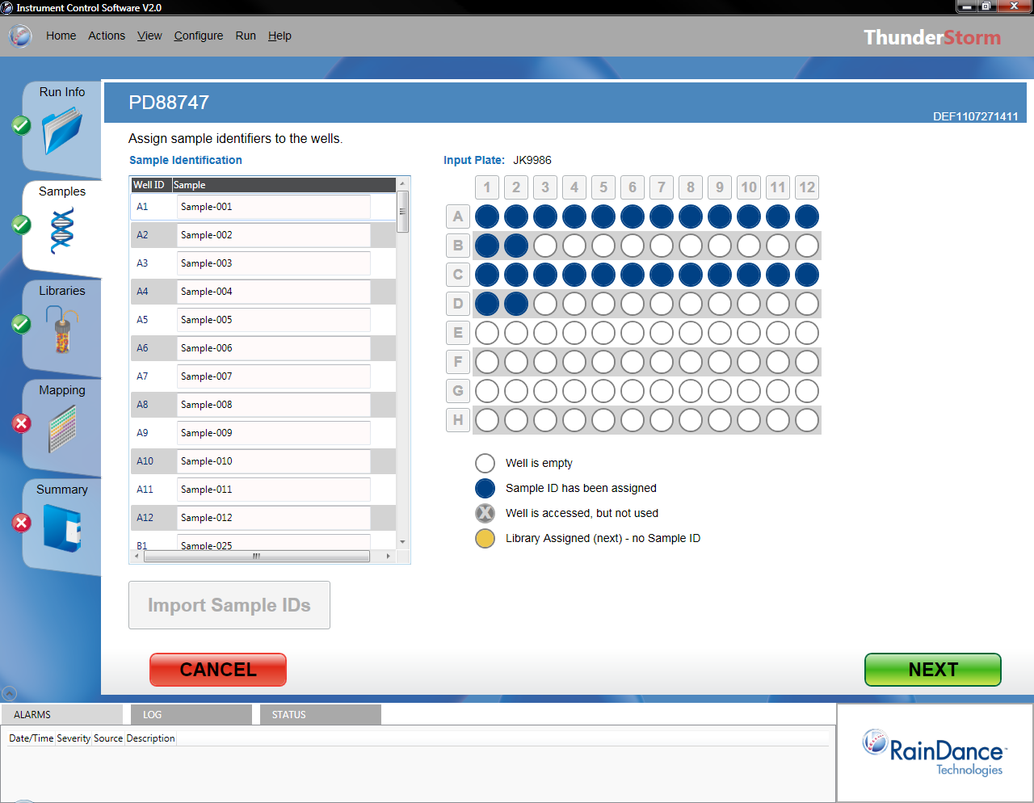
ThunderStorm: Define Run – Define SampleIDs

Slide 37
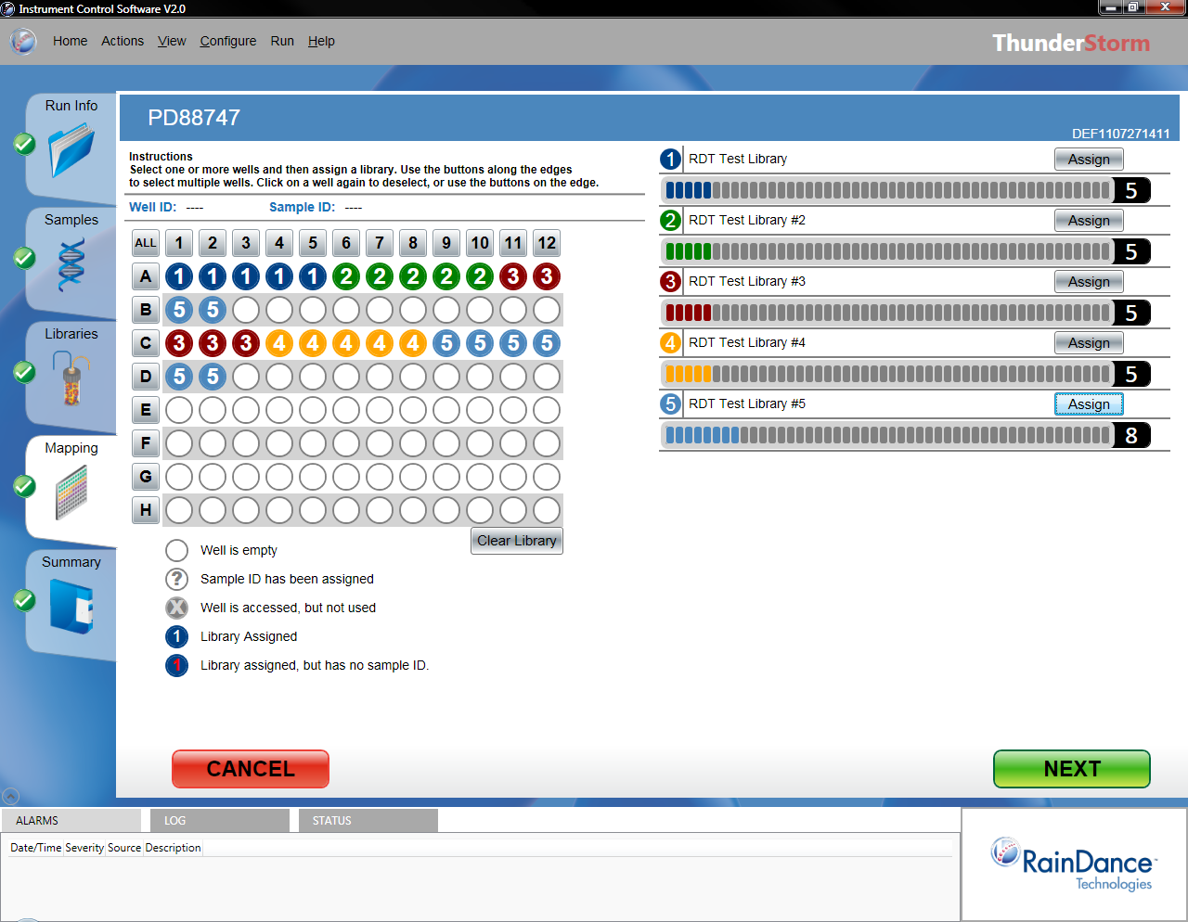

Slide 38


Slide 39
Questions:

Slide 40
RainDance ThunderStorm Workflow - Simplicity

Slide 41
ThunderStorm: Start Run
4 Steps to define a ‘Run’
Select Run Name
Load Primer Libraries
Load Sample Plate
Load Materials (Consumables)
  Chips
  Tips
  Oils
Start Run

Slide 42
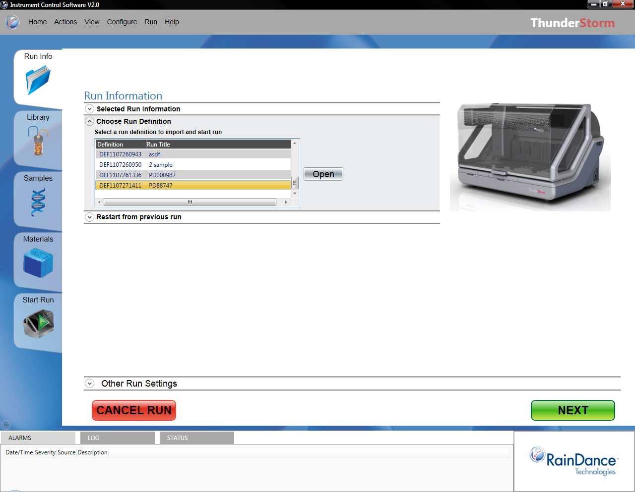
ThunderStorm: Start Run – Select Run

Slide 43
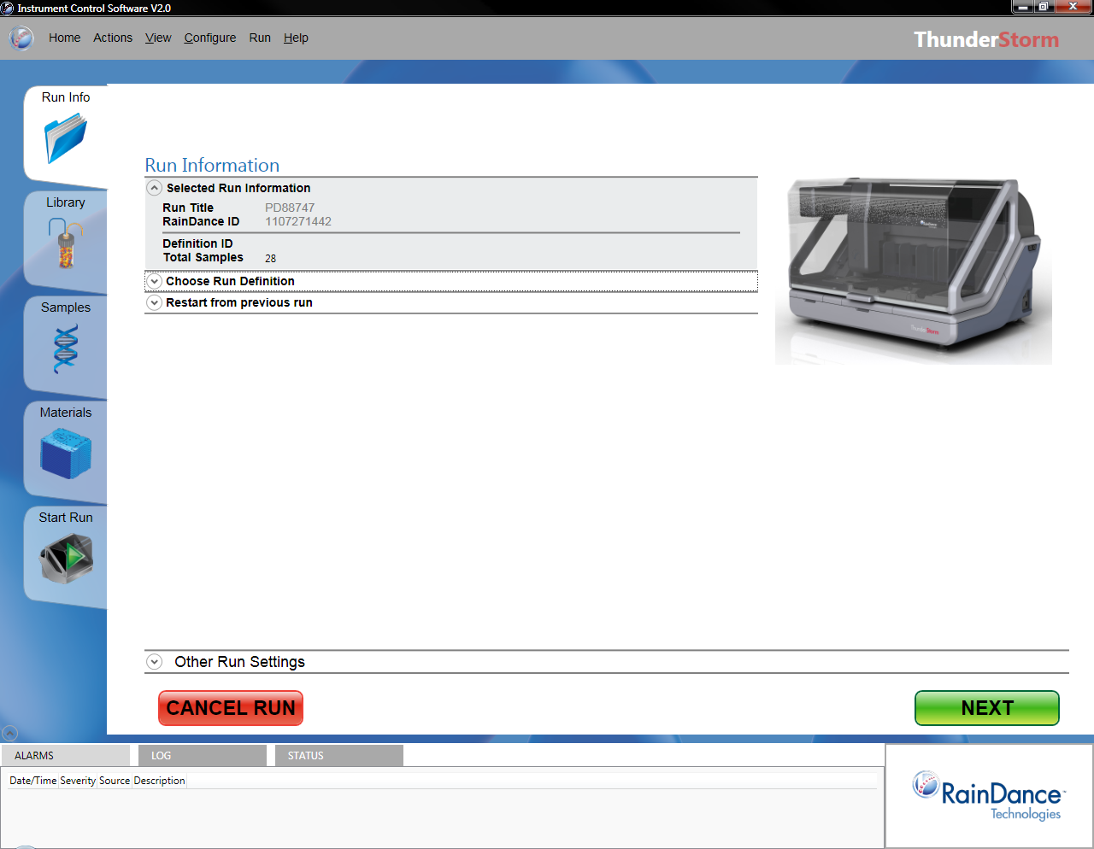
ThunderStorm: Start Run – Select Run

Slide 44
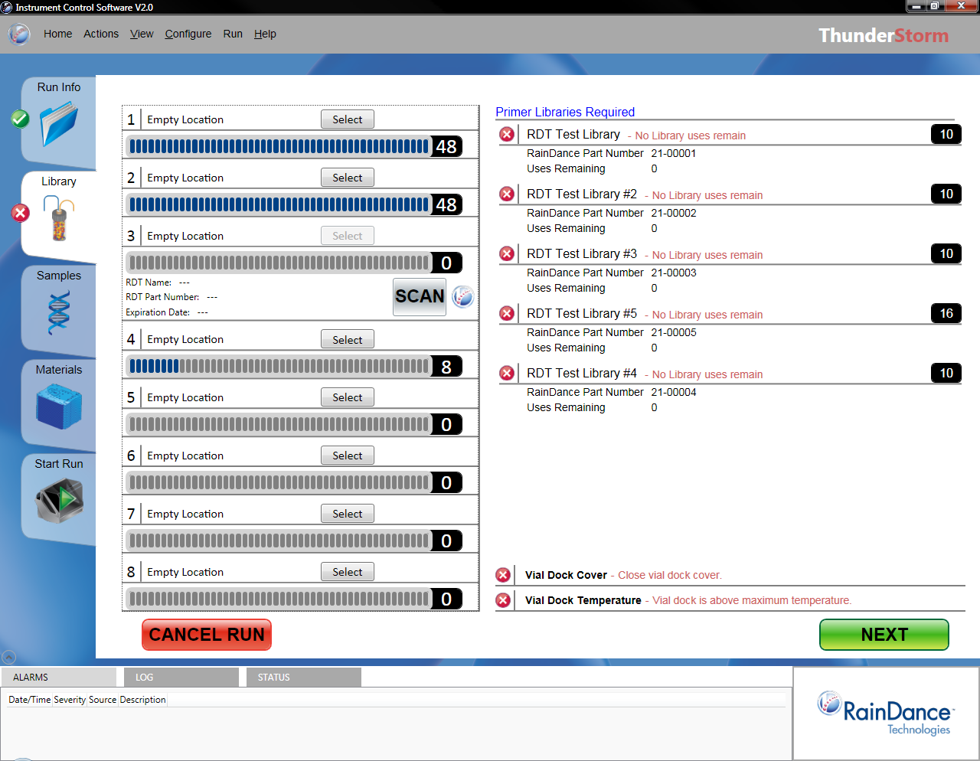
ThunderStorm: Start Run – Load Primer Libraries
RDT Library #10
RDT Library #14
RDT Library #15

Slide 45
ThunderStorm: Start Run – Scan Library Barcode

Slide 46
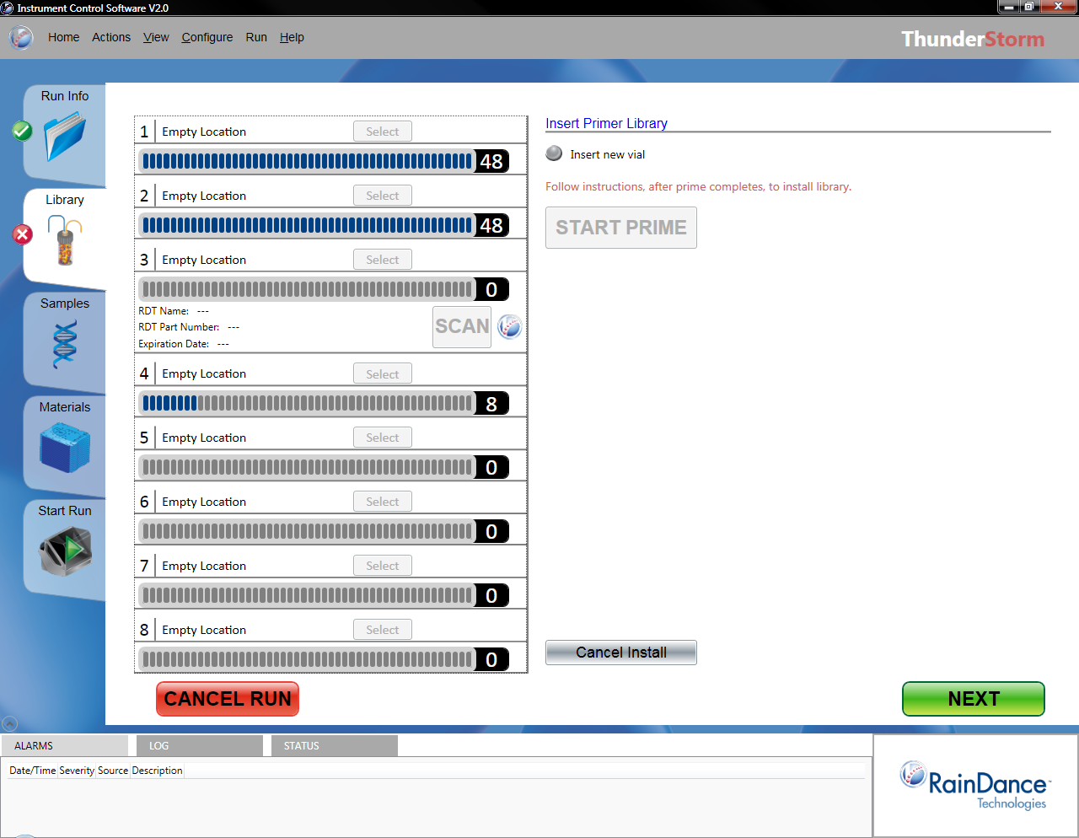
ThunderStorm: Start Run – Insert Vial & Start Prime

Slide 47
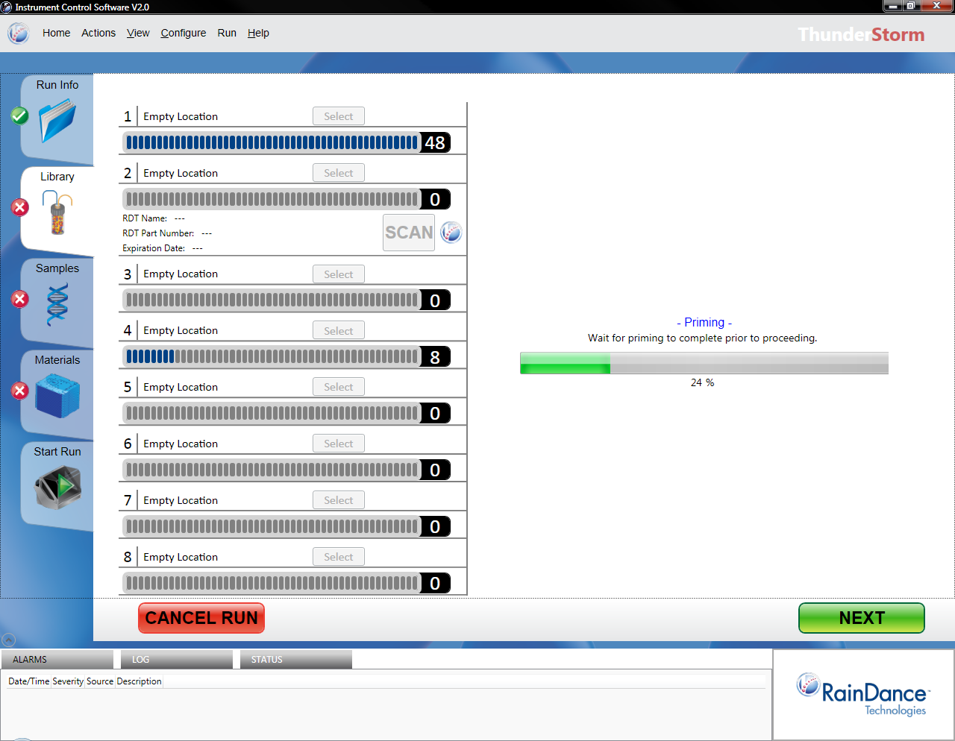
ThunderStorm: Start Run – Priming

Slide 48
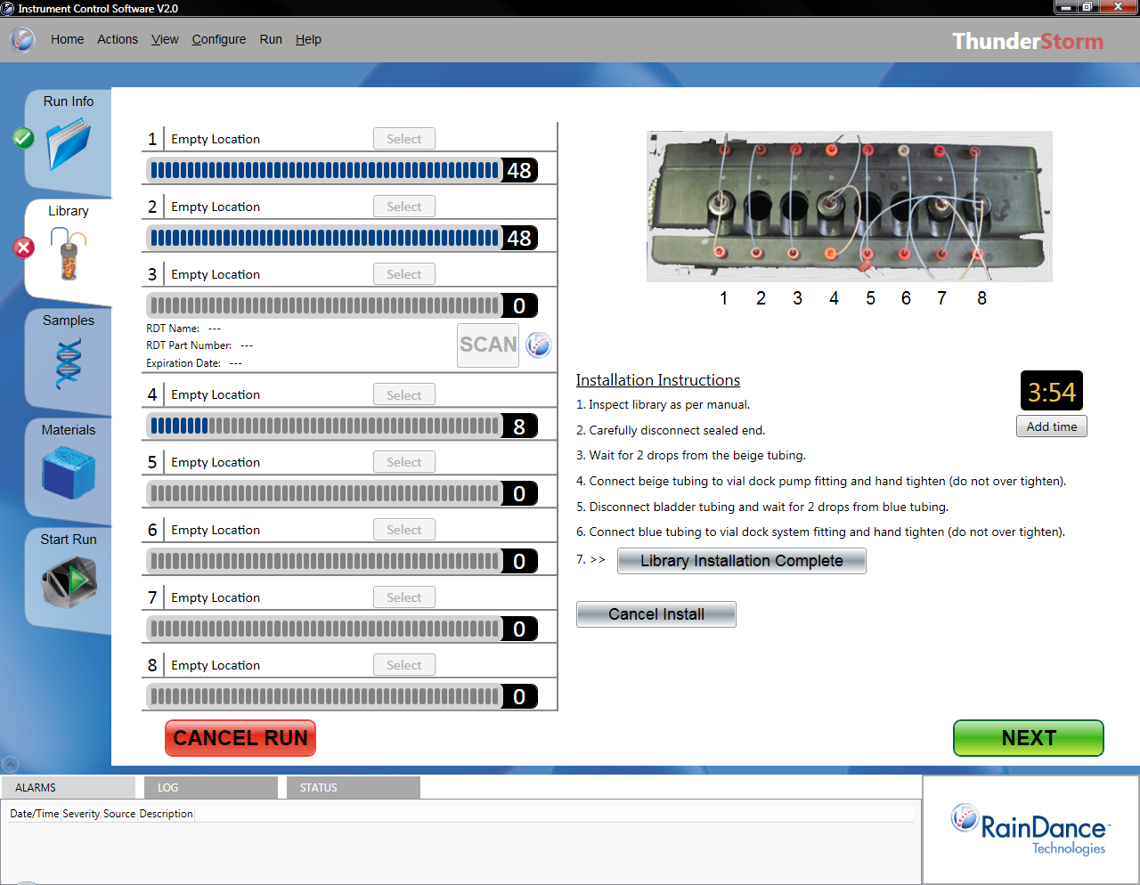
ThunderStorm: Start Run – Connect Library

Slide 49
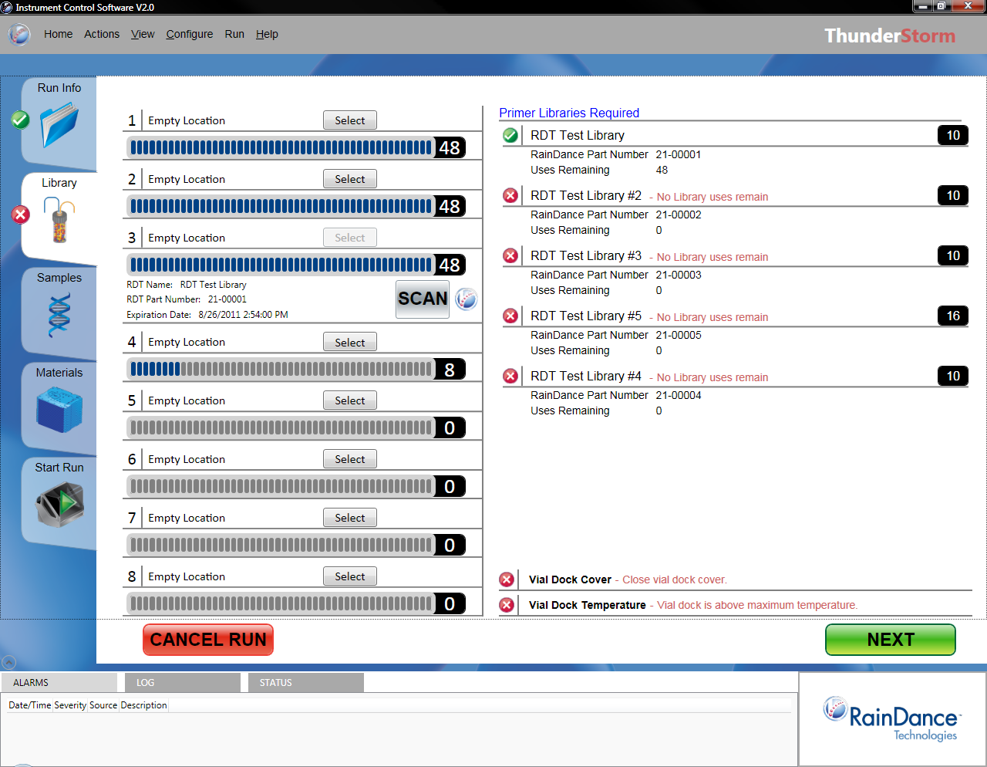
ThunderStorm: Start Run – Load Primer Libraries

Slide 50
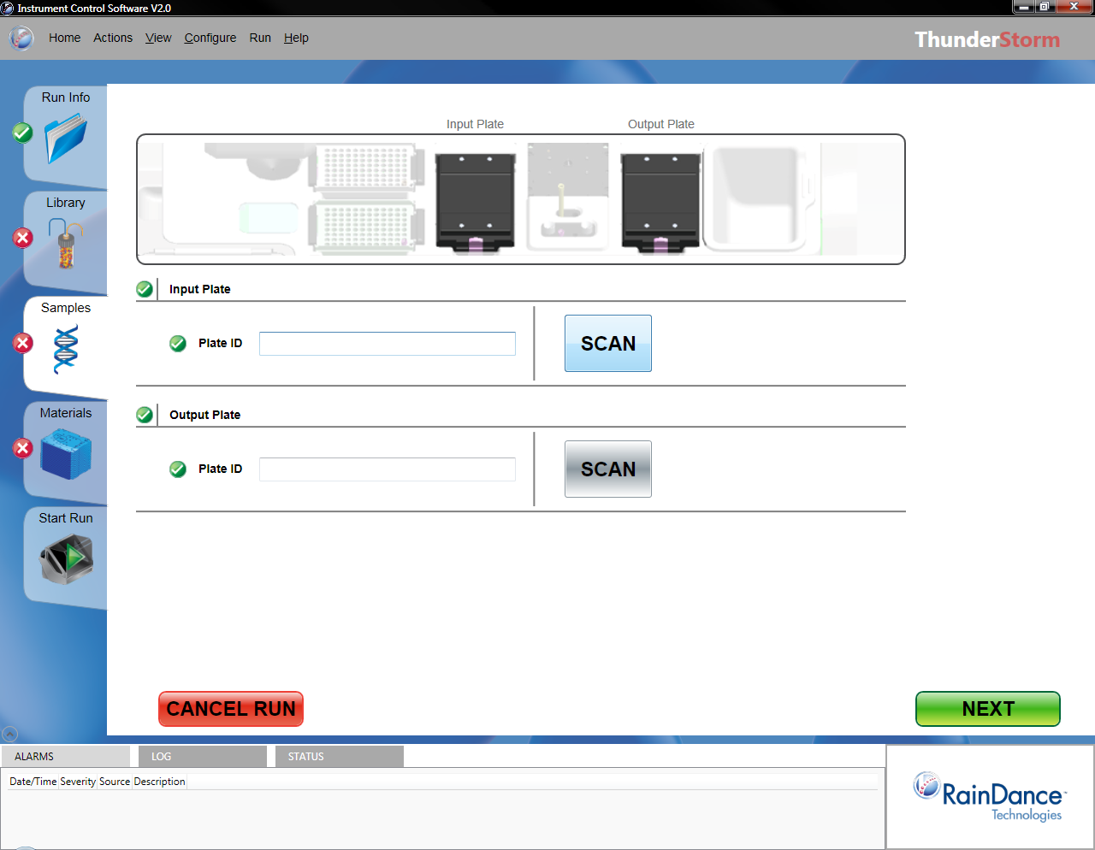
ThunderStorm: Start Run – Load Input Plate
- Install Plate
- Install Plate

Slide 51
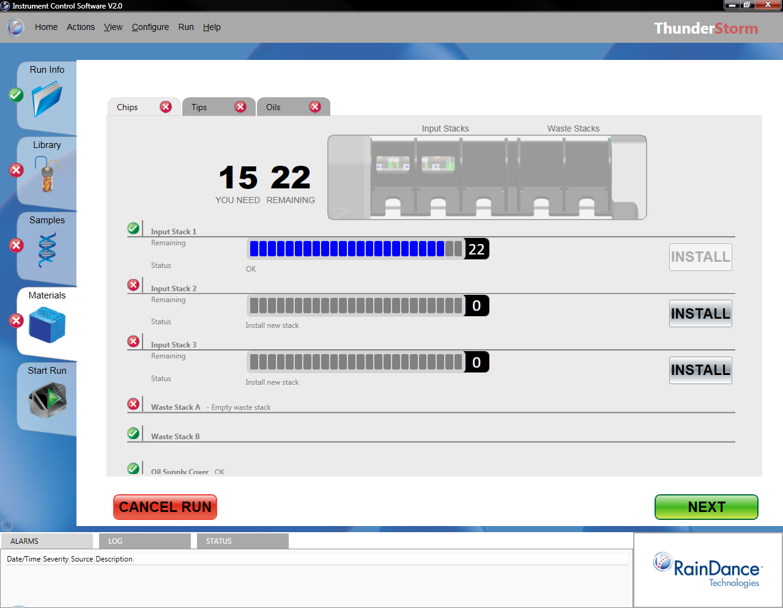
ThunderStorm: Start Run: Load Materials - Chips

Slide 52
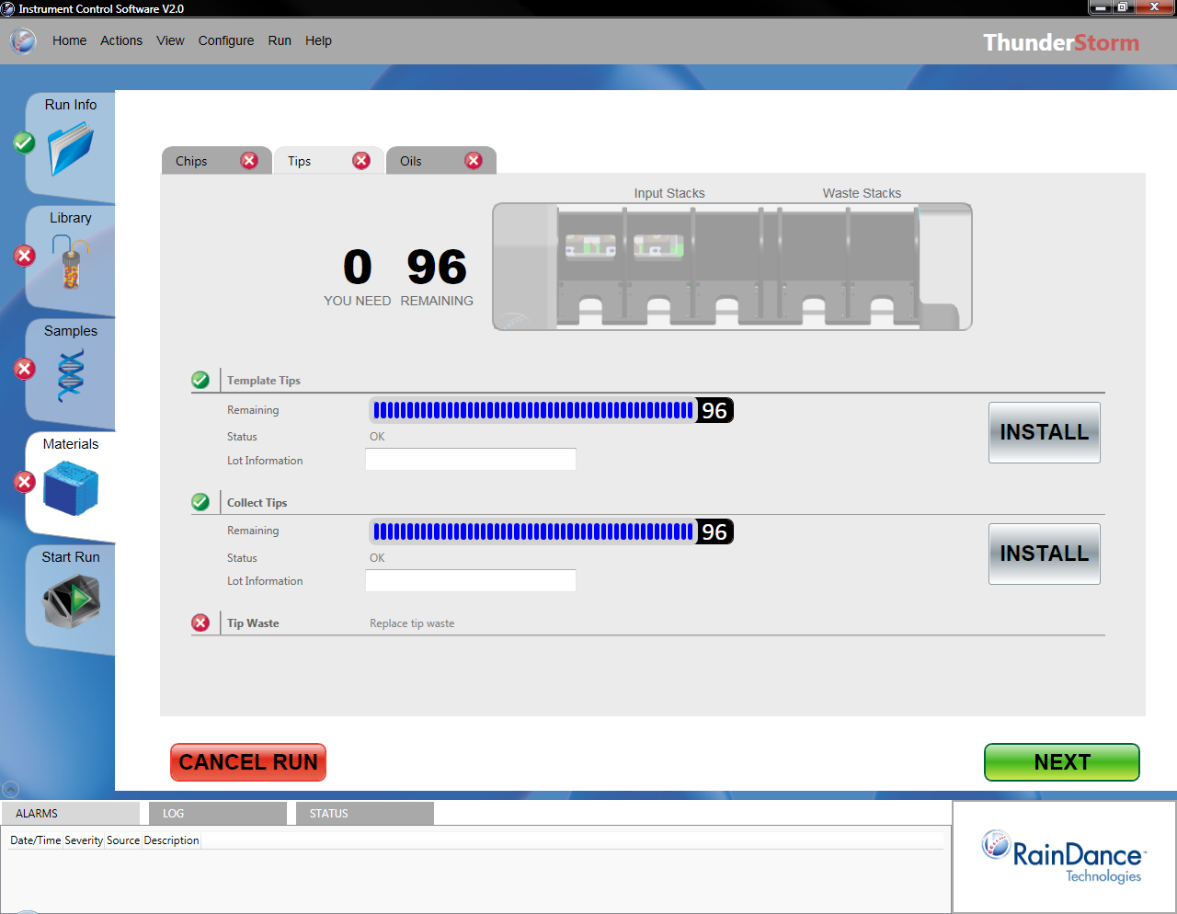

ThunderStorm: Start Run: Load Materials - Tips
30

Slide 53
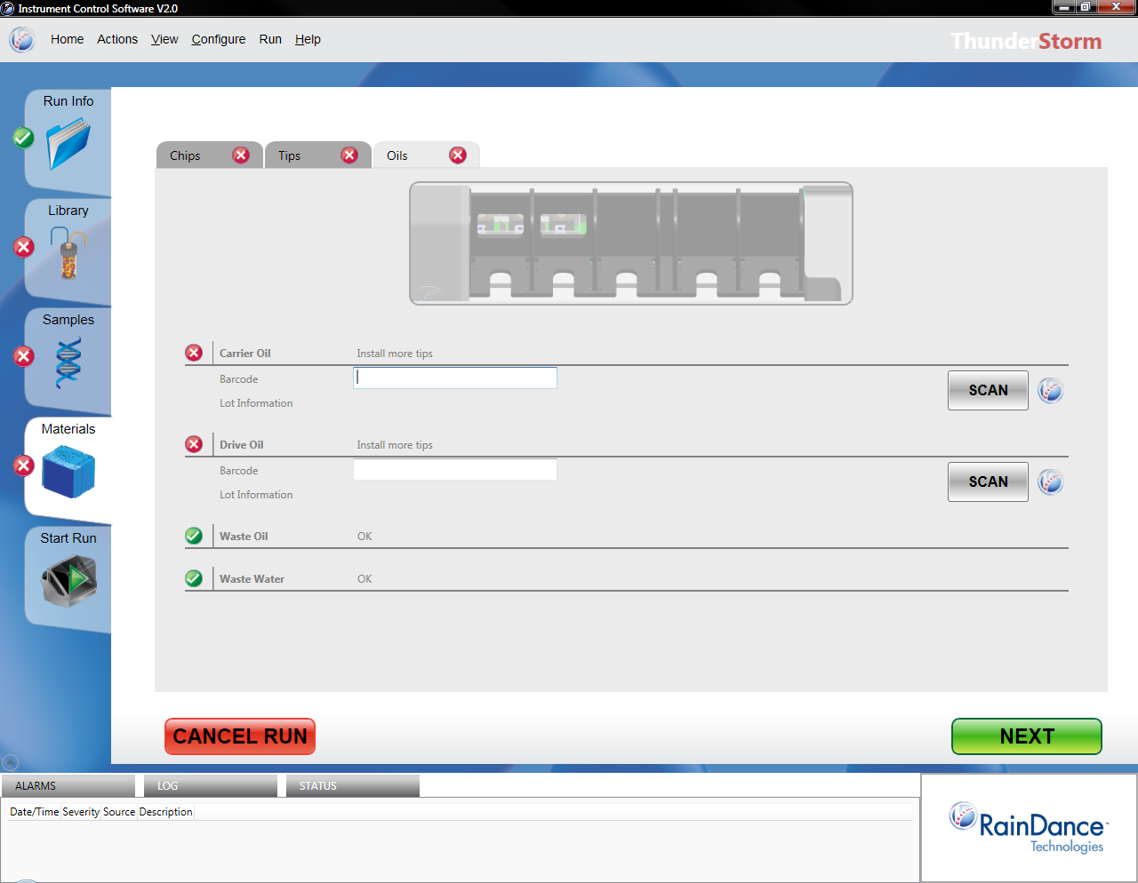

ThunderStorm: Start Run: Load Materials - Oils
- Refill Oil Reservoir
- Refill Oil Reservoir

Slide 54
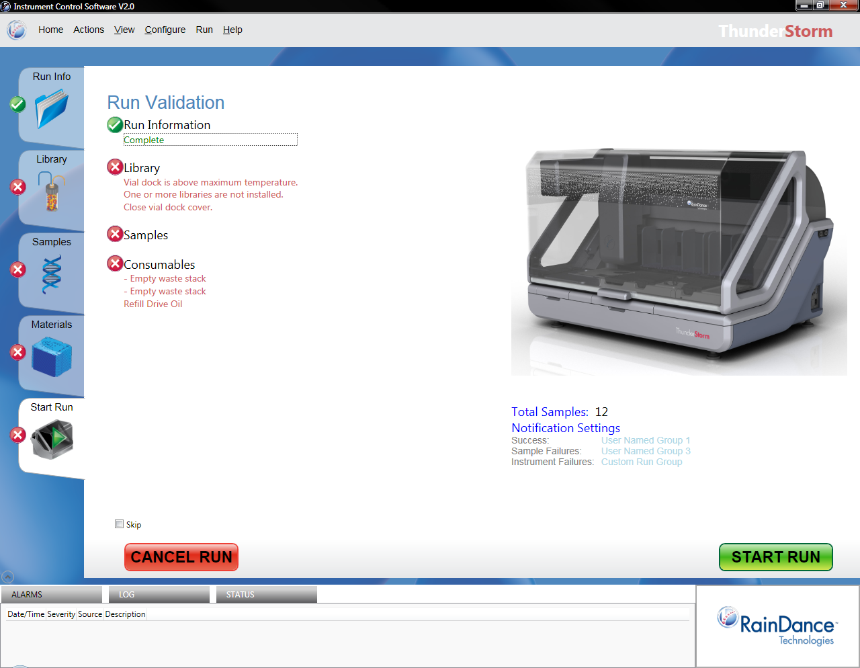
ThunderStorm: Start Run

Slide 55
ThunderStorm: Status & Reports
Mid-Run Status Information
End of Run
Run Summary Report

