Slide 1
Figure 1. Overview of the targeted LC/MS/MS experiment for polar metabolite profiling via selected reaction monitoring (SRM).

Slide 2
Figure 2. Chromatographic Q3 Peak representing total ion current (TIC) for hexose-phosphate from two different experiments.

Slide 3
Figure 2. Chromatographic Q3 Peak representing total ion current (TIC) for hexose-phosphate from two different experiments.
Figure 3. A small portion of the Q3 peak area integration covering targeted glycolytic intermediates from different drug treatments calculated using MultiQuant software.

Slide 4
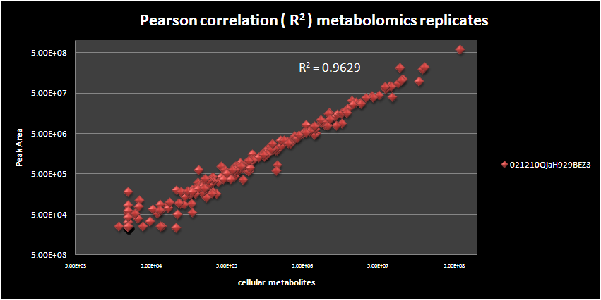
a)
b)
Figure 4. Unsupervised Hierarchical clustering heat map of H929 and 293T cancer cells treated with EGF and Insulin growth factor stimulation. b.) Typical R² values across replicates are 0.95 and higher. CV values of platform are on the order of ~0.12 and the dynamic range is approximately 10⁴.

Slide 5
Figure 5. PCA clustering of polar metabolites from human cancer cells with growth factor stimulation

Slide 6
Figure 6. Serum stimulation of glycolytic intermediates correlated with pAKT signaling. Lower pAKT resulting in reduced glycolysis in multiple myeloma cells.
~10⁴ dynamic range

