Slide 1
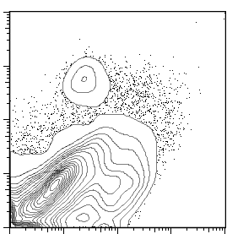
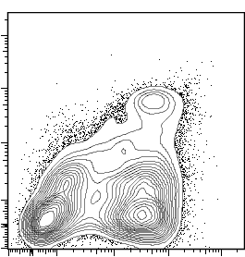
Figure 1: Differential cDC frequency in lung and spleen
Lung
Spleen
cDC
cDC
1.4%
4.8%
CD11c
MHC-II

Slide 2
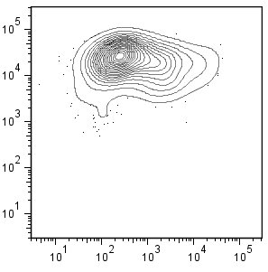
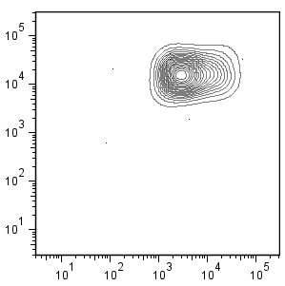
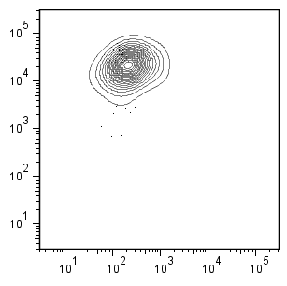
Figure 2: Isolation of cDC from mouse lung
A) After magnetic isolation
72.1%
16.5%
CD11c
Mφ
cDC
MHC-II
B) After cell sorting
CD11c^{hi}/MHC-II^{hi}
96.6%
CD11c
cDC
MHC-II
CD11c^{hi}/MHC-II^{Lo}
94.6%
CD11c
Mφ
MHC-II

