Slide 1
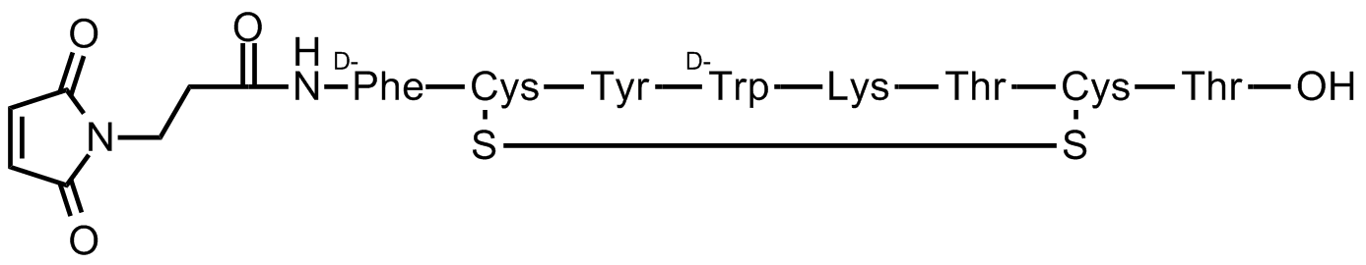
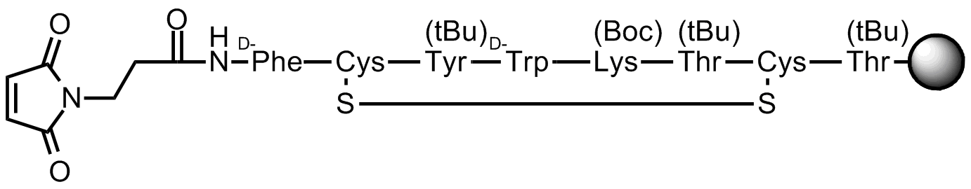
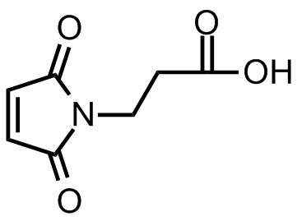
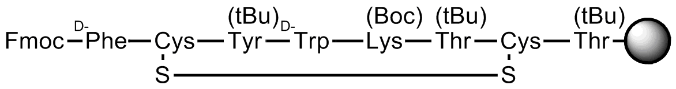
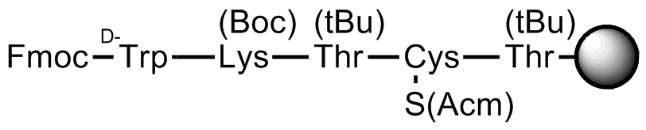
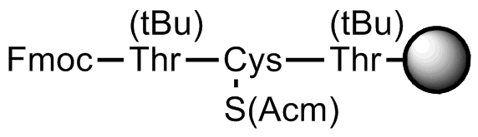
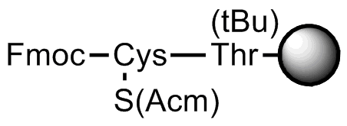
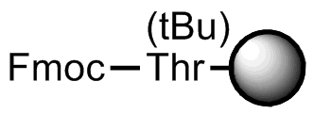
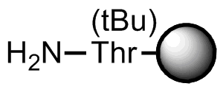
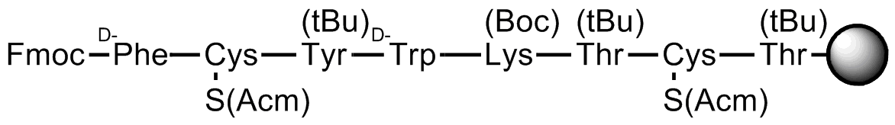
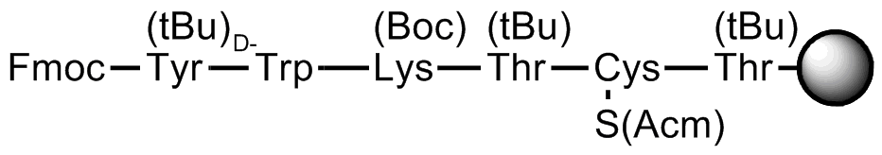
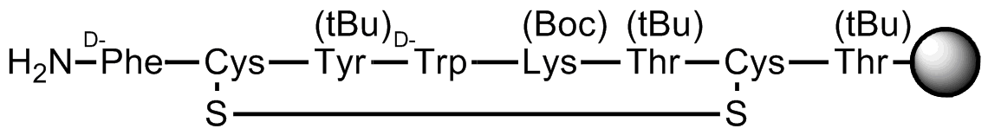
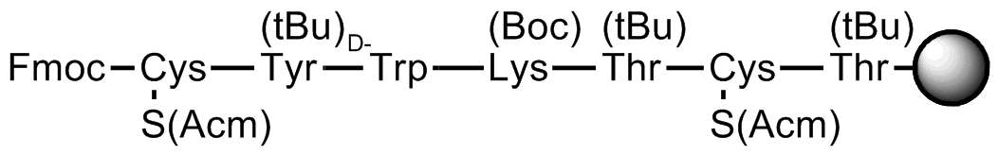
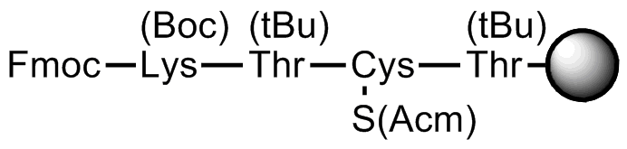
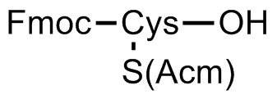
Synthesis of maleimido-Tyr³-octreotate (MI-TATE)
Maleimido (MI)
Tyr³-octreotate (TATE)
1. N-terminal deprotection (piperidine/DMF)
2. Coupling (HBTU/DIPEA/DMF)
3. Repeat
4. Cyclization (Tl(TFA)₃)
5. N-terminal deprotection and coupling
6. Full deprotection and resin cleavage (TFA/H₂O/^{i}Pr₃SiH)

Slide 2
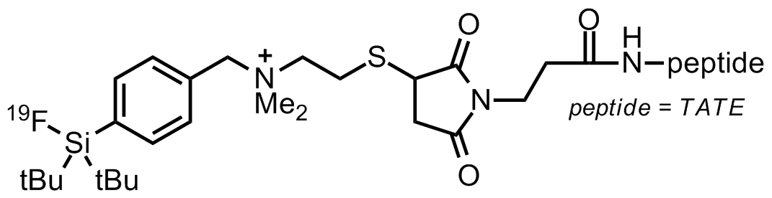

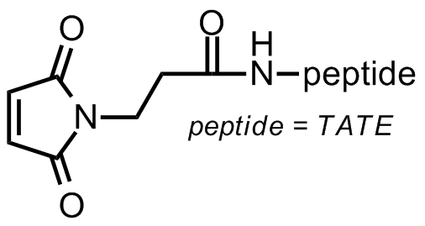
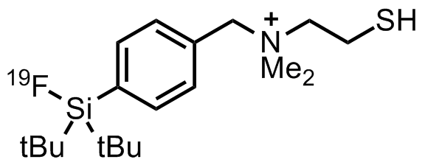
Synthesis of [¹⁸F]SiFA⁺-maleimido-Tyr³-octreotate
([¹⁸F]SiFA⁺-MI-TATE)
SiFA⁺-SH
[¹⁸F]SiFA⁺
MI
TATE
SiFA⁺
¹⁸F-
1. Thiol-maleimido coupling
2. ¹⁸F-¹⁹F isotopic exchange
([¹⁸F]F⁻/K_{2.2.2.}/MeCN, 5 min, 0ºC)

Slide 3
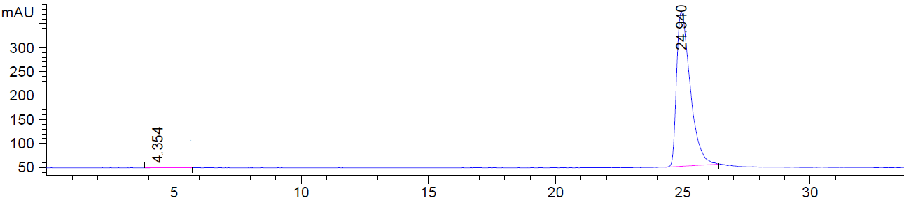
[¹⁸F]SiFA⁺-MI-TATE Quality Control by radio-HPLC
unreacted ¹⁸F⁻
Peak area: 0.4%
[¹⁸F⁻]SiFA⁺-MI-TATE
Peak area: 99.6%

