Slide 1

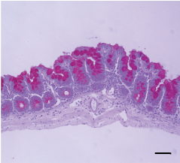
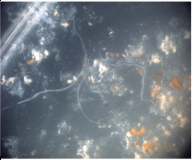
Blood
ELISA
Fecal Pellets
Western Blot
mLN
Re-Stimulate
+
ELISA
21 Days Post Infection
Colon
qPCR
P1
Cecum
Histology
+
Worm Enumeration
P2
P3
Cecum
4% PFA
P4
P5

