Slide 1

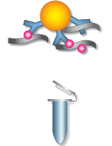
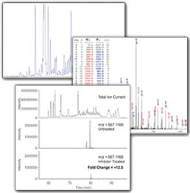
Figure 1
Cell treatment or disease state
Unmodified peptides
Notes:
Remove WB gel and arrow to green blob

Slide 2
Figure 1B
Ser/ Thr Phosphorylation
Tyrosine Phosphorylation
Proteomic Analysis
Acetylation
Ubiquitination

Slide 3
Figure 2
PTMScan® Services:
PhosphoScan®
AcetylScan™
UbiScan™

Slide 4
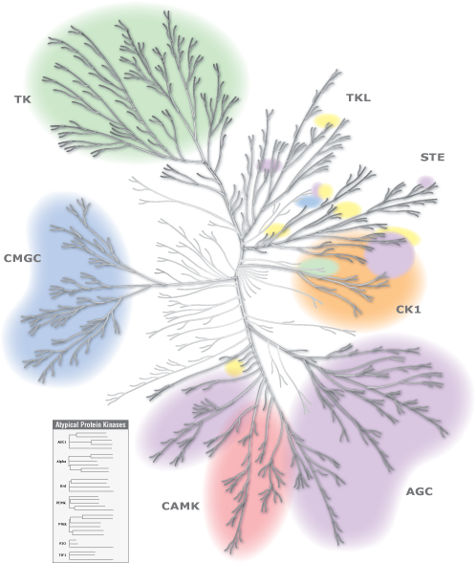
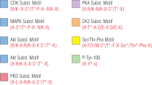
Figure 3A
Notes:
High resolution phosphoscan motif antibodies

Slide 5
PhosphoScan® Motif Antibodies
Figure 3B
Target | Consensus Site
Phospho-Akt Substrate | (R)XRXXpS/pT
Phospho-Akt Substrate | RXRXXpS/pT
Phospho-(Ser/Thr) ATM/ATR Substrate | pS/pTQ
Phospho-(Ser/Thr) ATM/ATR Substrate | pS/pTQG
Phospho-(Ser) CDKs Substrate | K/RpSPXK/R
Phospho-(Thr) CK Substrate | pS/pTD/EXD/E
Phospho-MAPK/CDK Substrates | 10814/10815
Phospho-MAPK Substrates | PXpTP
Phospho-PKA Substrate | 10619/10620
Phospho-(Ser) PKC Substrate | K/RXpSXK/R
Phospho-(Ser/Thr) PKD Substrate | LXRXXpS/pT
Phospho-(Ser/Thr) PDK1 Docking Motif | F/YpS/pTF/Y
Phospho-(Thr) PLK Binding Motif A7907 | SpTP
Phospho-Thr-Pro Motif | pTP
Phospho-Thr-Pro-Glu Motif | pTPE
Phospho-Thr-X-Arg Motif | pTXR
Phosphotyrosine (P-Tyr-100) | pY

Slide 6
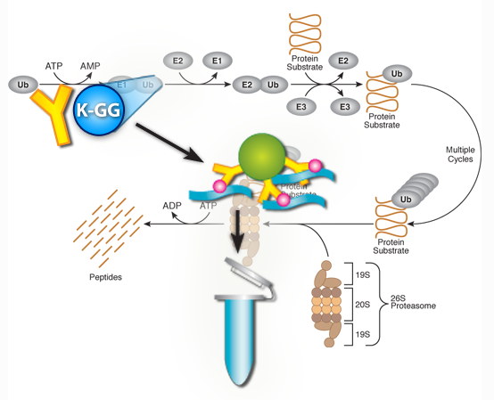
Figure 4
UbiScan™

Slide 7
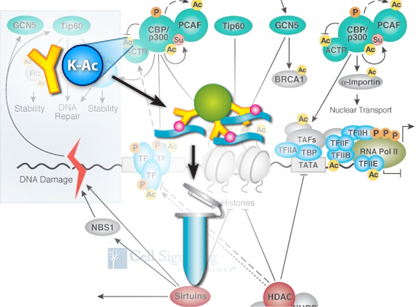
Figure 5
AcetylScan™

Slide 8
Figure 6
PTMScan® Service Offering:
KinomeView™
PhosphoScan®
Serine / Threonine Phosphorylation Events

Slide 9
Figure 7 has been deleted, please use image from figure 7B instead
Notes:
Don’t need this one

Slide 10
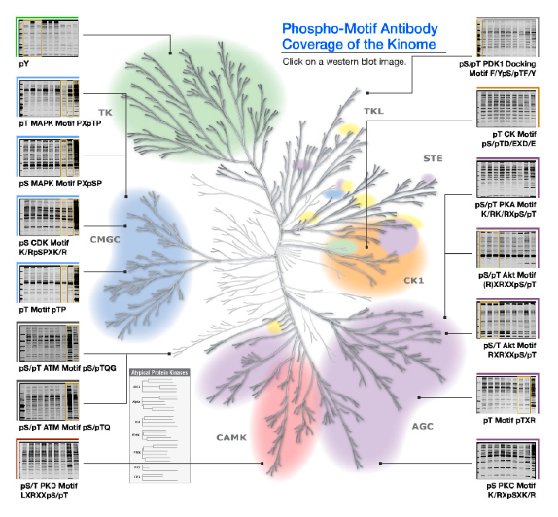
Figure 7B
Notes:
High resolution kinome tree

Slide 11
Figure 7C

Slide 12
Figure 8
Scientist from CST talking on the phone and taking notes

Slide 13
Figure 9
Video imagery from LI-COR machine and someone working with it
Show full page phospho-motif coverage of kinome tree. Show KinomeView westerns of pS/T Akt Motif, pS MAPK Motif, pT MAPK Motif, and pS/T PKA Motif
http://www.cellsignal.com/services/kinomeview.html

Slide 14
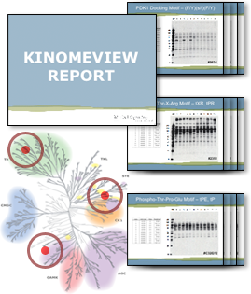
Figure 10
Notes:
High resolution image

Slide 15
Figure 11
Step 2: PhosphoScan®

Slide 16
Figure 12
Video image of mass spec machine and someone working with samples

Slide 17
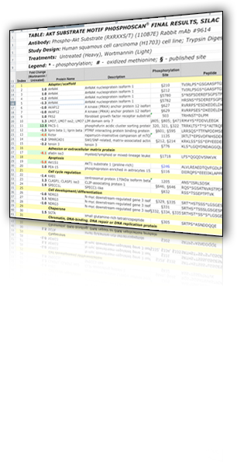
Figure 13
Video images of a conference room with scientists discussing the report and:
Notes:
High resolution if possible

Slide 18
Figure 14A
Akt-RSK-S6 kinase signaling networks activated by oncogenic
receptor tyrosine kinases.
Moritz A, Li Y, Guo A, Villén J, Wang Y, MacNeill J, Kornhauser J, Sprott K,
Zhou J, Possemato A, Ren JM, Hornbeck P, Cantley LC, Gygi SP, Rush J, Comb MJ.
Cell Signaling Technology Inc., Danvers, MA 01923, USA.
Science Signaling. 2010 Aug 24;3(136):ra64.

Slide 19
Figure 14B has been deleted; please refer to figure 14A

Slide 20
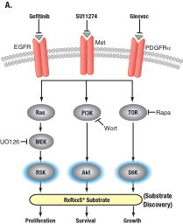
Figure 14C (fig 2A of the paper)

Slide 21
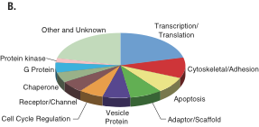
Figure 15 (fig 3B of paper)

Slide 22
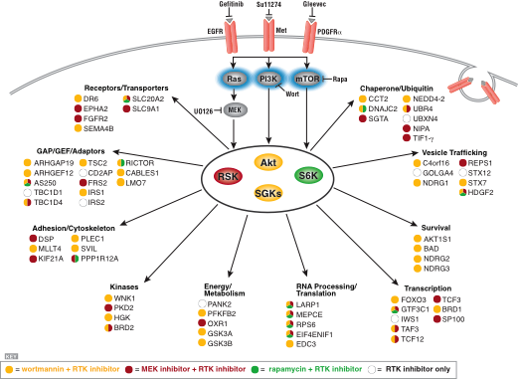
Figure 16 (Fig 5 of paper)

Slide 23
Figure 17
Using Excel table (Akt9614-1.xls) from this study

Slide 24
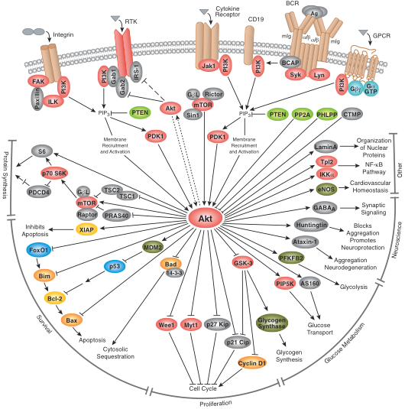
Figure 18

