Slide 1
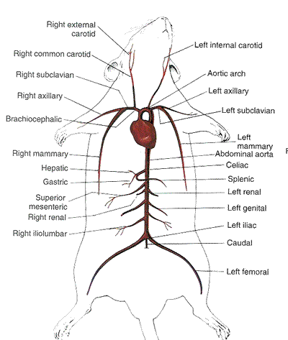
Figure 1A

Slide 2
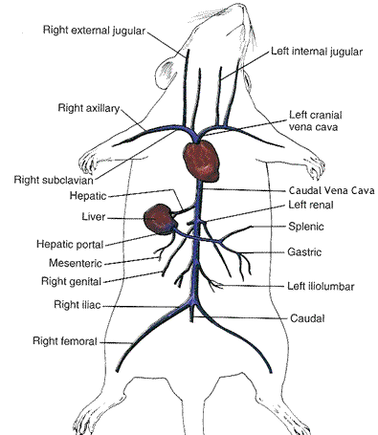
Figure 1B

Slide 3
Figure 2A
Pump 1 - Insulin
Y-Conncetor
8cm
Blood Sample
8cm
15cm
20cm
Pump 2 – D50
Vein
Artery

Slide 4
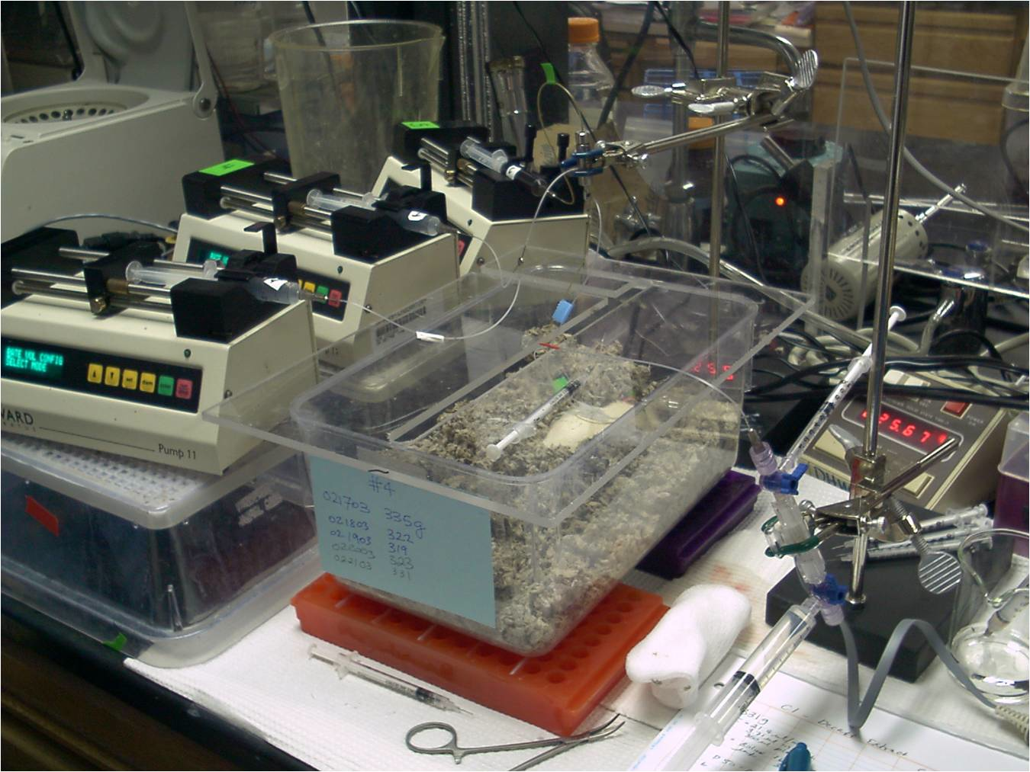
Figure 2B

Slide 5
Figure 3
6
C
E
A
Blood Glucose (mM)
5
“Clamped”
F
D
4
B
Time (min)
Graph | Time (min) | Glucose (mM) | GIR (ul/min) | Time of Change (min) | Notes
A | 0 | 5 | 0 | - | Start of experiment. Insulin infusion started at Time 0.
B | 5 | 4 | 4 | 6 | Glucose infused to counter drop resulting from insulin infusion
C | 10 | 5.8 | 2 | 11 | Blood glucose too high, lower glucose infusion rate
D | 15 | 4.5 | 3 | 16 | Blood glucose too low, increase glucose infusion rate
E | 20 | 5.3 | 2.5 | 21 | Blood glucose slightly high, lower glucose infusion rate between 2 and 3ul/min.
F | 25 | 4.8 | 2.75 | 26 | Blood glucose slightly low, increase glucose infusion rate between 2.5 and 3ul/min.

Slide 6
Figure 4
A
8
Chow Fed
High Fat Fed
6
Blood Glucose (mM)
4
2
0
0
10
20
30
B
200
Chow Fed
High Fat Fed
150
Glucose Infusion Rate
(umol/kg/min)
100
50
0
0
10
20
30
Time (min)

