Slide 1
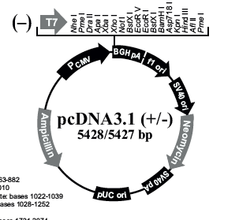
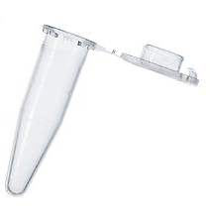
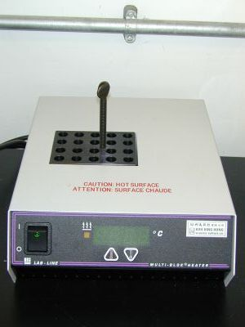
Schematic 2
B
site-directed mutagenesis
A
GIRK2
annealing
+
mutant primers
DpnI digest
PCR - extension
C
transform bacteria
parent wt strand
mutant strand
parent wt strand
mutant strand
pcr DNA
D
plate bacteria
heat shock
+Amp
incubate 37°
+Amp
LB agar plates

Slide 2
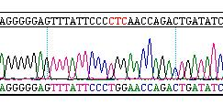
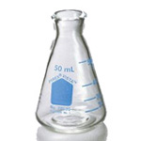
E
F
mini-prep DNA isolation
+Amp
incubate 37°
DNA sequencing
pick colonies
grow in LB + Amp
G
maxi-prep DNA isolation
CTC → TGG
incubate 37°
Leu → Trp
grow in LB + Amp

