Slide 1
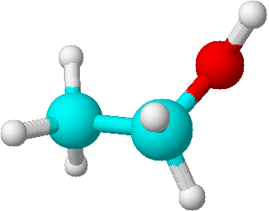
P1
P2
K⁺
K⁺
K⁺
M2R
GIRK
carbachol
Closed
Open
α_{i/o}
βγ
gate
α_{i/o}
βγ
alcohol
K⁺
K⁺
G protein

Slide 2
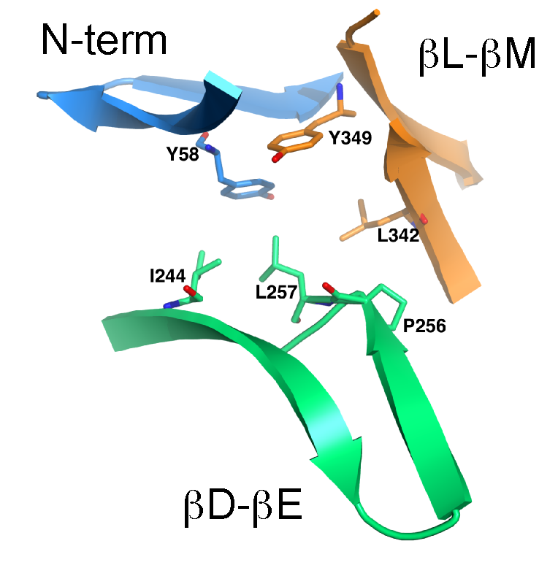
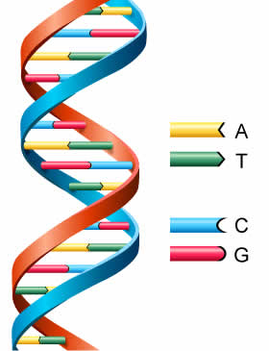
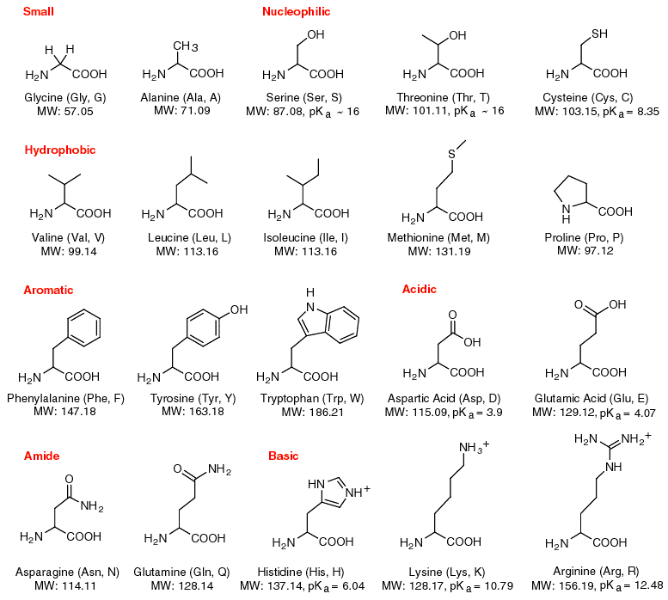
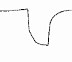
P3
GIRK2 structure
Site-directed mutagenesis
Leucine
Tryptophan
GIRK2-L257
GIRK2-L257W
P4
GIRK currents
transfect cDNA in HEK293
GIRK2-L257W
Whole-cell patch-clamp
electrophysiology
YFP
M2R

Slide 3
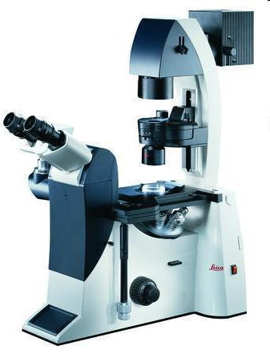
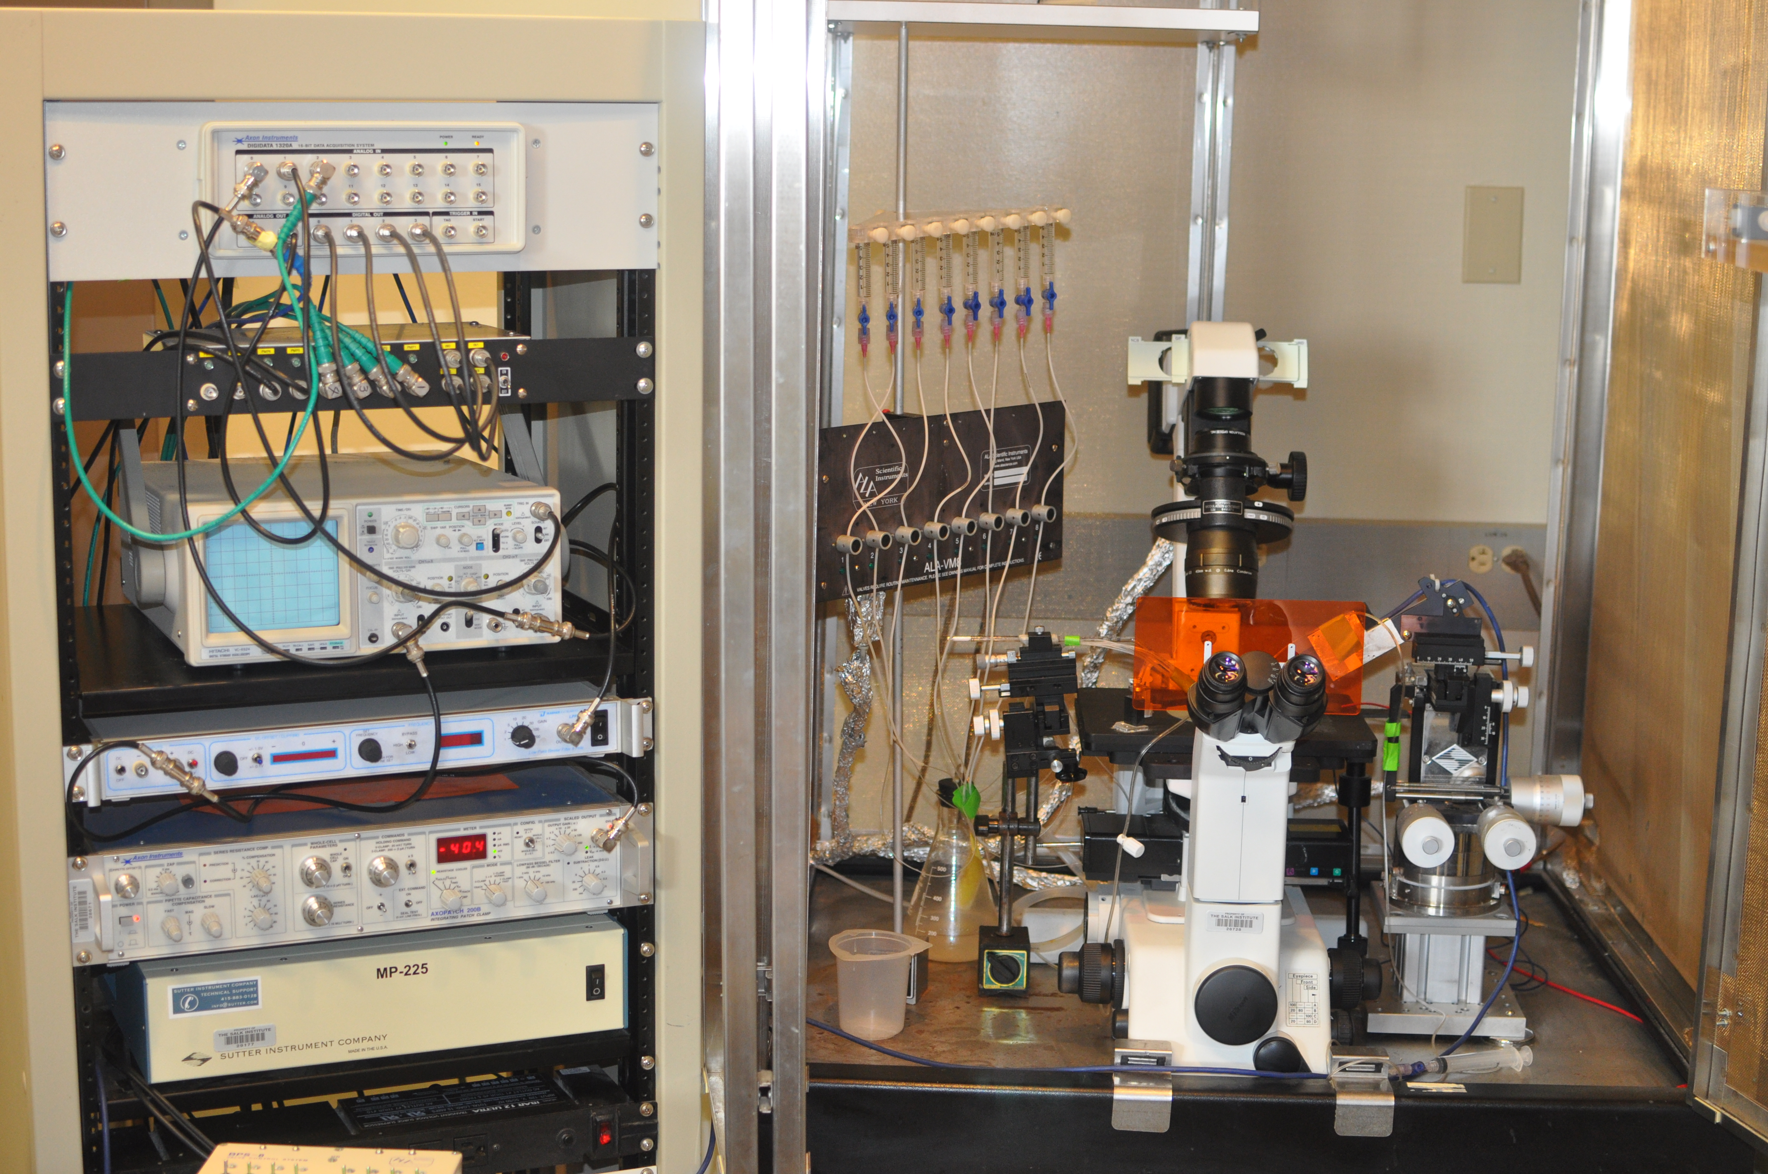
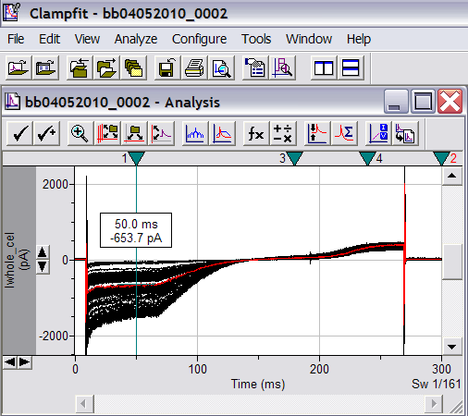
P5
P6

