Slide 1
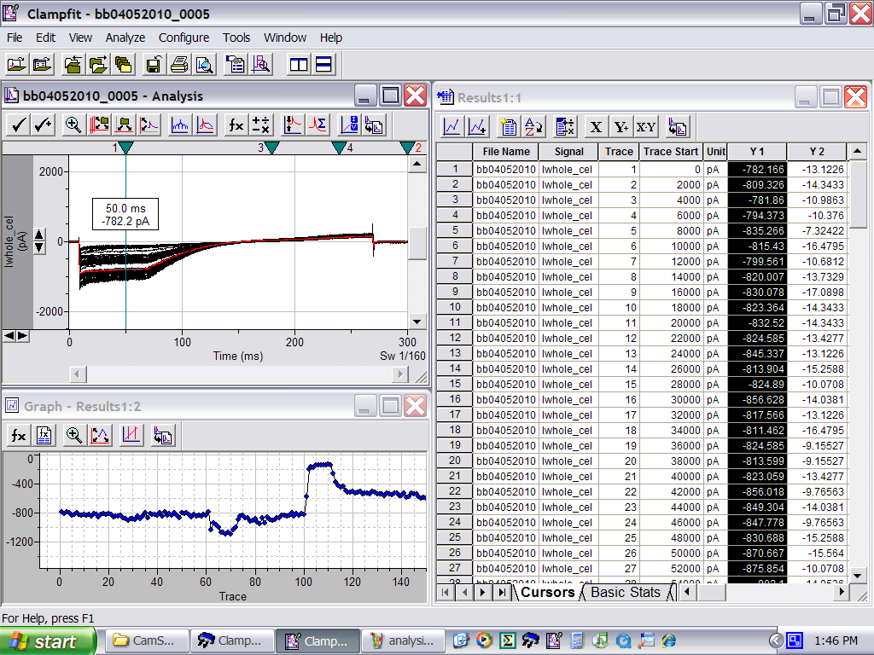
mutant recording – GIRK2L257W
GIRK2 L257W
Carb
EtOH
Ba²⁺
20K

