Slide 1
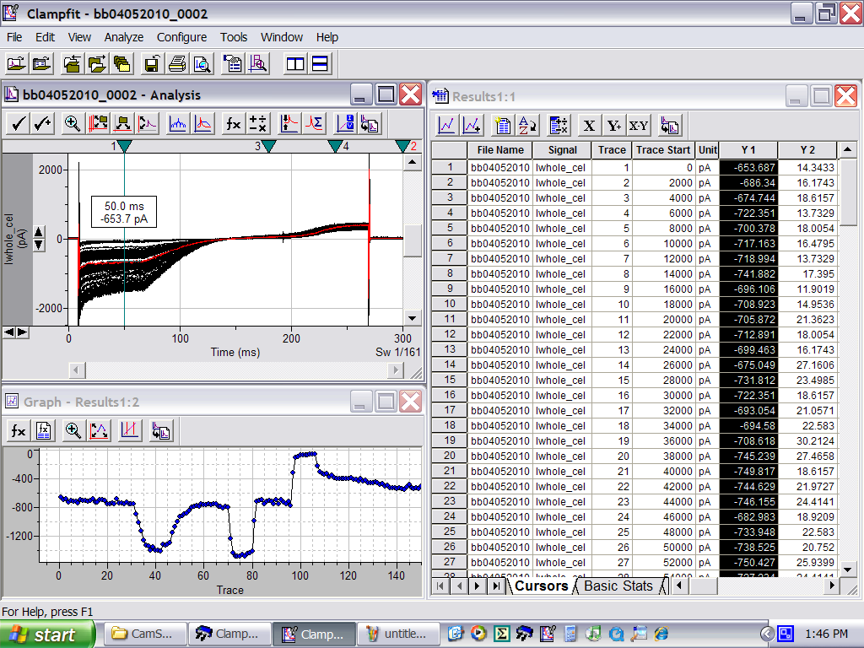
GIRK2 wild-type recording
GIRK2 wt
Carb
EtOH
Ba²⁺
20K

