Slide 1
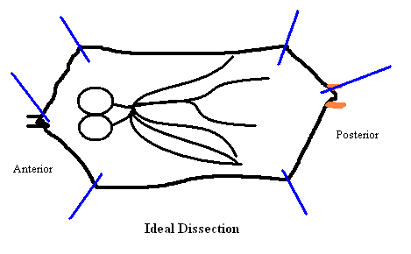
Cell Body
Neuron
Axon Terminal
Axon
Axonal Transport
Microtubule Tracts
Wandering 3rd Instar Larvae
Petri dish
-
Vesicles
+
Dynein
Kinesin
P1.
P2.
100x
Cover slip
Gel cube
P3.
P3.

