Slide 1
Patient Background
Patient is a 24-month-old male who was born with bladder exstrophy. He had a failed closure in Israel and as a result came to United States to the Johns Hopkins Hospital in order to undergo re-closure of his exstrophic bladder.

Slide 2
HPI
History of Present Illness:
The patient is a 24-month-old male with bladder exstrophy and urethral anomalies. The patient is here for a definitive surgery.
Past Surgical History: Includes bladder repair two years ago, and bilateral hernia repairs 18-22 months ago.
Past Medical History: He was 38 weeks' gestation, no health problems during the delivery, he was head first. He has continued to meet all of his milestones, first sat at 7 months, crawled at 7 months, walked at 14 months, and he said his first words at 16 months. He has had no other surgery that are reported. He had no developmental delays.
Social History: He is not currently in school. He lives with his parents. He also has a 14-year-old, an 11-year-old brother, and a 5-year-old sister.
Family History: His family history appears to be noncontributory.
Review of Systems: His complete review of systems is negative at this point.
Medications:
He is not currently taking any medications.
Allergies:
He has no known drug allergies.

Slide 3
Physical Exam
On physical examination, the patient is 34 inches tall and weighs 26.2 pounds. On evaluation, he has a full and equal flexion of bilateral hips to approximately 120 degrees. He has external rotation of approximately 50 degrees. On examination of his hips, he has small incisions where his hernia repairs were performed. He is noted to have exstrophy at the midline of the skin. On evaluation of his gait, he has a mild pes planus that is noted. His hips appear to be well located at this point.

Slide 4
Op Note
Title of Operation:
Bilateral anterior and posterior iliac osteotomies (27146) x4.
Application external fixator bilaterally (20692-50).
Indications for Surgery:
Brief Clinical History: The patient has classic exstrophy. Dr. Gearhart wants to perform a reconstruction and requested osteotomies.
Preoperative Diagnosis:
Exstrophy, classic.
Postoperative Diagnosis:
same
Anesthesia:
general
Specimen (Bacteriological, Pathological or other):
None.
Prosthetic Device/Implant:
External fixators.

Slide 5
Op Note
Procedure: The patient was taken after giving general anesthetic in supine position. He was given a tunneled epidural, arterial line, central line, and peripheral line. The lower half of the body was prepped and draped in a sterile fashion. Bilateral transverse inguinal incisions were made in a skin lines. The lateral femoral cutaneous nerve was identified and protected. Tensor-sartorius interval was identified. Subperiosteal exposure of the ilium was carried out, first on the left and then on the right side.
A Gigli saw was passed around the sciatic notch, first on the right side. Osteotomy was then done transversely, so that it was complete. Then a second osteotomy was done vertically just lateral to the SI joint, so that it was closed down. This was done using a rongeur and an osteotome. The wound was irrigated. 4-mm external fixator pins were placed with 2 in the inferior fragment, one in the superior fragment on each side. Bone graft was applied. The wound was closed using #1 pop-offs for the fascia lata, 2-0 for subcutaneous, and 4-0 for the skin.
The same procedure was then performed on the right side. Fluoroscopy was used to verify pin placement and mobility.
The urological procedure was then performed performed.
Following this, the external fixator was affixed and the patient was placed, given sterile dressing, and was placed in bilateral longitudinal skin traction. He was awakened and taken to the PACU in stable condition.
Complications: No complications.
Estimated Blood Loss: 100 cubic centimeters.

Slide 6
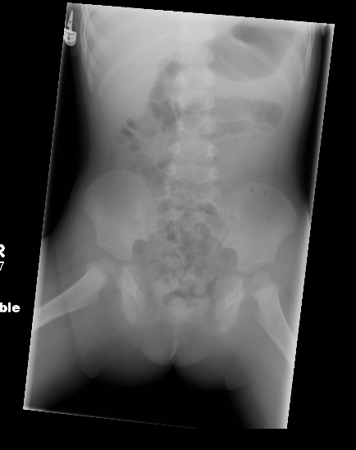
AP Abdominal Radiograph 2 months pre-op
IMPRESSION:
There is approximately 4.5 cm diastasis of pubic symphysis. Few
air-filled loops of bowel without distention. Air filled stomach
compatible with aerophagia. Otherwise unremarkable.

Slide 7
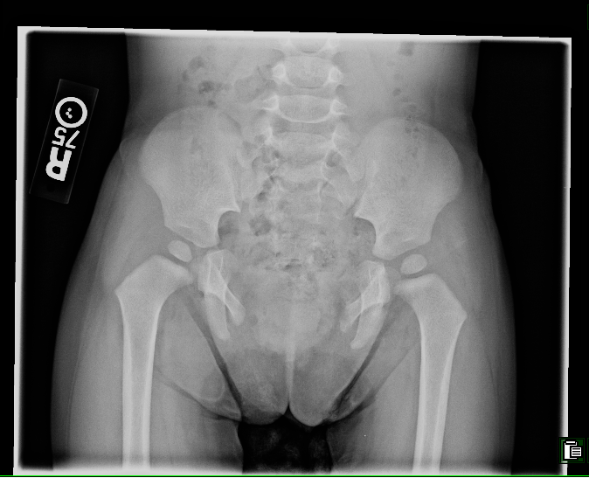
1- day Pre-Op AP Pelvic Radiograph
Indication: Preop exstrophy of the bladder.
Result: AP pelvis: Wide separation of the symphysis pubis compatible with
skeletal deformity accompanying extrophy of the urinary bladder.

Slide 8
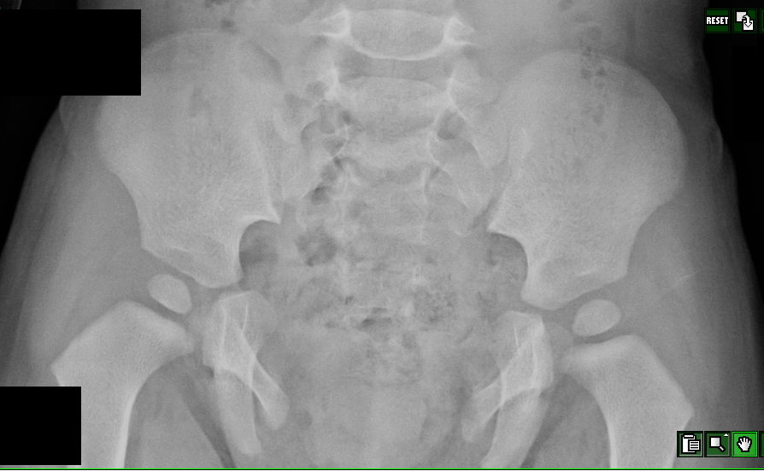
Zoom of previous

Slide 9
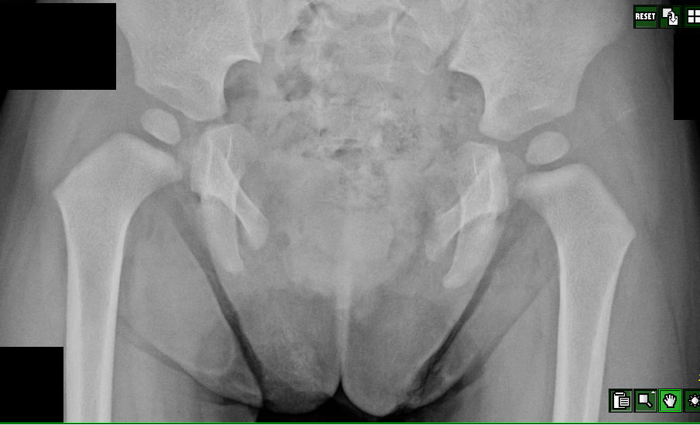
Zoom of previous, continued

Slide 10
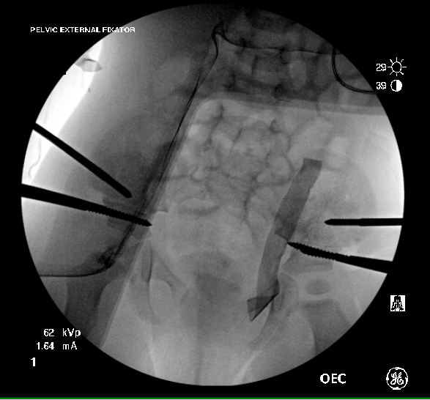
Pelvis, fluoroscopic view, intra-op
Intraoperative examination for repair of bladder exstrophy. External
fixation device securing bilateral iliac osteotomies. Surgical sponge overlying operative field. Widened separation of the pubic symphysis,
unchanged in appearance since prior preoperative exam one day previous (see above slides).

Slide 11
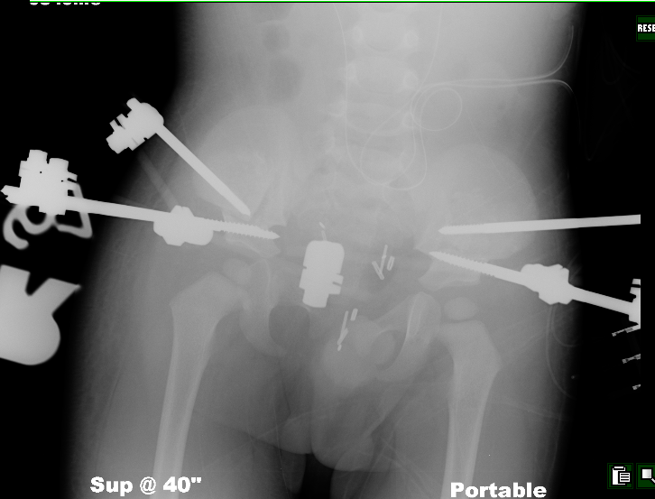
AP Pelvic Radiograph Post-Op Day #4
Supraacetabular
osteotomies are fixed
by external fixation
devices.
Interval decreased
separation of the
symphysis pubis is
noted with
multiple surgical
staples overlying the
pelvis. Stents overlie
the region of both
ureters.

Slide 12
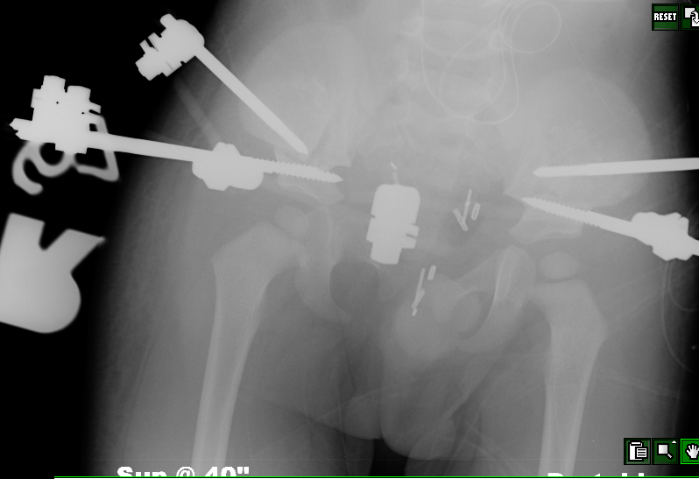
Zoom of previous

Slide 13
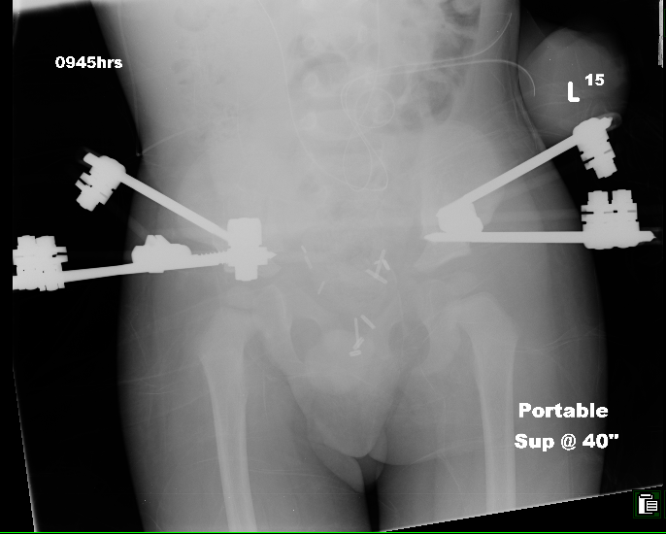
AP Pelvic Radiograph Post-Op Day #14
Status post bilateral iliac osteotomies.
Comparison is made with the prior image from Post-Op Day #4.
IMPRESSION:
Bilateral iliac osteotomies with external fixators once again noted.
Interval appearance of radiodense material overlying the left iliac
osteotomy. Surgical clips in the pelvis appear unchanged. Bilateral
femoral heads are well seated. Bilateral ureteral stents are
incompletely included on the image

Slide 14
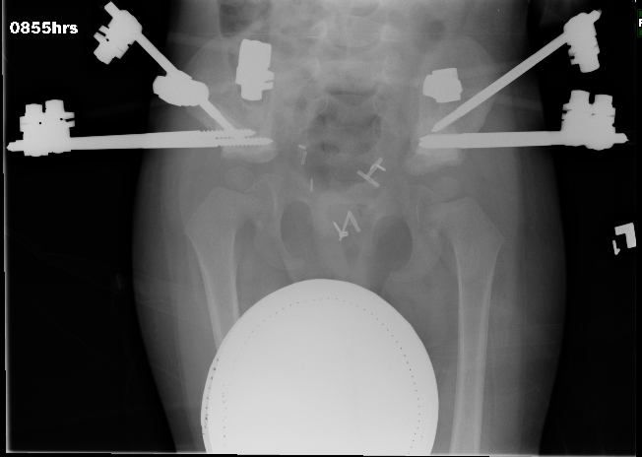
AP Pelvic Radiograph, 5 wks post-op
RESULT:
Indication: Follow up pelvic osteotomy.
AP pelvis, 0855 hrs: Comparison is made with a prior exam of 4/21/09.
Osteotomy lines are no longer clearly distinct . All orthopedic pins are
unchanged in orientation. The hips remain normally articulated.
Nephroureteral stents have been removed.
IMPRESSION:
Evidence of interval bony healing.

Slide 15
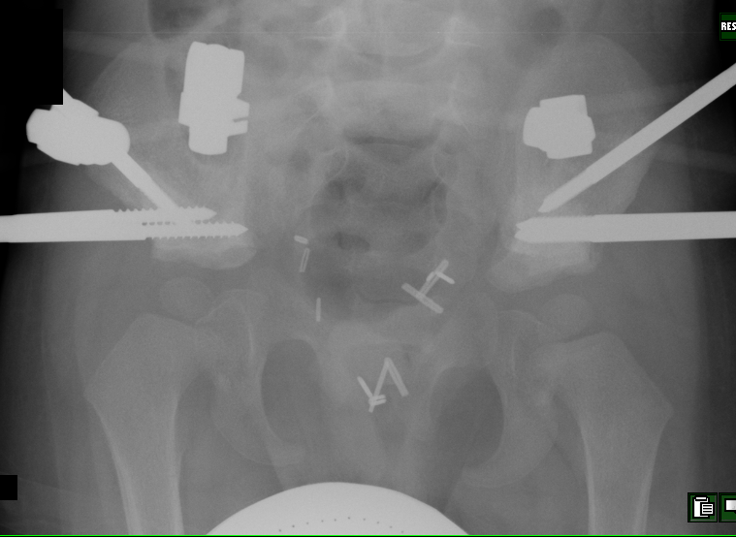
Zoom of previous

