Slide 1
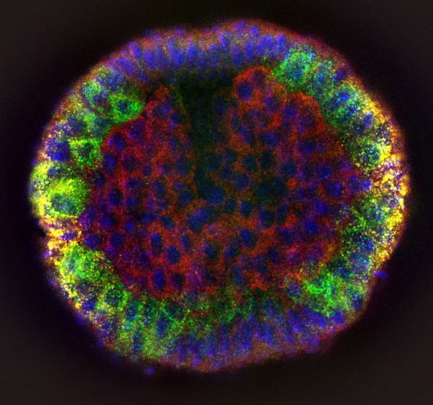
The overall goal of the following experiment is to obtain coronal viewing images of intact Drosophila embryos using Confocal microscopy that can be used to precisely measure embryo size and quantify protein and RNA expression levels (Intro).

Slide 2
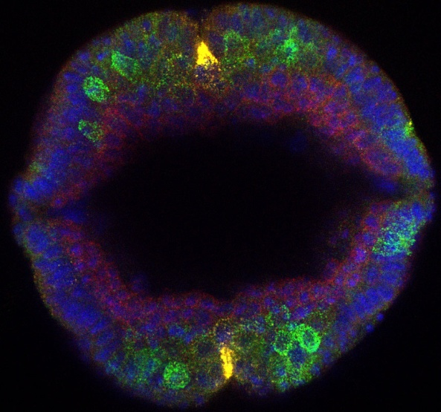
The overall goal of the following experiment is to obtain coronal viewing images of intact Drosophila embryos using Confocal microscopy that can be used to precisely measure embryo size and quantify protein and RNA expression levels (Intro).

Slide 3
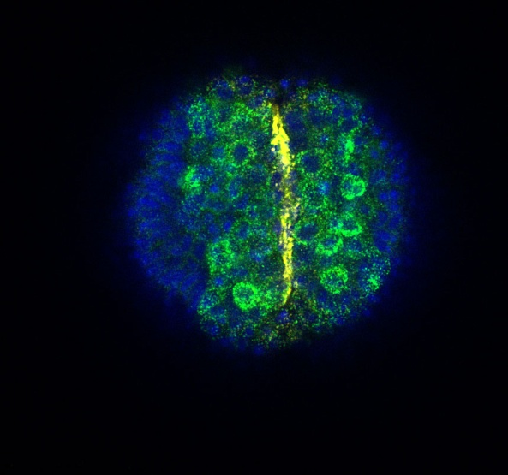
The overall goal of the following experiment is to obtain coronal viewing images of intact Drosophila embryos using Confocal microscopy that can be used to precisely measure embryo size and quantify protein and RNA expression levels (Intro).

Slide 4
This is achieved by using a mounting media of gelatinous consistency to encase embryos within it and position them upright (P1).

Slide 5
This is achieved by using a mounting media of gelatinous consistency to encase embryos within it and position them upright (P1).

Slide 6
As a first step, the embryos are aligned over a thin layer of glycerin jelly, and then covered with a second layer of this media (P2).

Slide 7
As a first step, the embryos are aligned over a thin layer of glycerin jelly, and then covered with a second layer of this media (P2).

Slide 8
Next, the mounting media containing the embryos is cut into blocks, which can be flipped vertically to hold the embryos in position for imaging (P3).

Slide 9
Results are obtained that show cross-section images visualized with any sort of Confocal microscope (P4).

