Slide 1


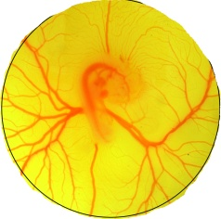




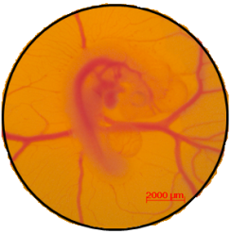
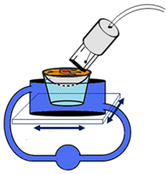
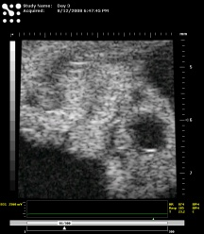
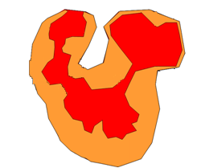

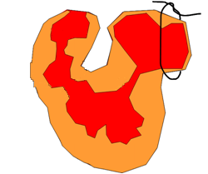
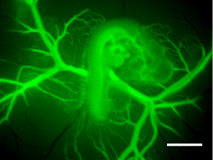
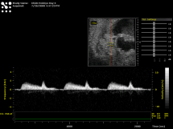

Ex-ovo embryonic cultures
Egg Incubator
2mm
Temp: 37.5ºC
Humidity: ~60%
72 hours
< 5 minutes
Selected Applications:
Microvasculature injection
Ultrasonography
Microsurgical procedures
Day 3:
B-mode
Left Atrial Ligation
2mm
Atria
Atria
Ventricle
Ventricle
5mm
Pulse Wave Doppler
Post Injection
Translational Stage
37.5ºC
Atrioventricular Cushions

