Slide 1
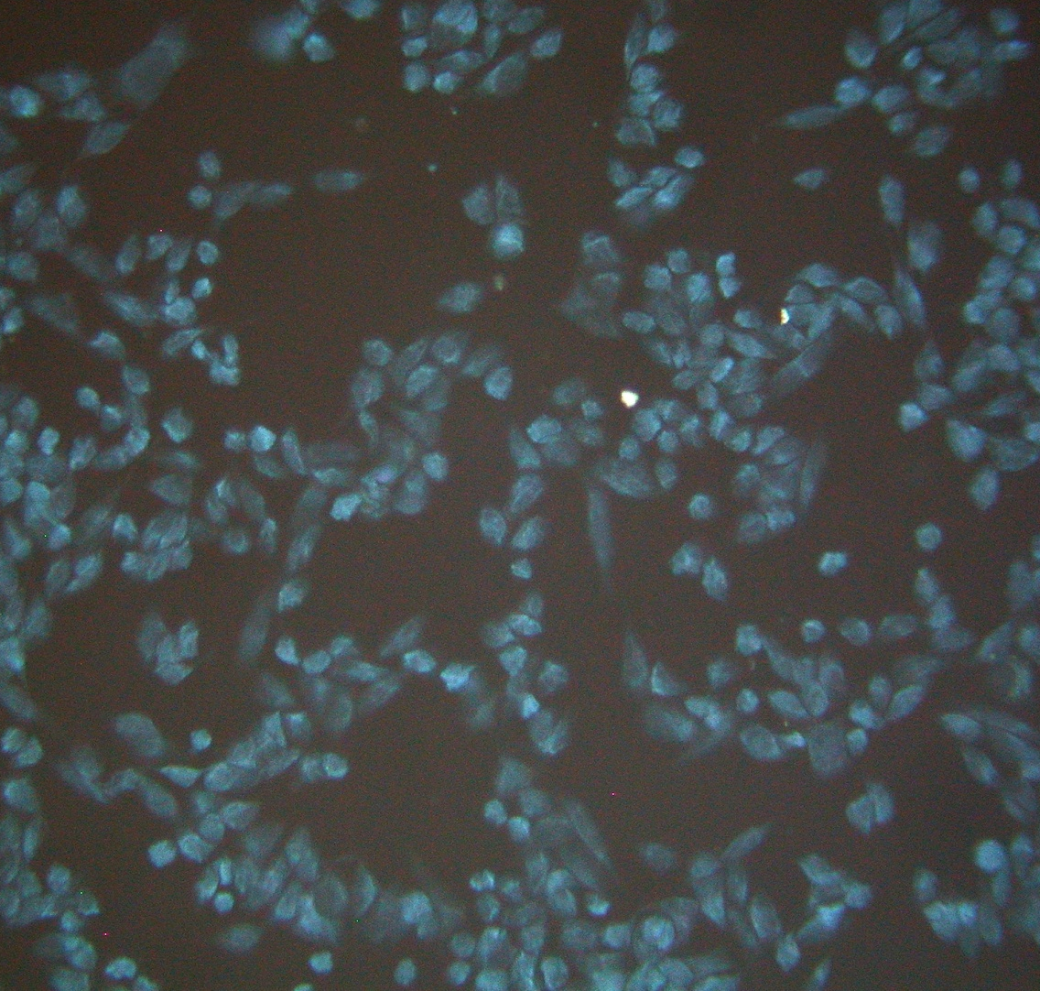
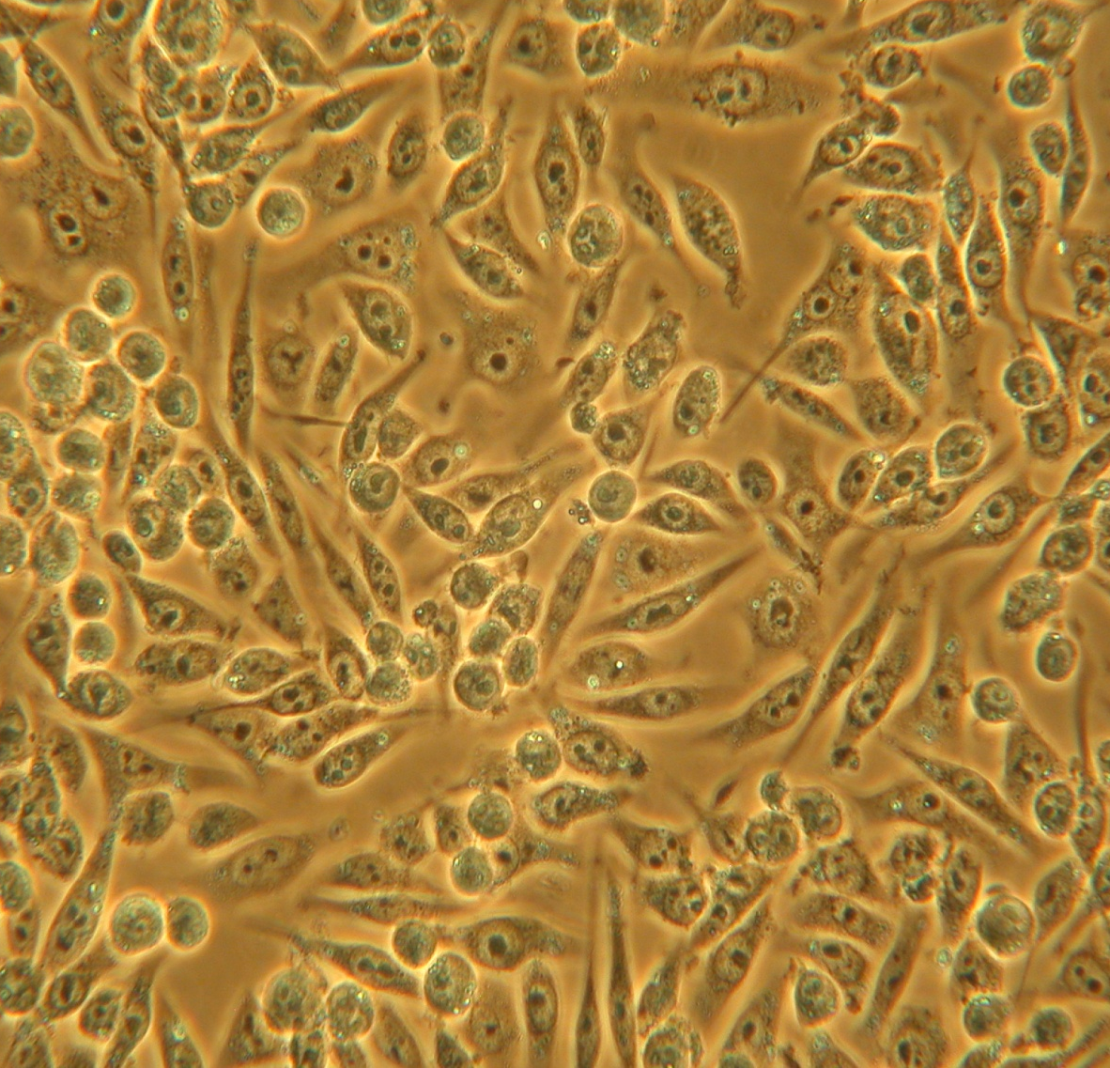
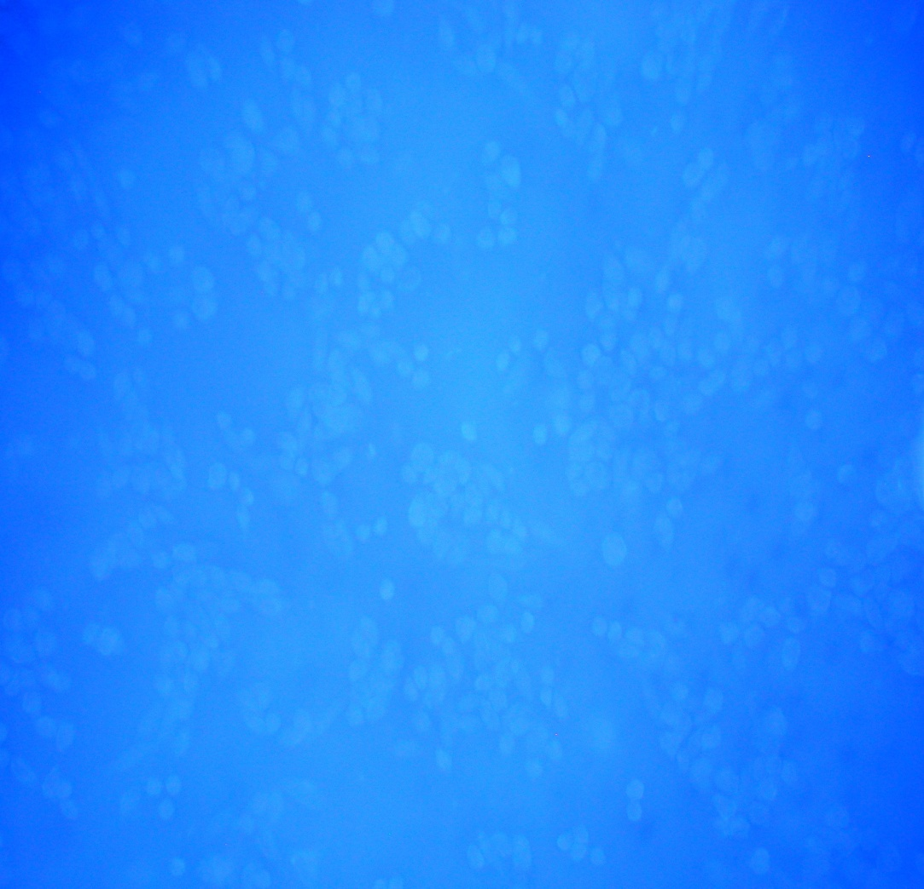
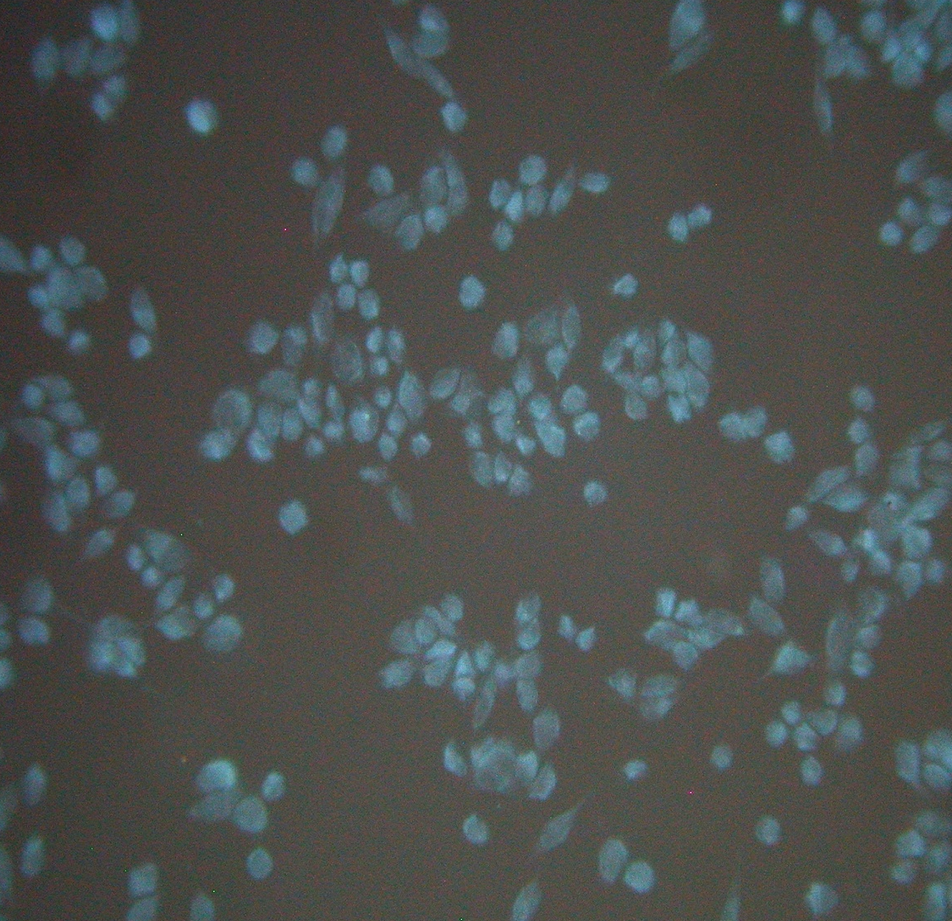
The Sialidase Assay Protocol
Cells cultured overnight (24-well plate) on glass coverslips
Negative
4-MU
Inhibitor + Ligand
Positive
4-MU
Ligand
Control
4-MU
Phase Contrast
Mounting media+4-MU+Treatment
Epi-fluorescent Images at 450nm (blue) – 40X
Notes:
4-mu = 4-methylumbelliferyl-N-acetyl-neuraminic acid
4/18/2010
1

