Slide 1
Morpholino-based gene knockdown
A morpholino oligomer mediates a block to gene
expression during embryogenesis
  A morpholino specific for any gene is injected into fertilized eggs
  Morpholinos can block translation or splicing
  The approach can be used to target multiple genes simultaneously
X
ATG
morpholino
exon1
exon2
morpholino

Slide 2
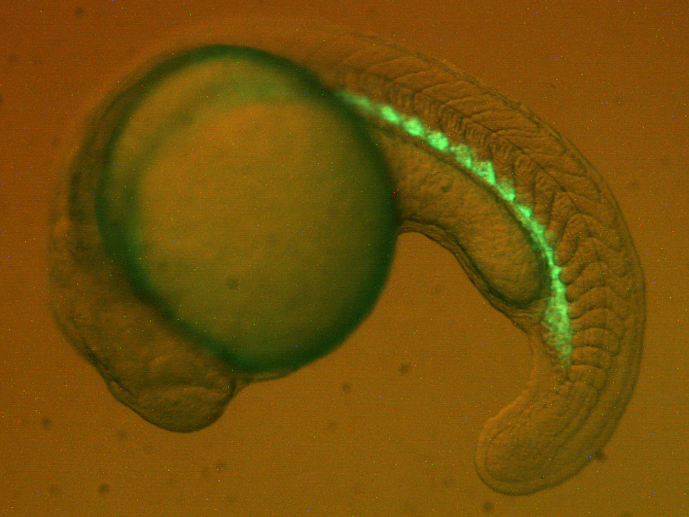
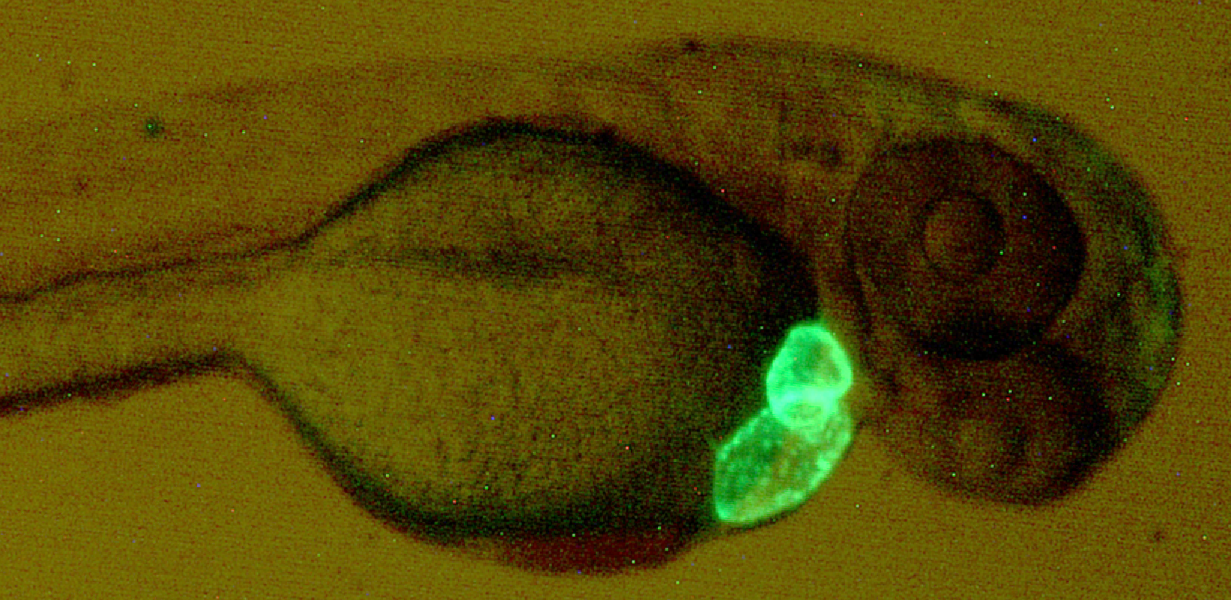
Visualizing organ development in the zebrafish model system
Transgenic reporter fish are used for visualizing organ development
Shown are reporter fish that express GFP in the emerging hematopoietic system (gata1:gfp, left) and the looping heart tube (cmlc2:gfp, right).

Slide 3
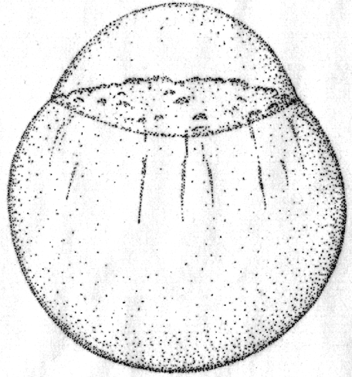
Targeting two genes in the same embryo
Gene 1
Gene 2
Morpholino 1
Morpholino 2
Morpholino 1
+
Morpholino 2

Slide 4
Evaluating the double morphant phenotype
Wildtype embryos have a green
GFP+ heart tube
Gata5+6 double morphants lack
GFP+ cardiomyocytes and are “heartless”

Slide 5
Molecular comparison of phenotypes
Wild
Type
Gata4 Morphant
Gata5 Morphant
Gata6 Morphant
Gata4+5 Morphant
Gata4+6
Morphants
Gata5+6 Morphant
In situ hybridization for nkx2.5 shows a complete loss of cardiac
progenitors in the Gata5+6 double morphants

