Slide 1
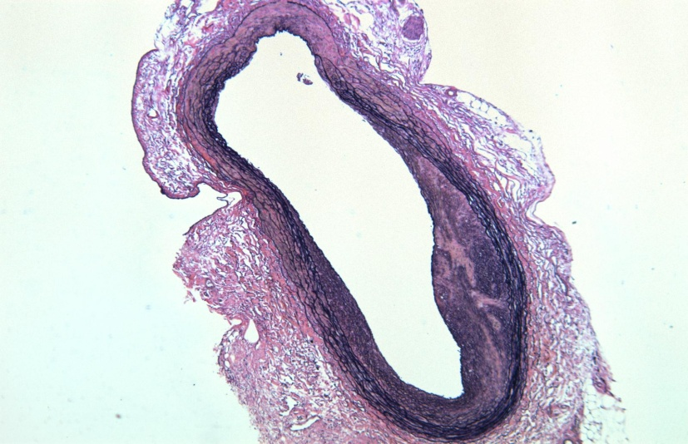
Histology (H+E-staining)
PVG ACI aortic transplantation after 120d
50x

Slide 2
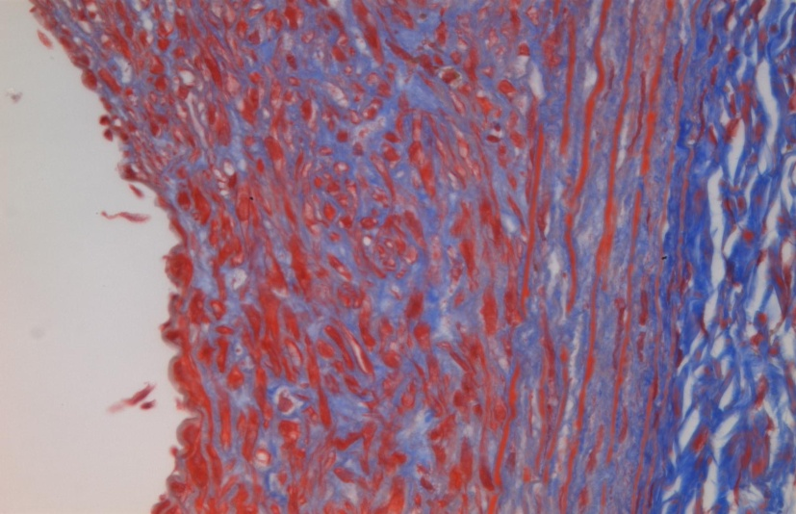
Histology (trichrome-staining)
PVG ACI aortic transplantation after 120d
400x

