Slide 1
Kramer, Revisions 10.16.09
Schematic Overview (Step 2.5-2.6) (see slide)
Step 2.3: Script is discussing embryo collection chamber and video could highlight it. (see slide)
Timing of Representative EM Data (see slide)
Step 2.6: Bree should have said “Late Stage 16 Embryos,” instead of “16 Late Stage Embryos”
Middle Initials Missing: Sunita G. Kramer
Nadine H. Soplop
***Please note that Sunita Kramer might have revisions regarding acknowledgements and references after speaking with Aaron Kolski-Andreaco.

Slide 2
M3: Step 2.5-2.6: Modify sequence of events
“When finished, embryos are removed from the fixation solution
and hand de-viltellinized while attached to
double-sided tape in a petri dish containing
buffer.”
(*Adding embryos to double stick tape)
(*Embryos Stuck to double stick tape)
(*Buffer is added)

Slide 3
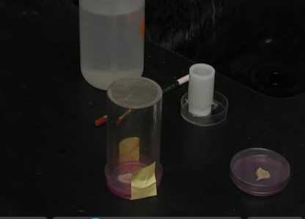
Step 2.3: “To collect 0-20 hour embryos, use an embryo collection chamber, which is a small basket with a removable mesh insert.”
(*This part could highlight the embryo collection chamber, see arrow)
Step 2.3: “Begin by recovering the grape juice plate containing the embryos and remove any dead flies. Then…”
(*This part is fine.)

Slide 4
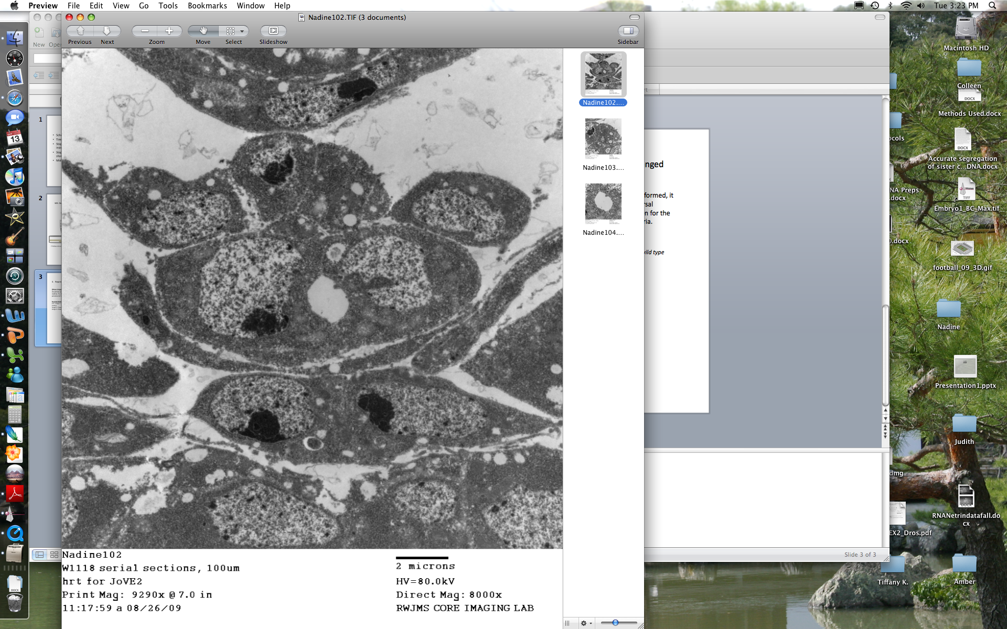
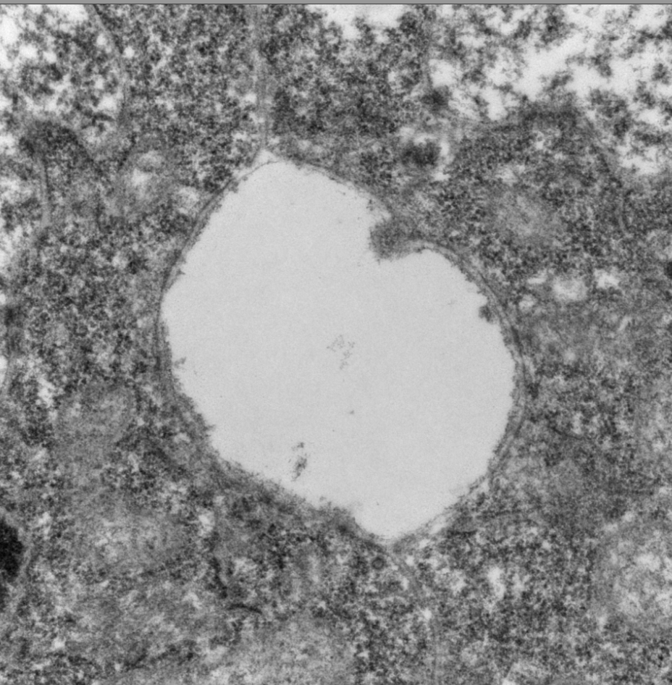
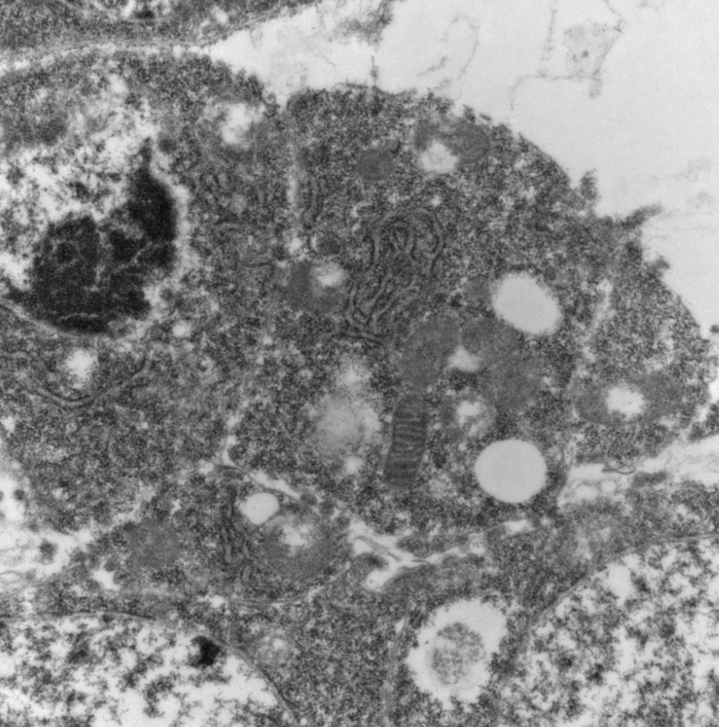
3. Representative Electron Microscopy Data: Timing of pictures and highlighting features
(Show Image 1) In order to determine whether the sectioning depth and staging were properly performed, it should be apparent that a mature heart lumen has formed between the two cardioblasts at the dorsal midline.
(Show Image 2) To determine whether cell membranes are intact, examine the heart lumen for the presence of extracellular matrix, and
(Show Image 3) look for the presence of cristae in mitochondria.

