Slide 1
Figure 1

Slide 2
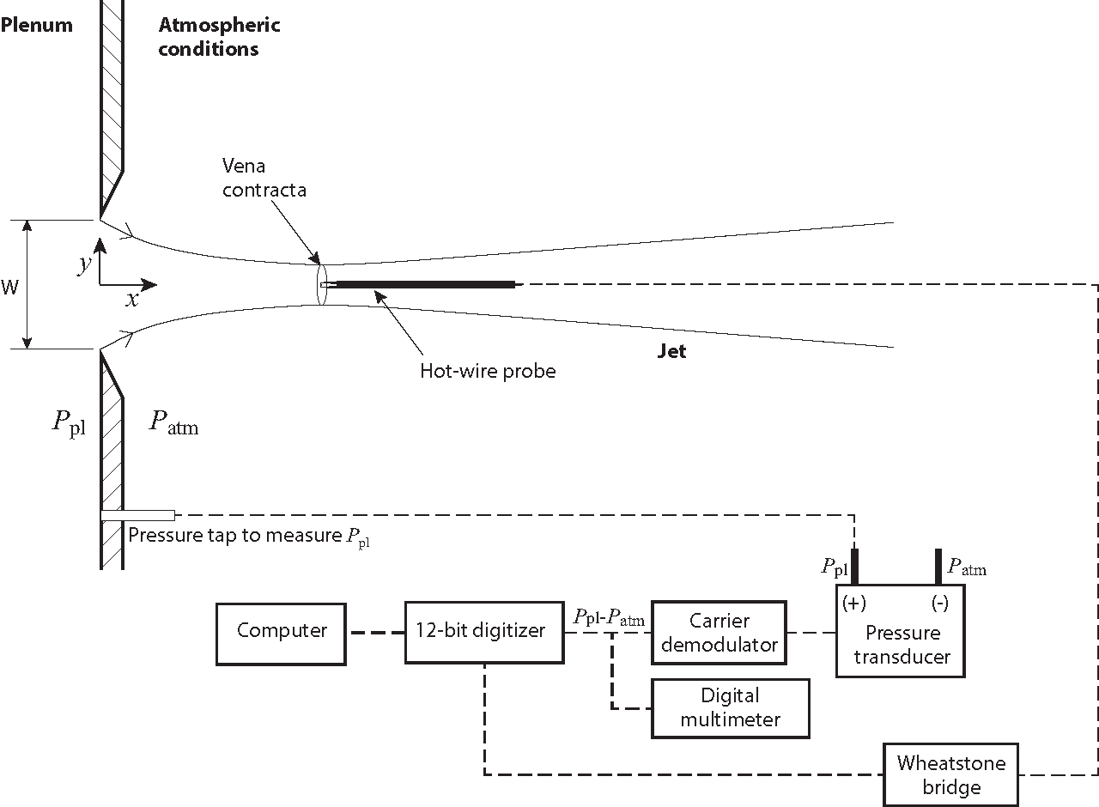
Figure 2

Slide 3
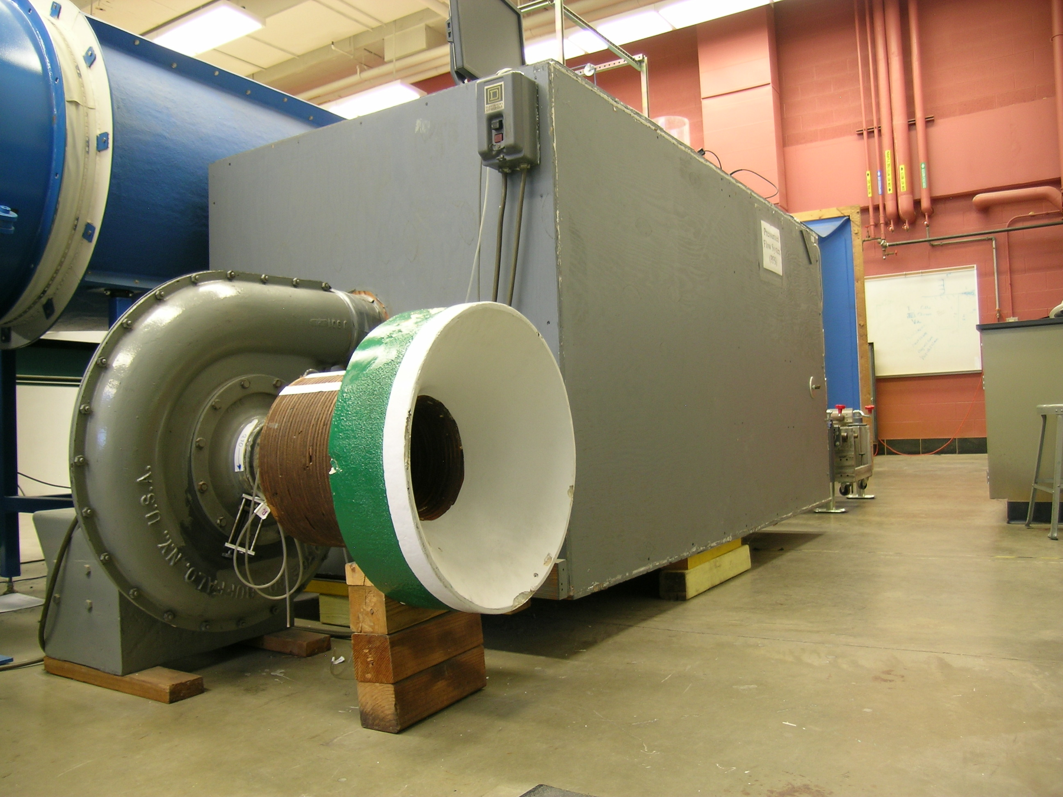
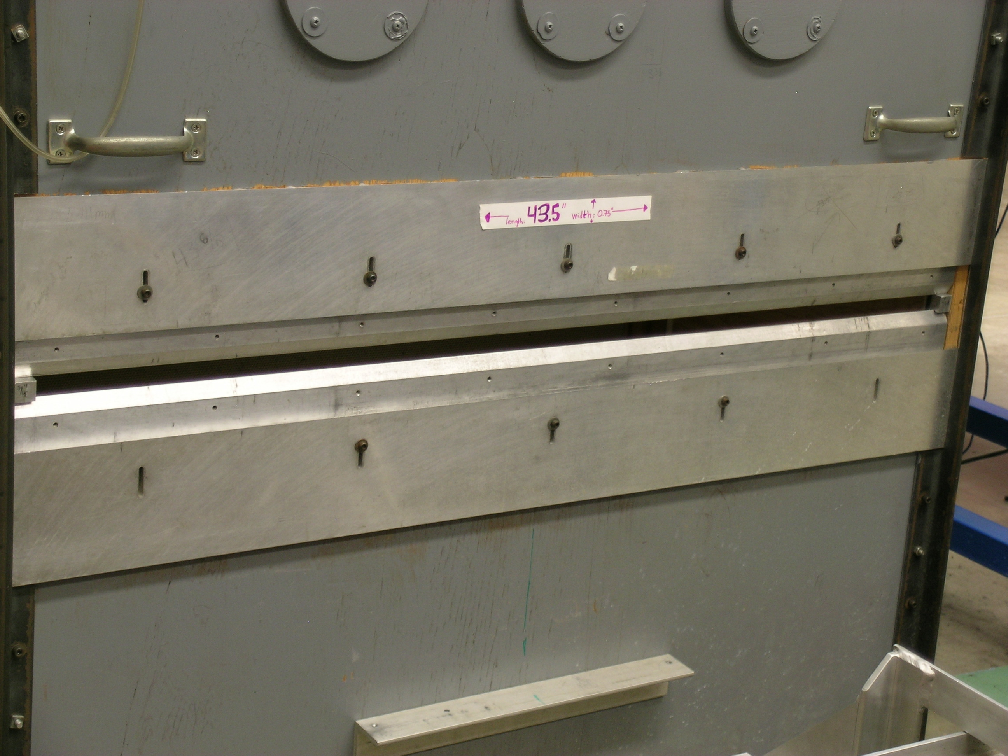
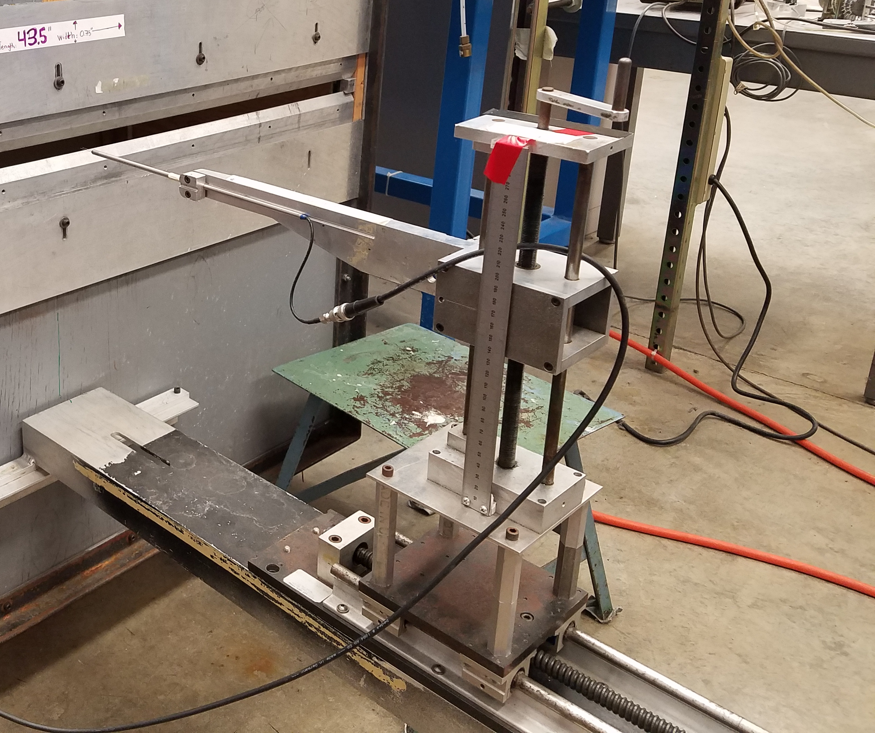
Figure 3
(A)
(B)
(C)
Anemometer
plenum
Centrifugal fan
Jet exit
Traversing system

Slide 4
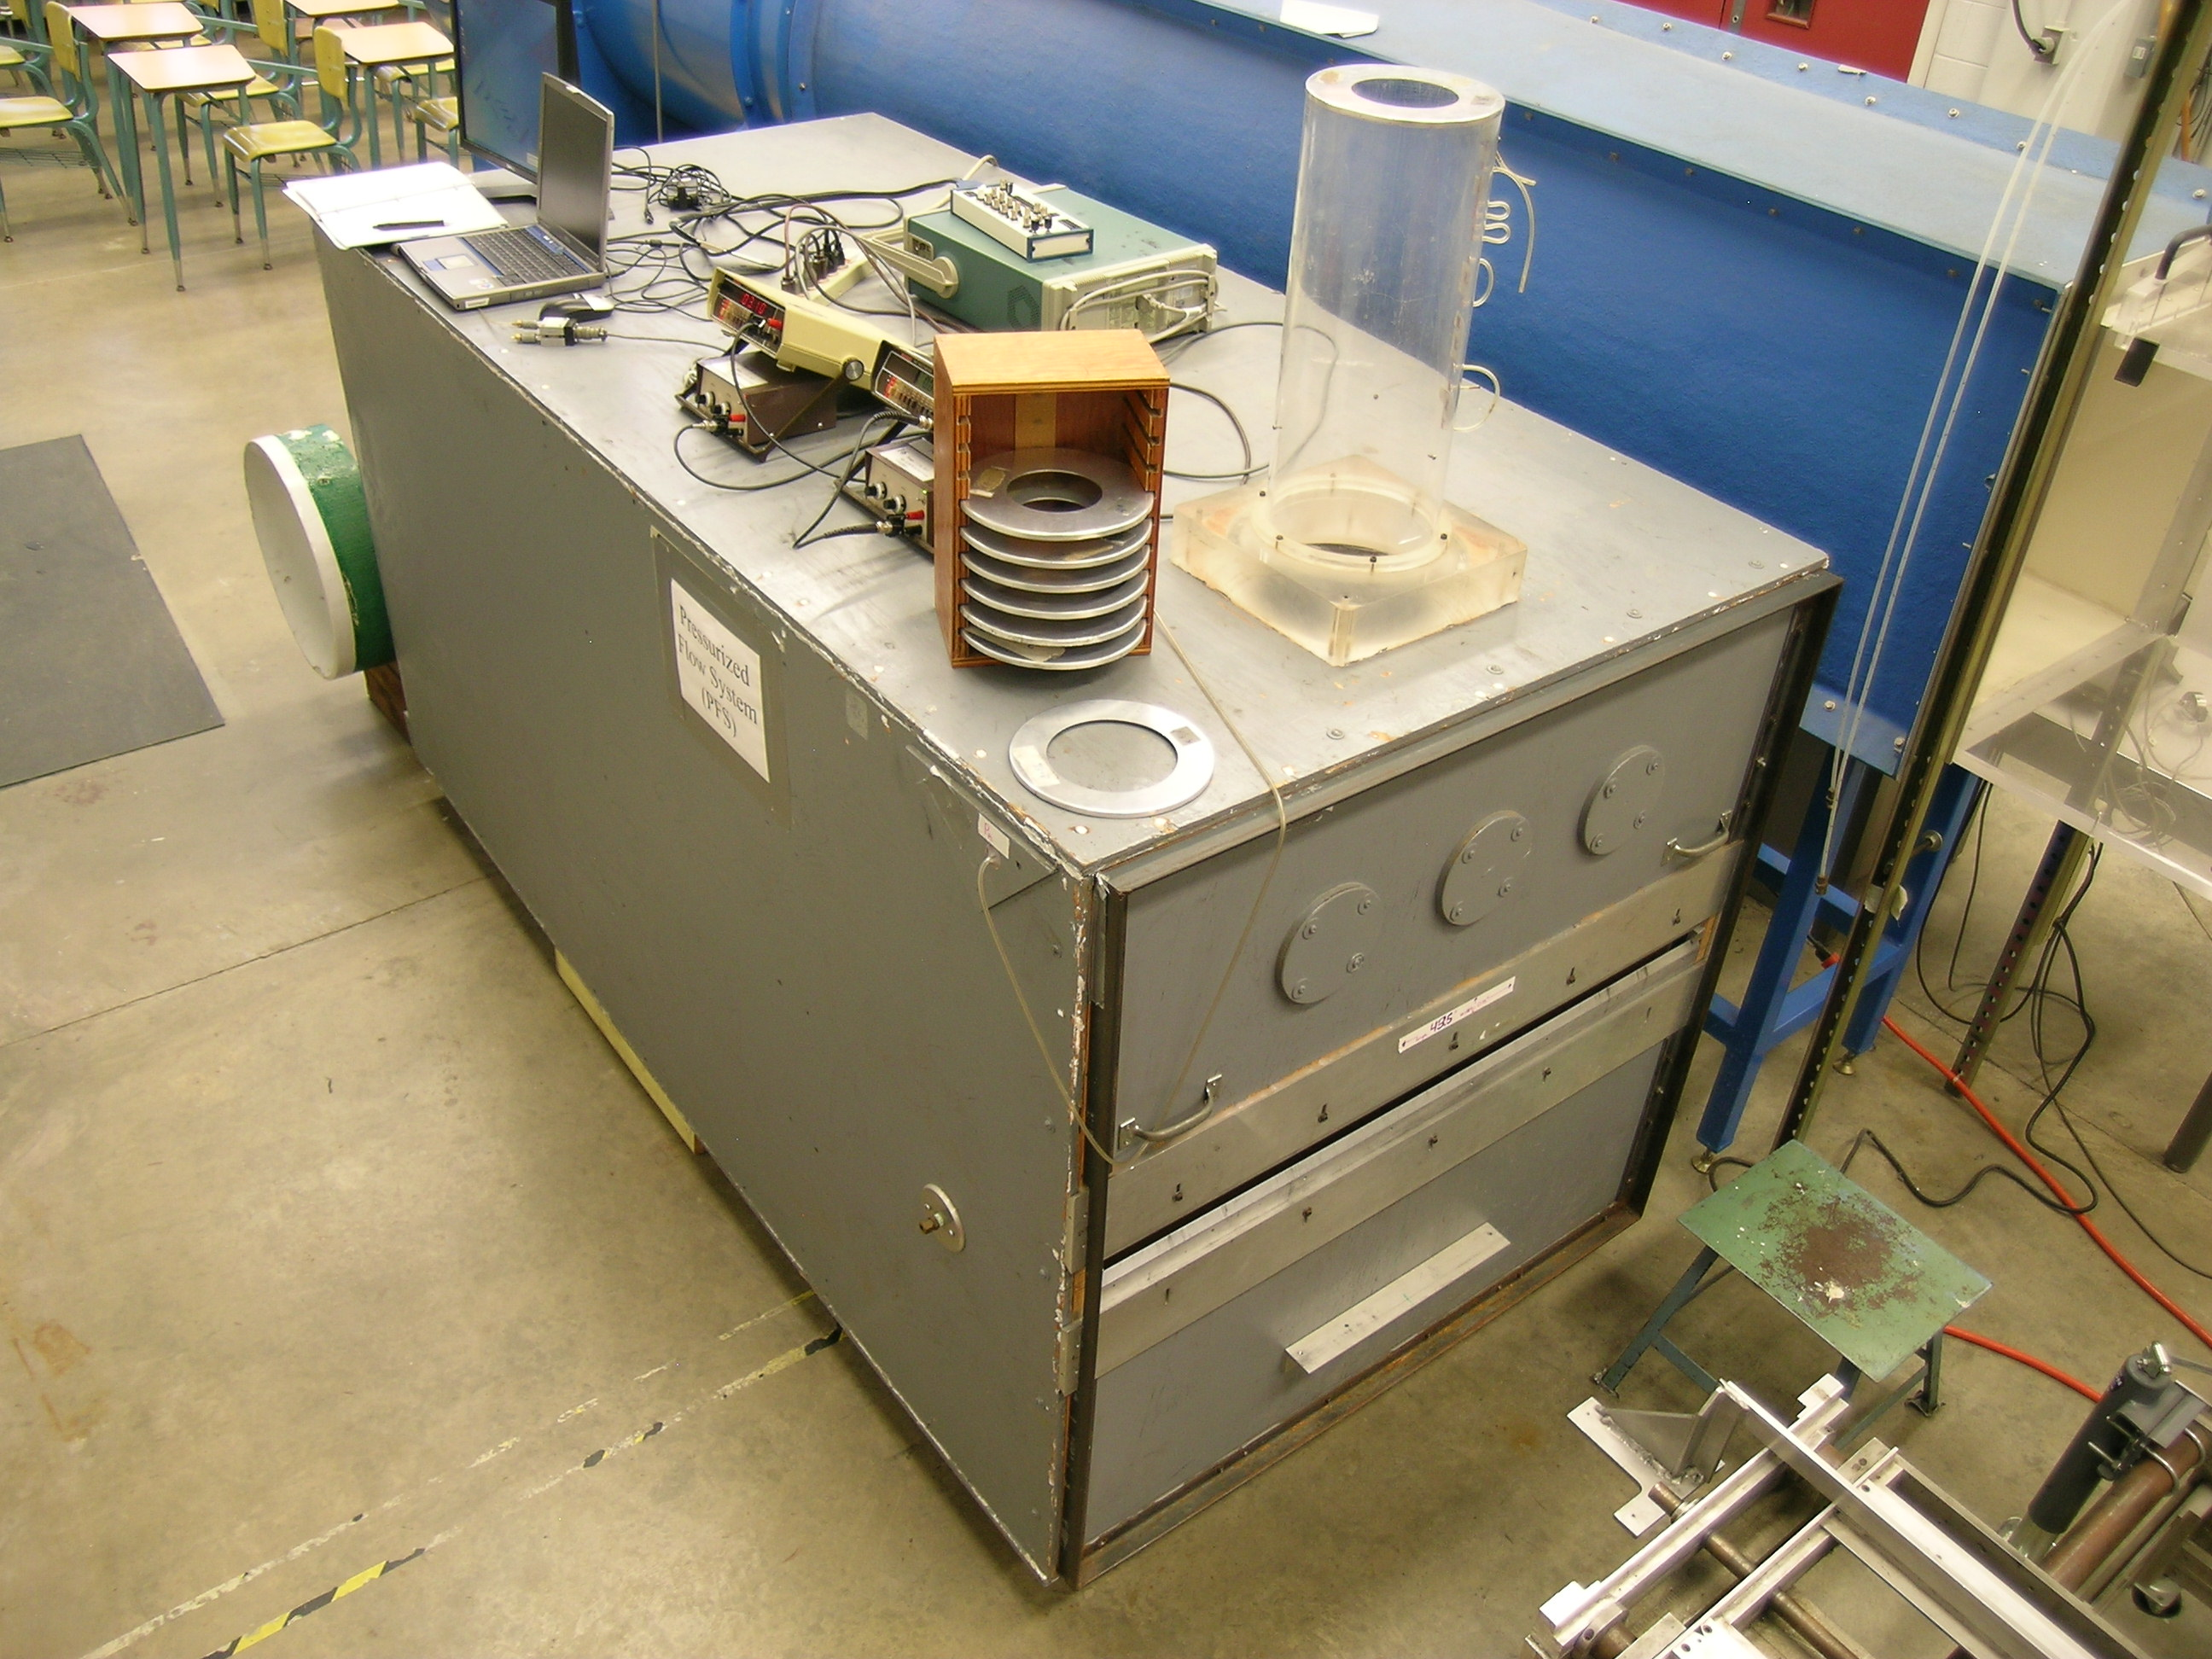
Figure 4
Stack
Orifice plates for restricting flow through the stack
Slit

Slide 5
Figure 5

