Slide 1



Figure 1
$$u(t)$$
$$u′(t)$$
$$\overline{u}$$
t

Slide 2
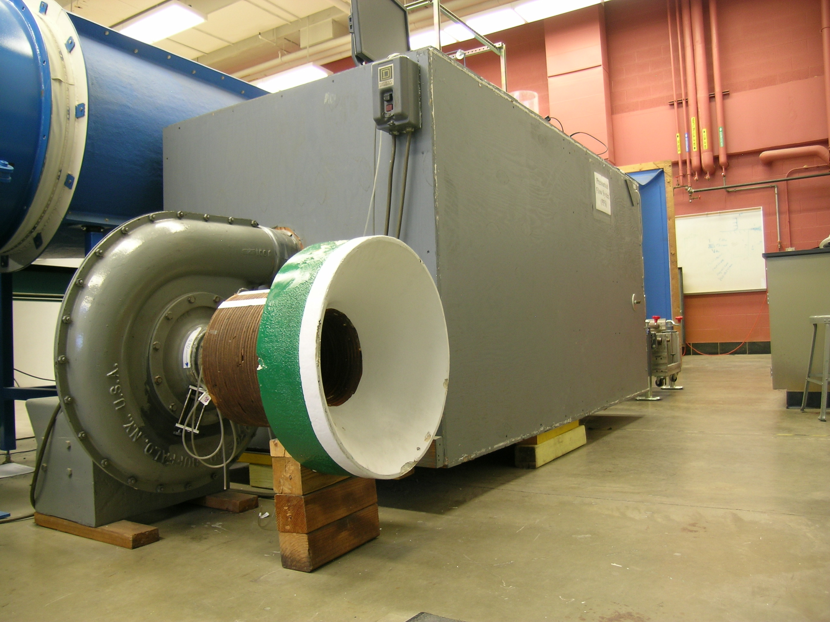
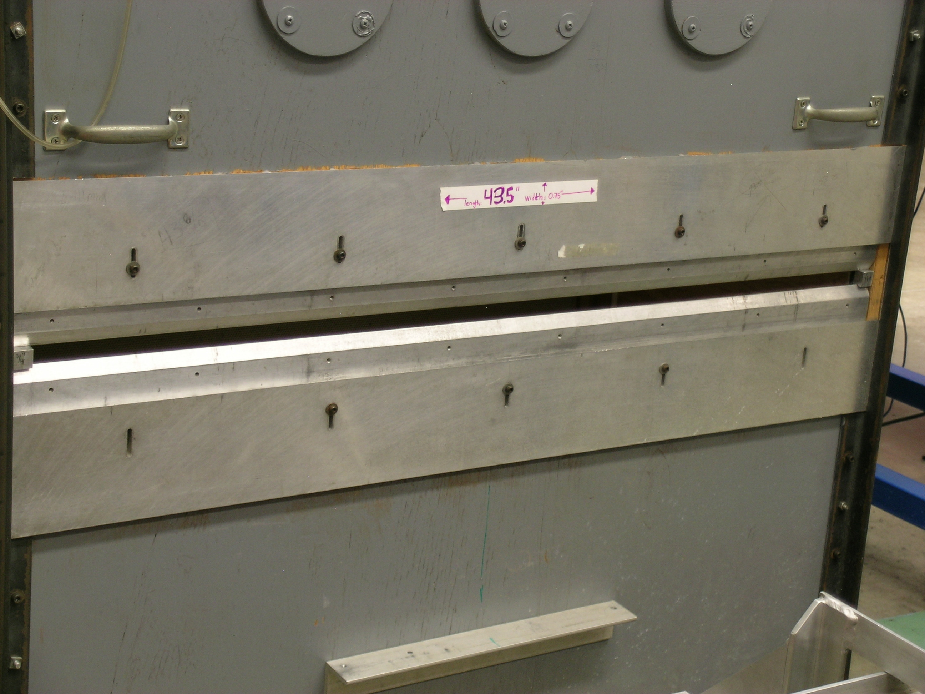
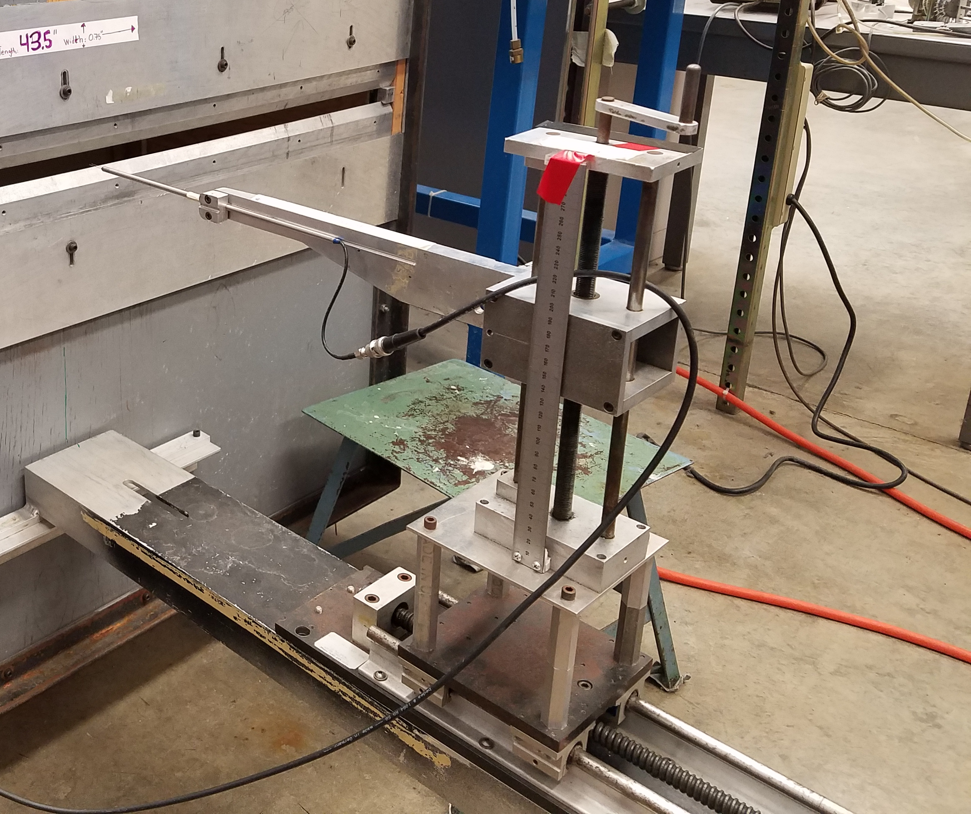
Figure 2
(A)
(B)
(C)
Anemometer
plenum
Centrifugal fan
Jet exit
Traversing system

Slide 3
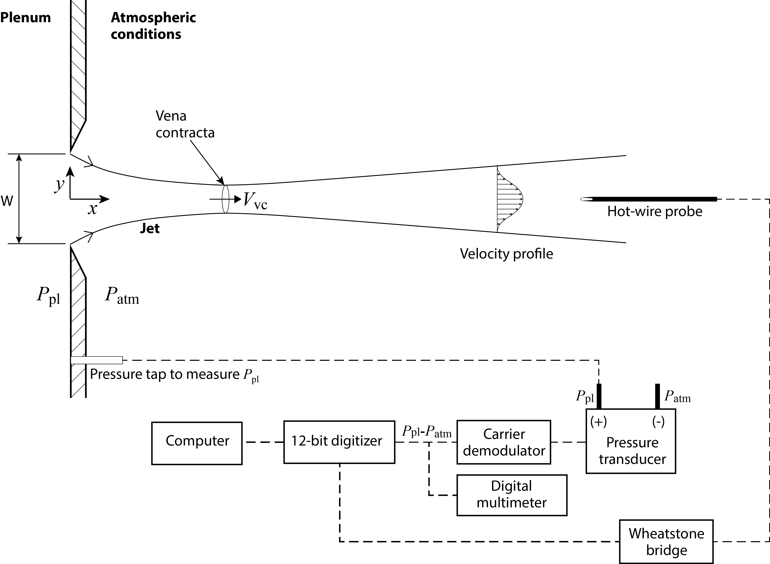
Figure 3

Slide 4
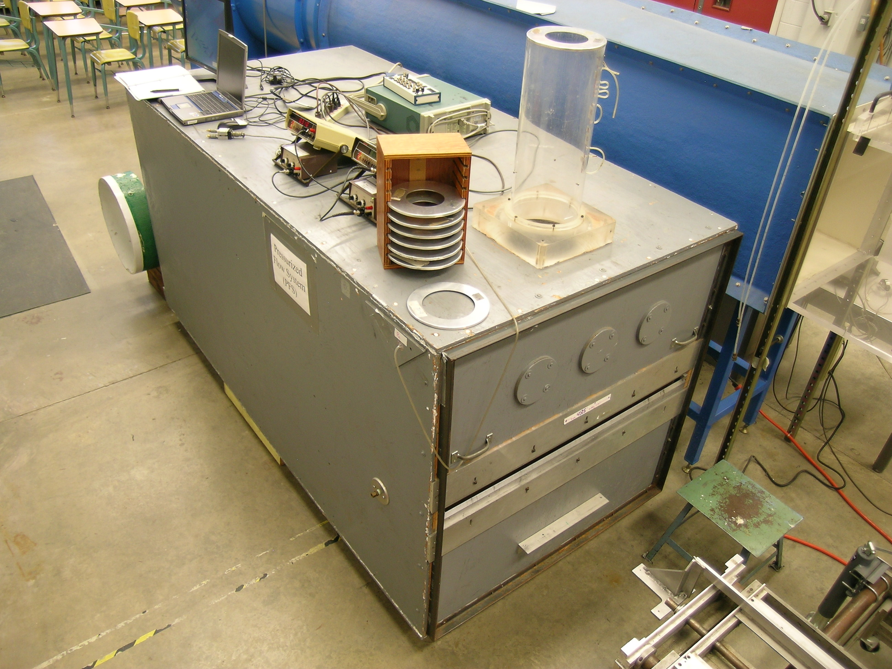
Figure 4
Stack
Orifice plates for restricting flow through the stack
Slit

Slide 5
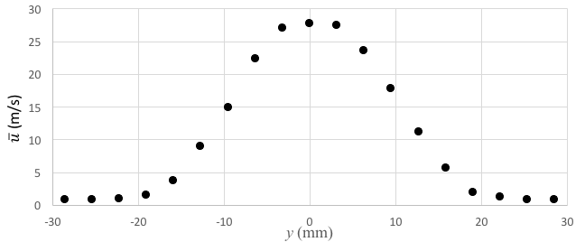
Figure 5

Slide 6
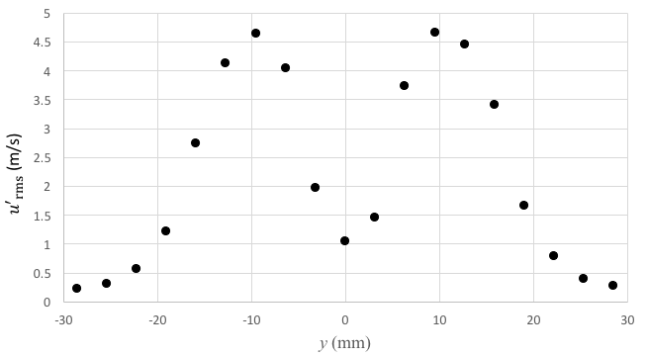
Figure 6

