Slide 1
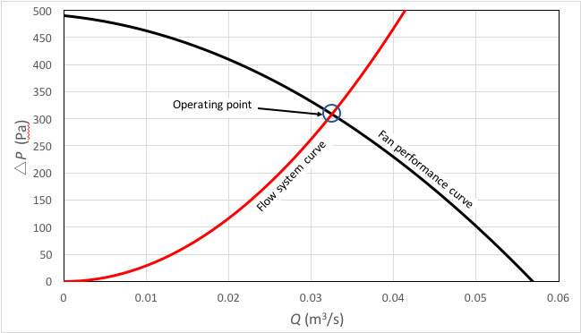
Figure 1

Slide 2
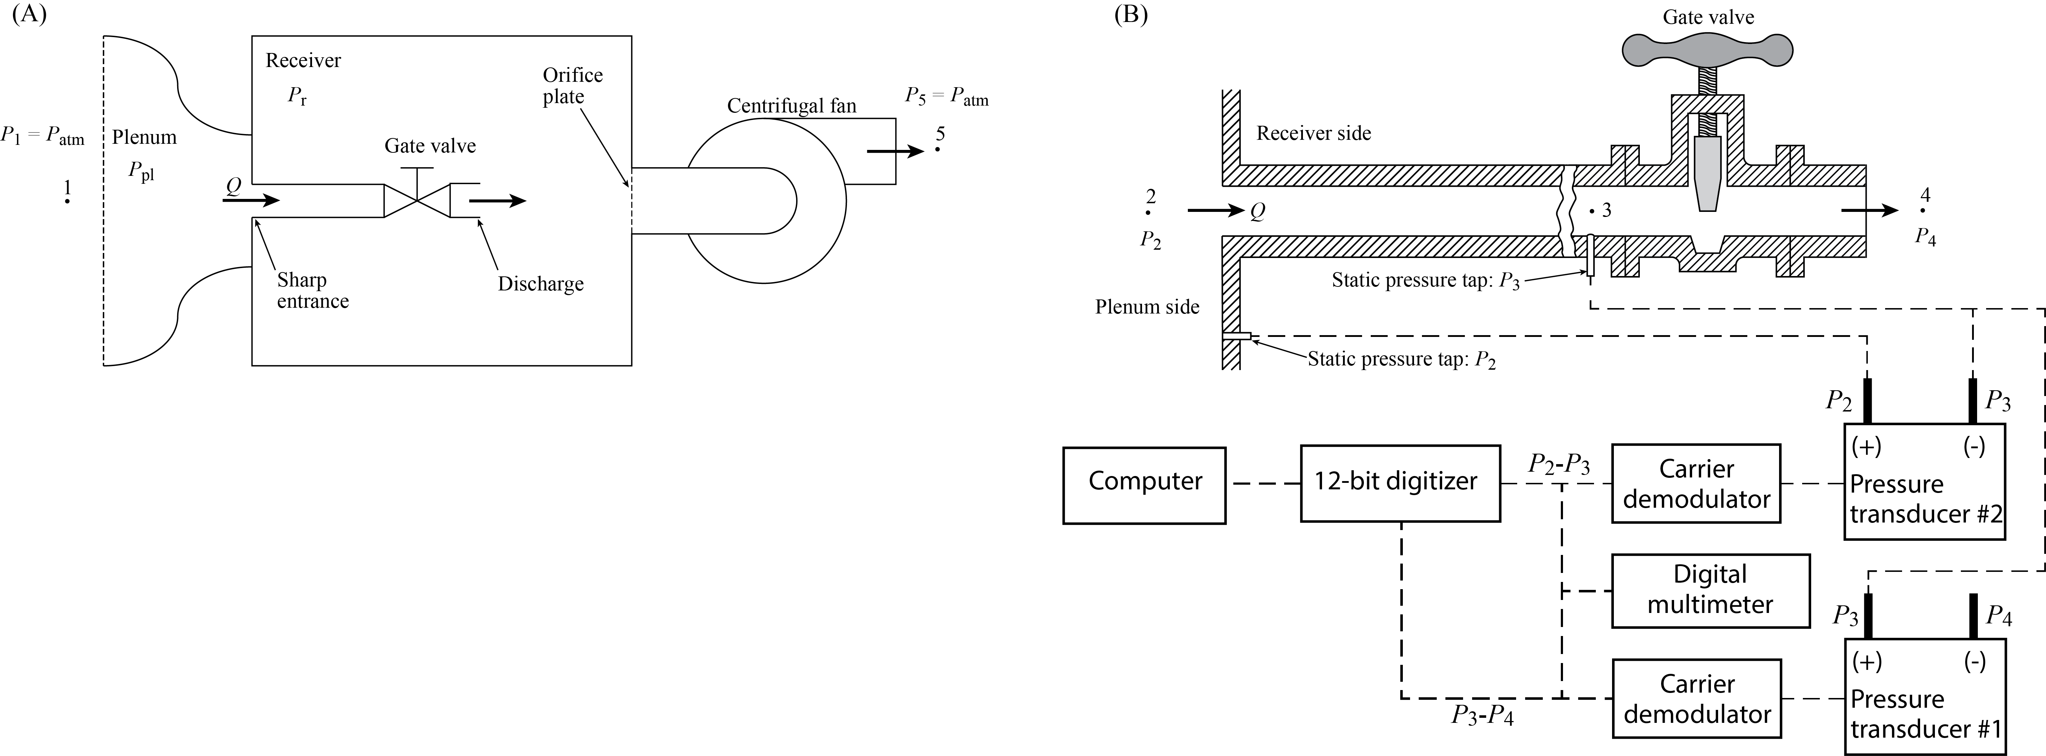
Figure 2

Slide 3
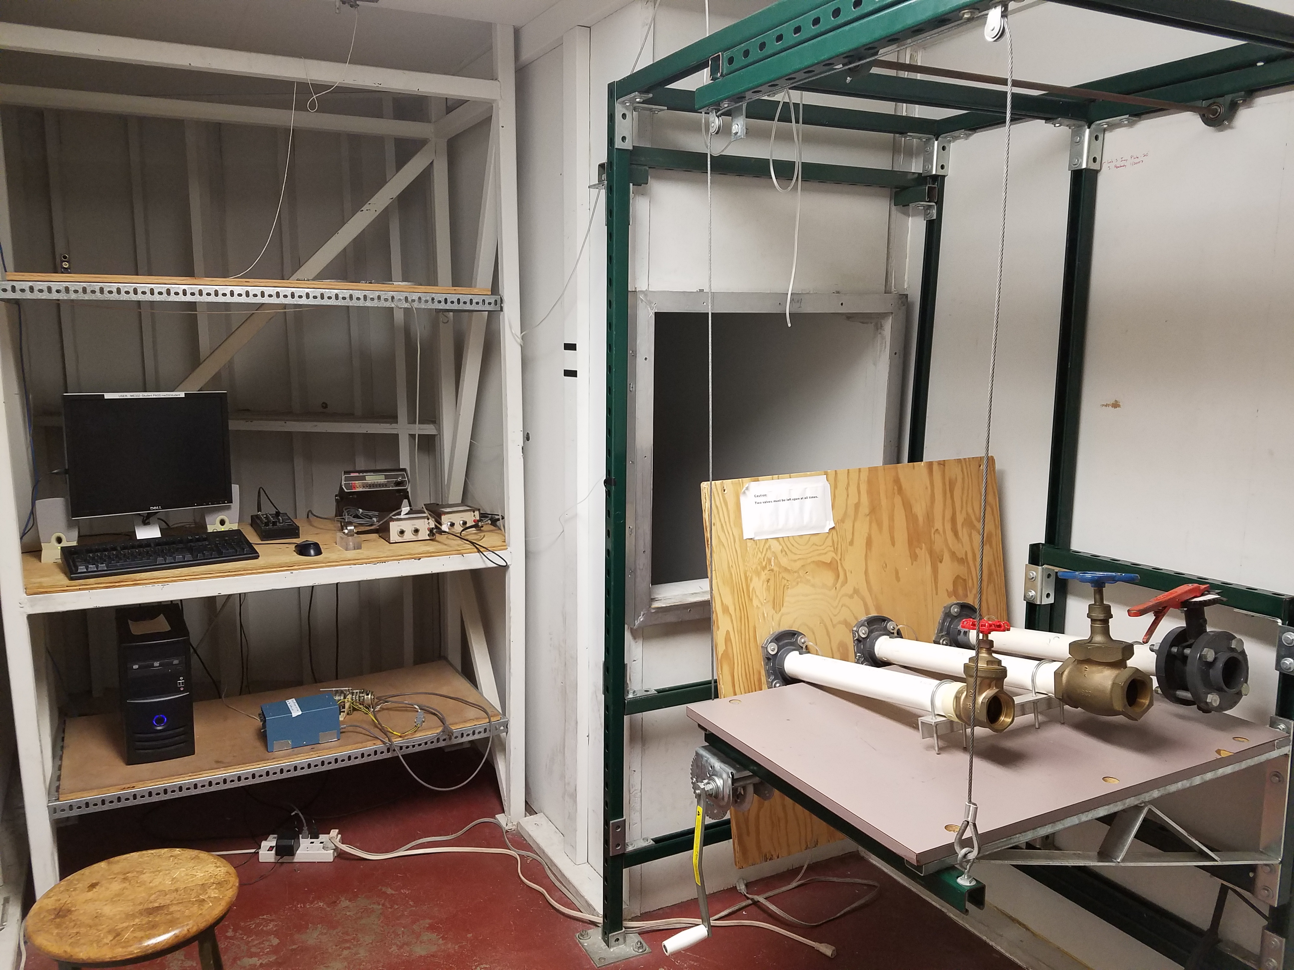
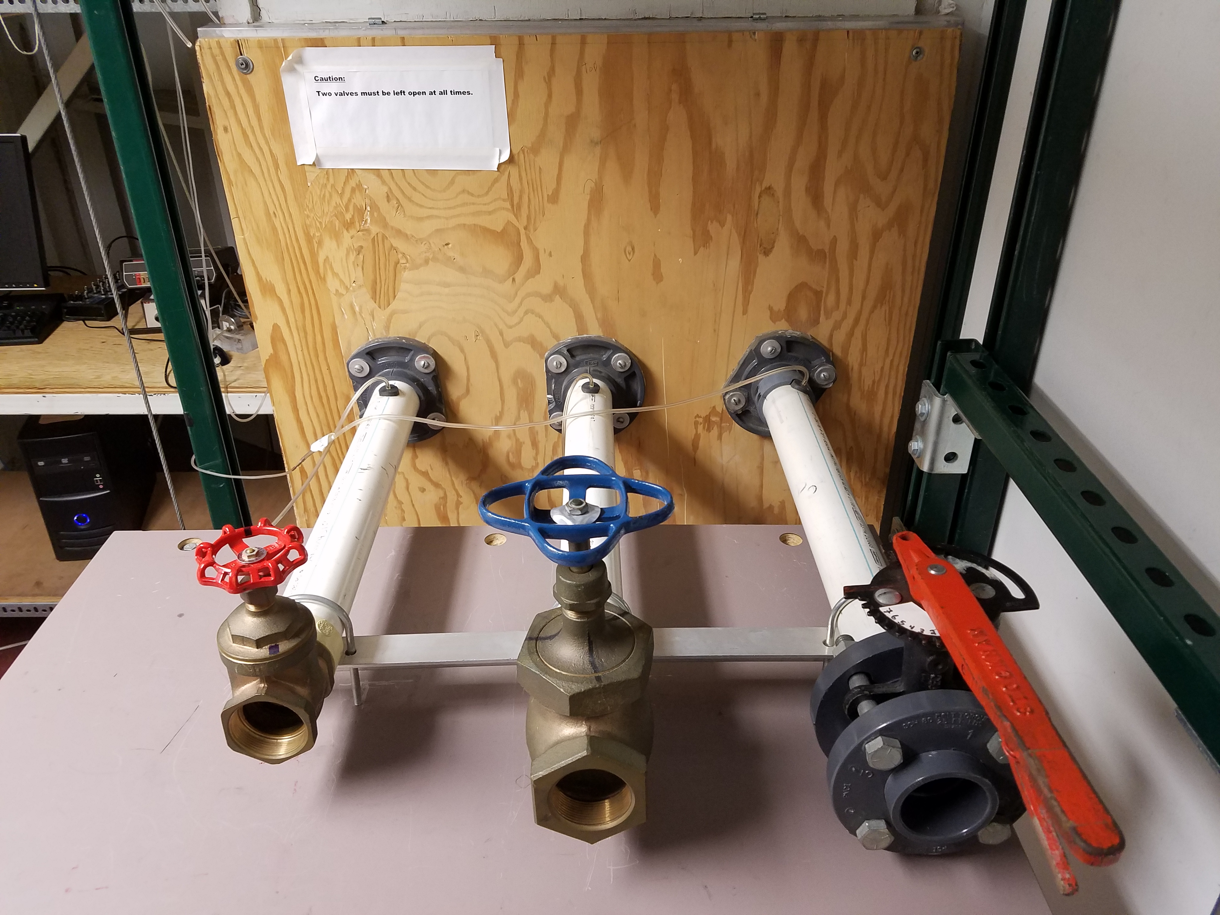
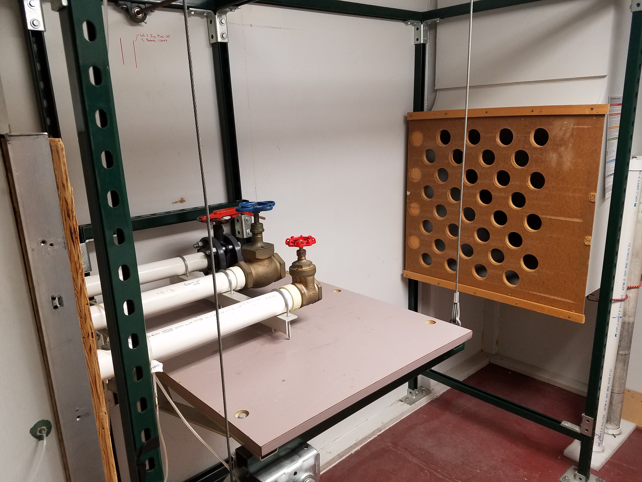
Figure 3
(A)
(B)
(C)

Slide 4
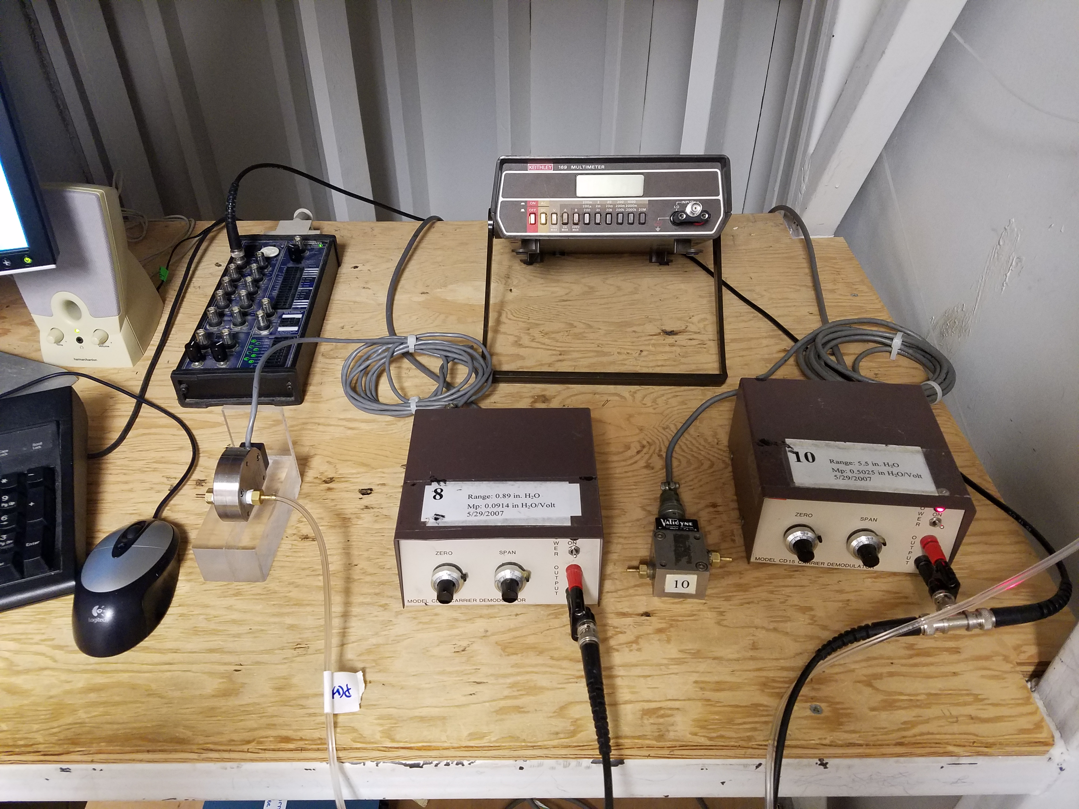
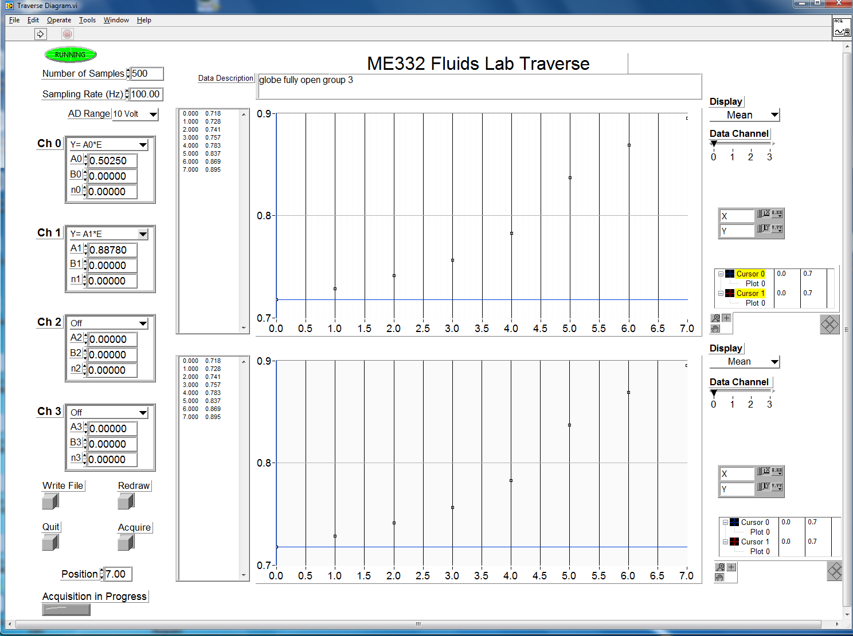
Figure 4
12-bit digitizer
Digital Multimeter
(A)
(B)
Pressure transducer #1
Carrier Demodulator #1
Pressure transducer #2
Carrier Demodulator #2

Slide 5
Figure 5

