Slide 1
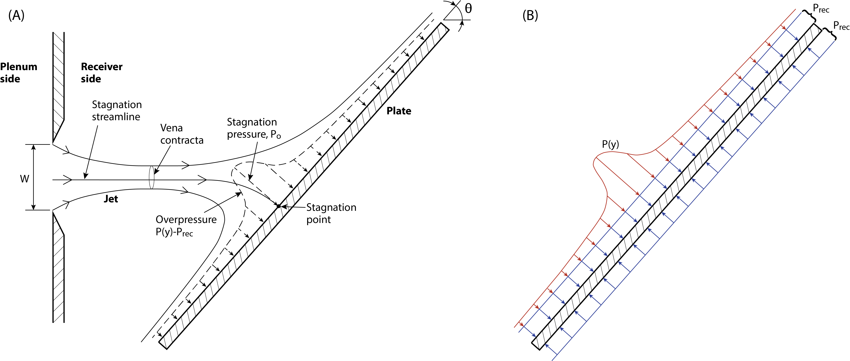
Figure 1

Slide 2
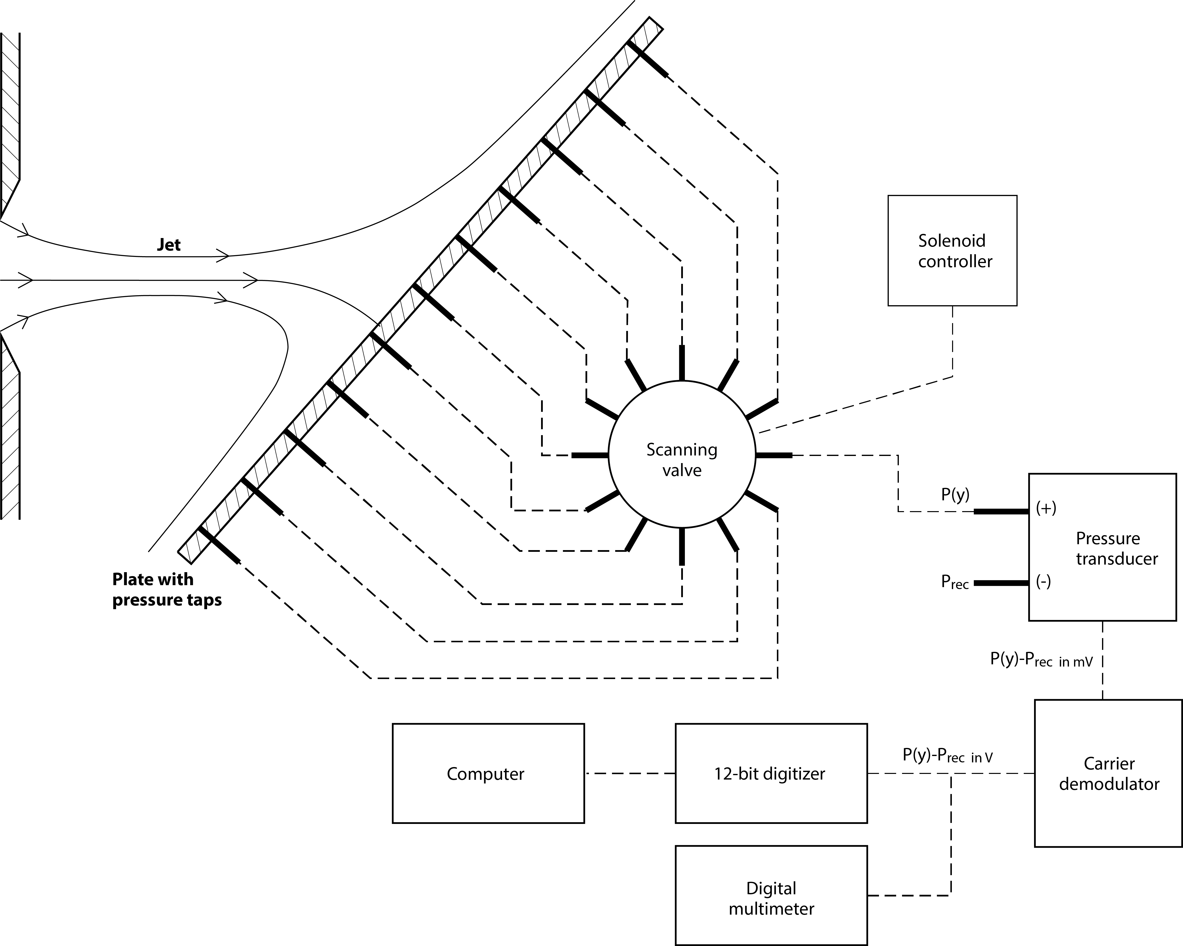
Figure 2

Slide 3
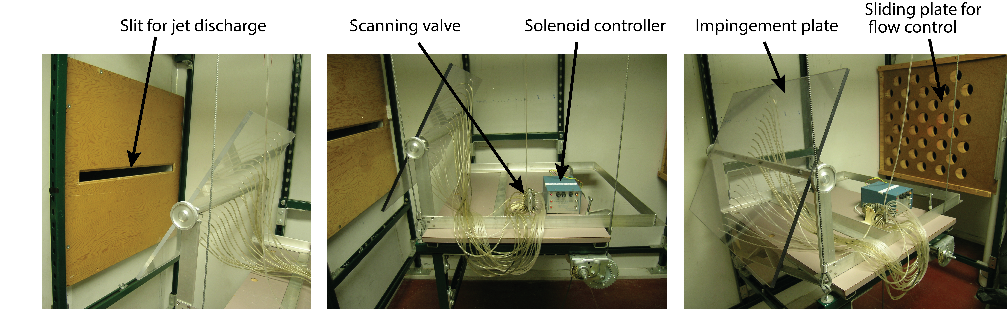
Figure 3

Slide 4
Figure 4

Slide 5
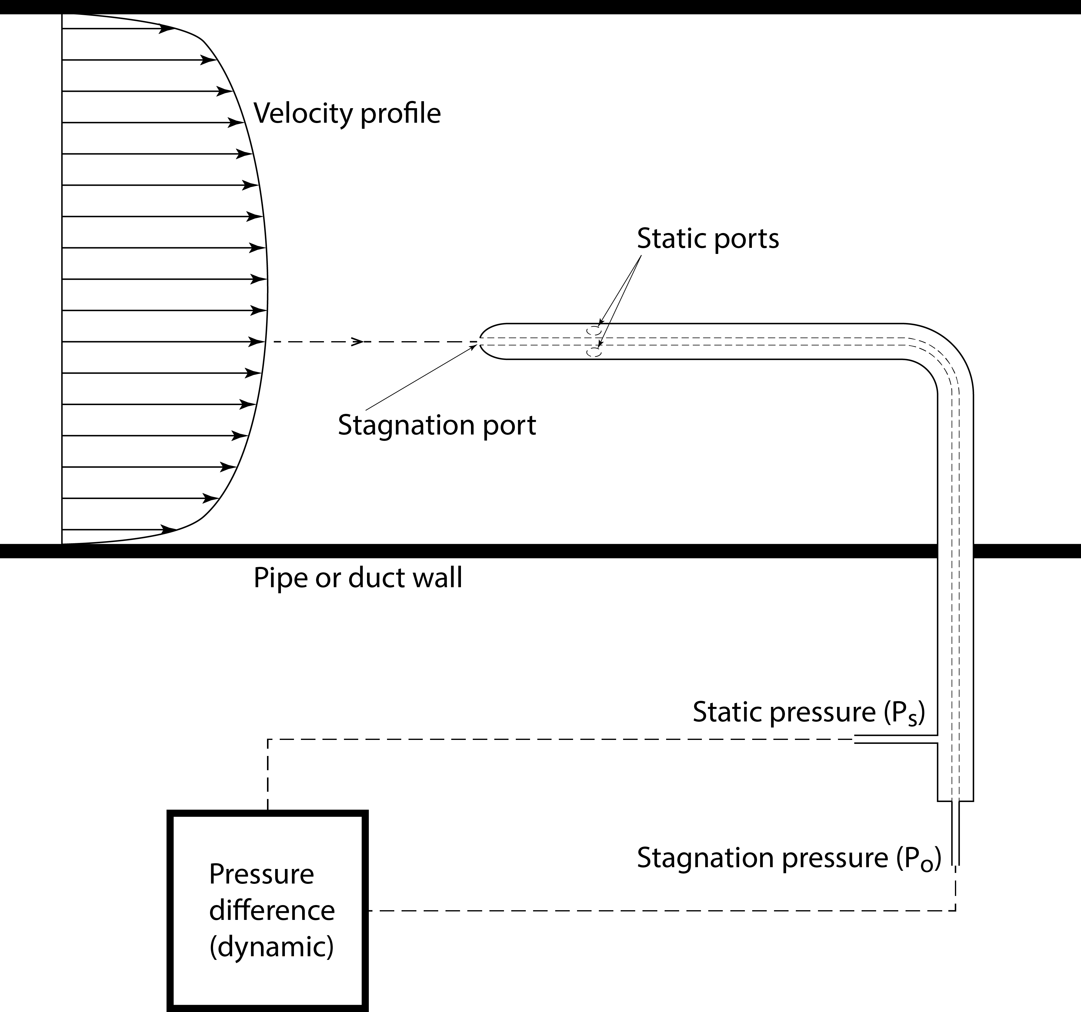
Figure 5

Slide 6
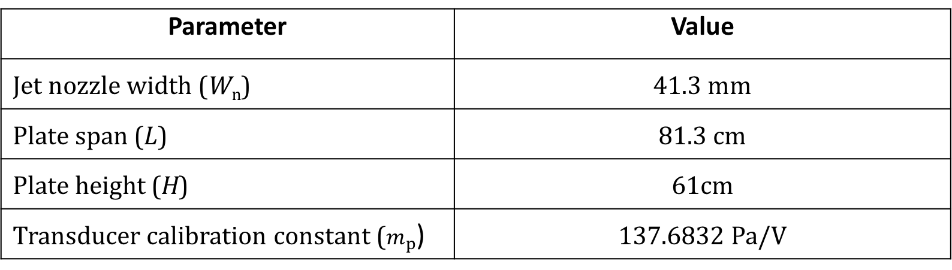
Table 1
Parameter | Value
Jet nozzle width (W_{n}) | 41.3 mm
Plate span (L) | 81.3 cm
Plate height (H) | 61cm
Transducer calibration constant ($m_{p}$) | 137.6832 Pa/V

Slide 7
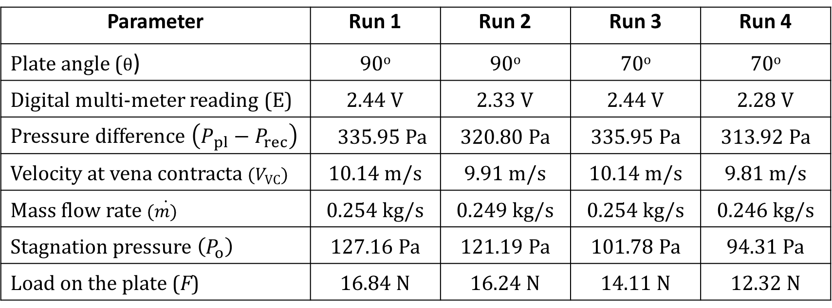
Table 2
Parameter | Run 1 | Run 2 | Run 3 | Run 4
Plate angle ($θ$) | 90º | 90º | 70º | 70º
Digital multi-meter reading (E) | 2.44 V | 2.33 V | 2.44 V | 2.28 V
Pressure difference $\left(P_{pl}−P_{rec}\right)$ | 335.95 Pa | 320.80 Pa | 335.95 Pa | 313.92 Pa
Velocity at vena contracta $(V_{VC})$ | 10.14 m/s | 9.91 m/s | 10.14 m/s | 9.81 m/s
Mass flow rate $(\dot{m)}$ | 0.254 kg/s | 0.249 kg/s | 0.254 kg/s | 0.246 kg/s
Stagnation pressure $\left(P_{o}\right)$ | 127.16 Pa | 121.19 Pa | 101.78 Pa | 94.31 Pa
Load on the plate (F) | 16.84 N | 16.24 N | 14.11 N | 12.32 N

