Slide 1
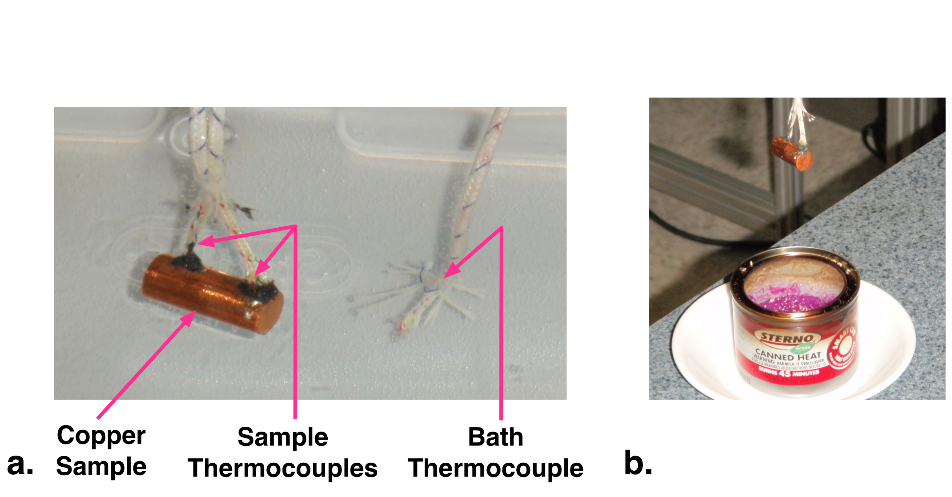
Figure 1

Slide 2

Figure 2

Slide 3
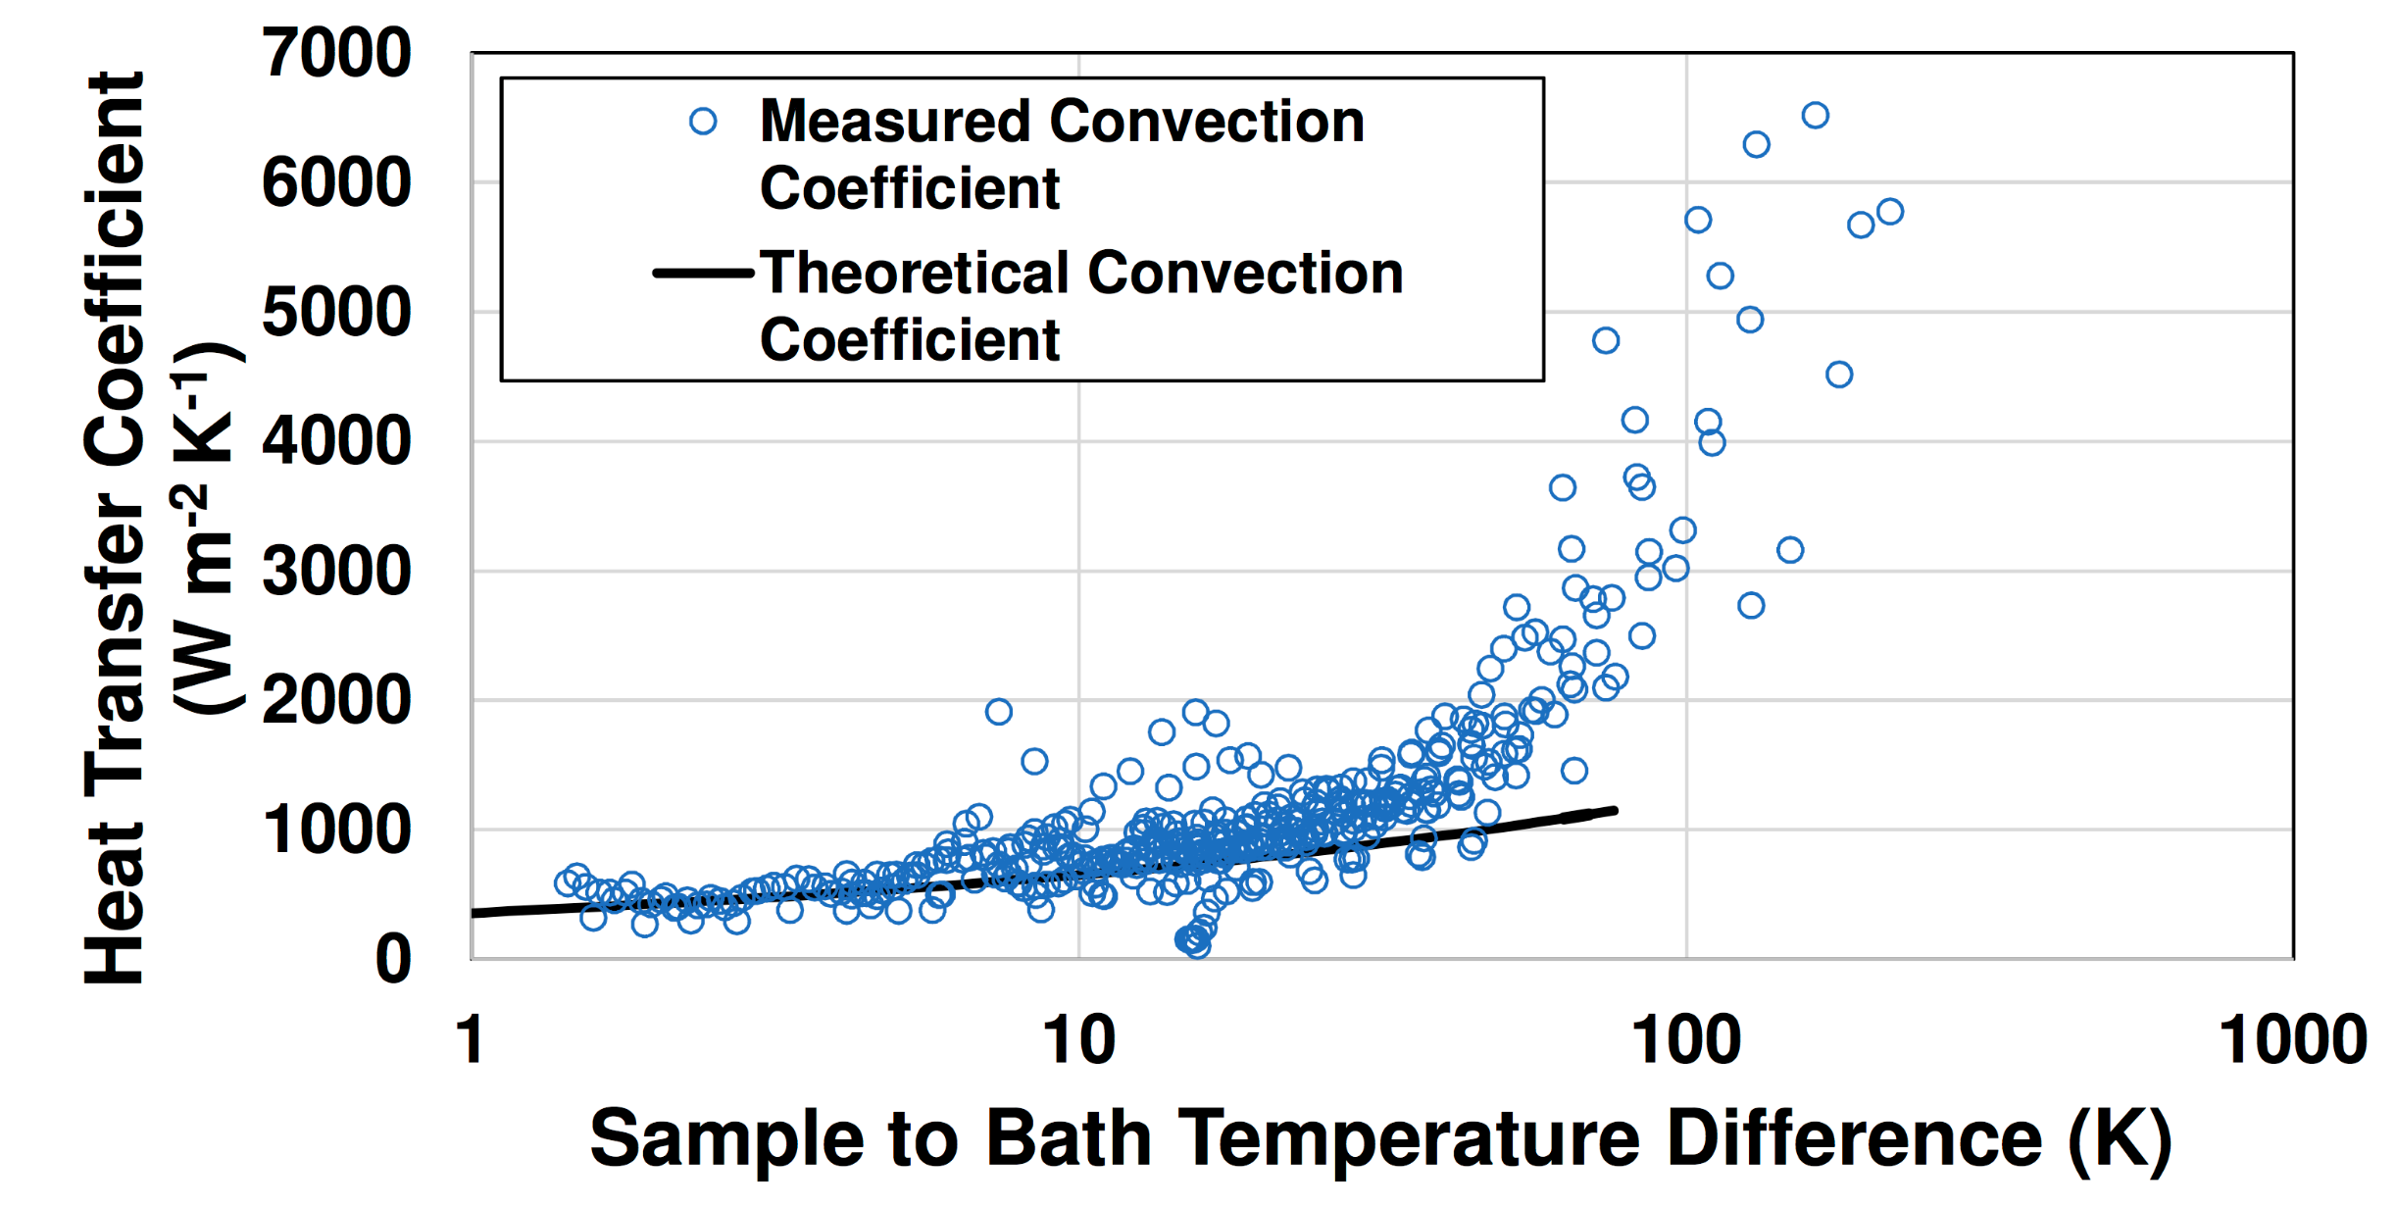
Figure 3

Slide 4
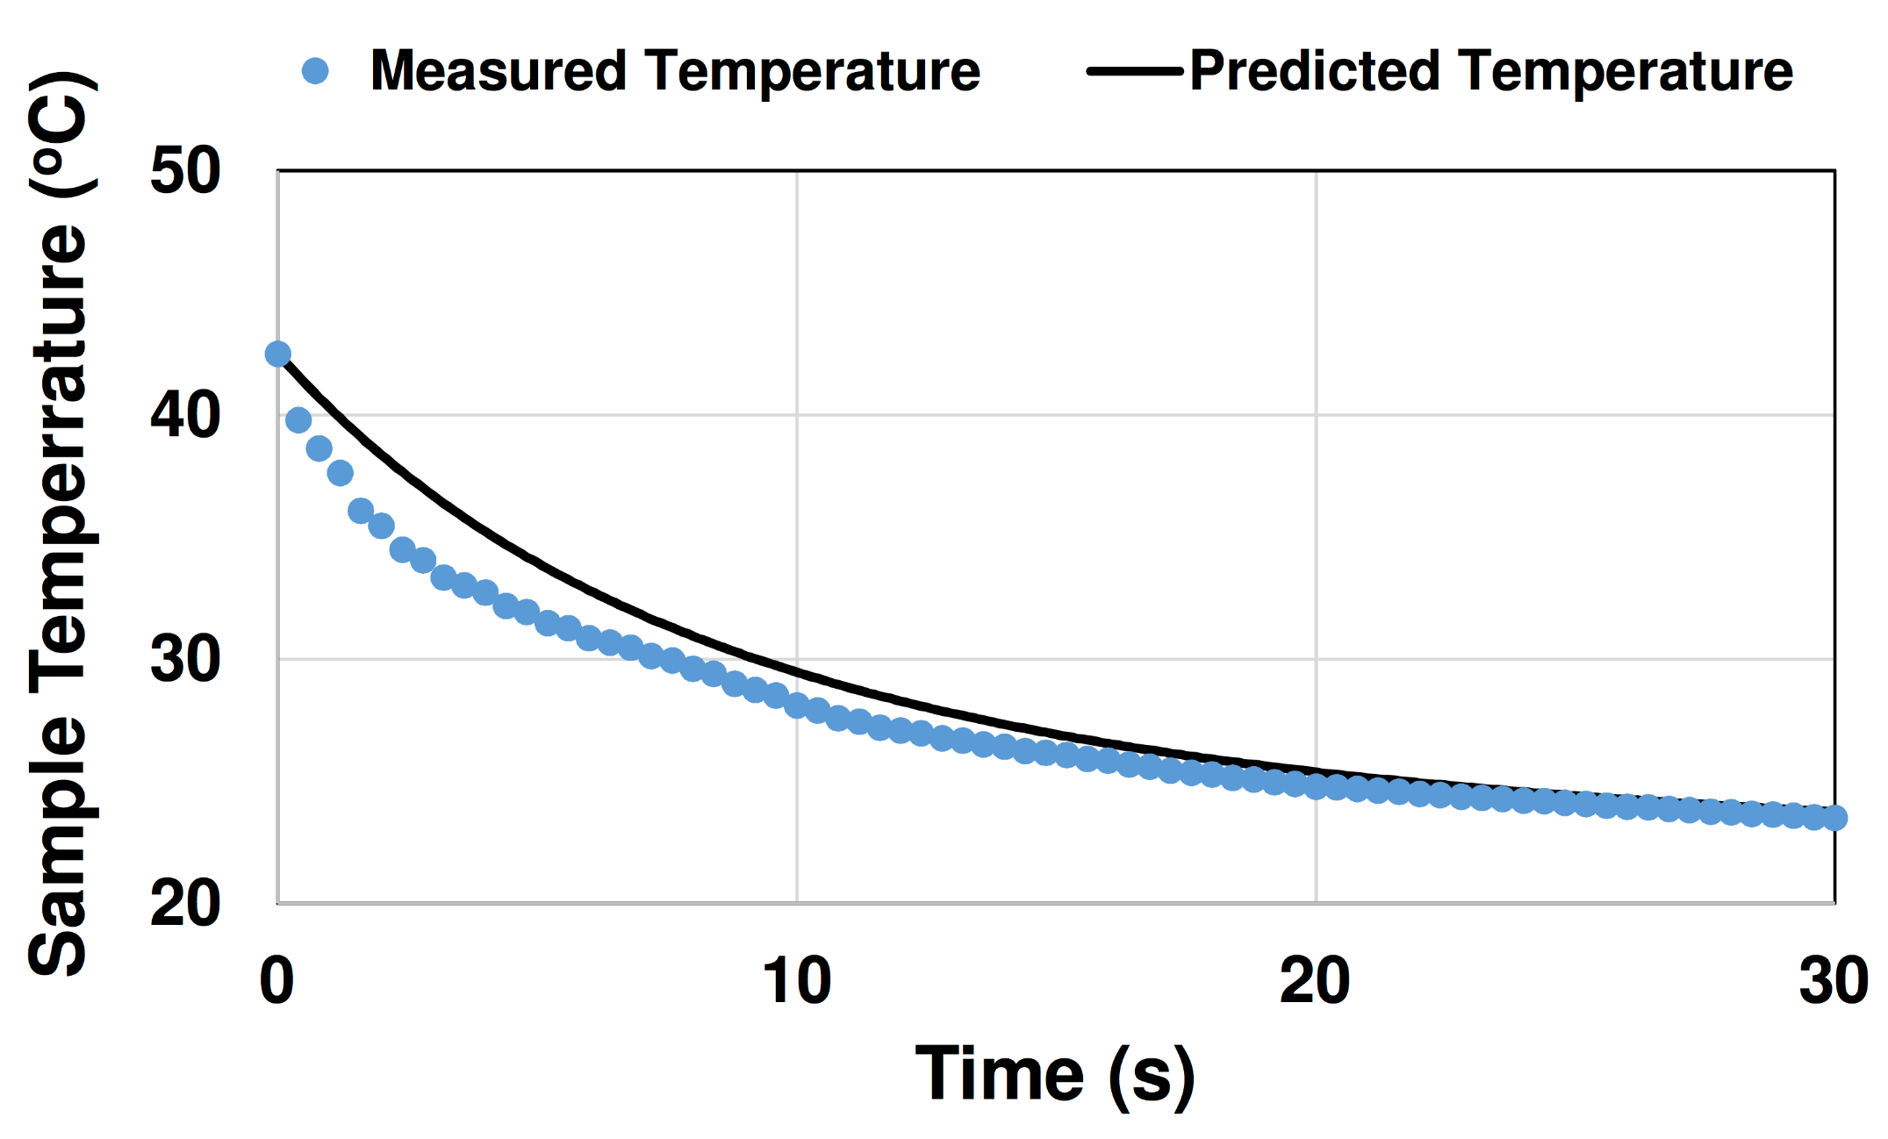
Figure 4

