Slide 1
Figure 1

Slide 2
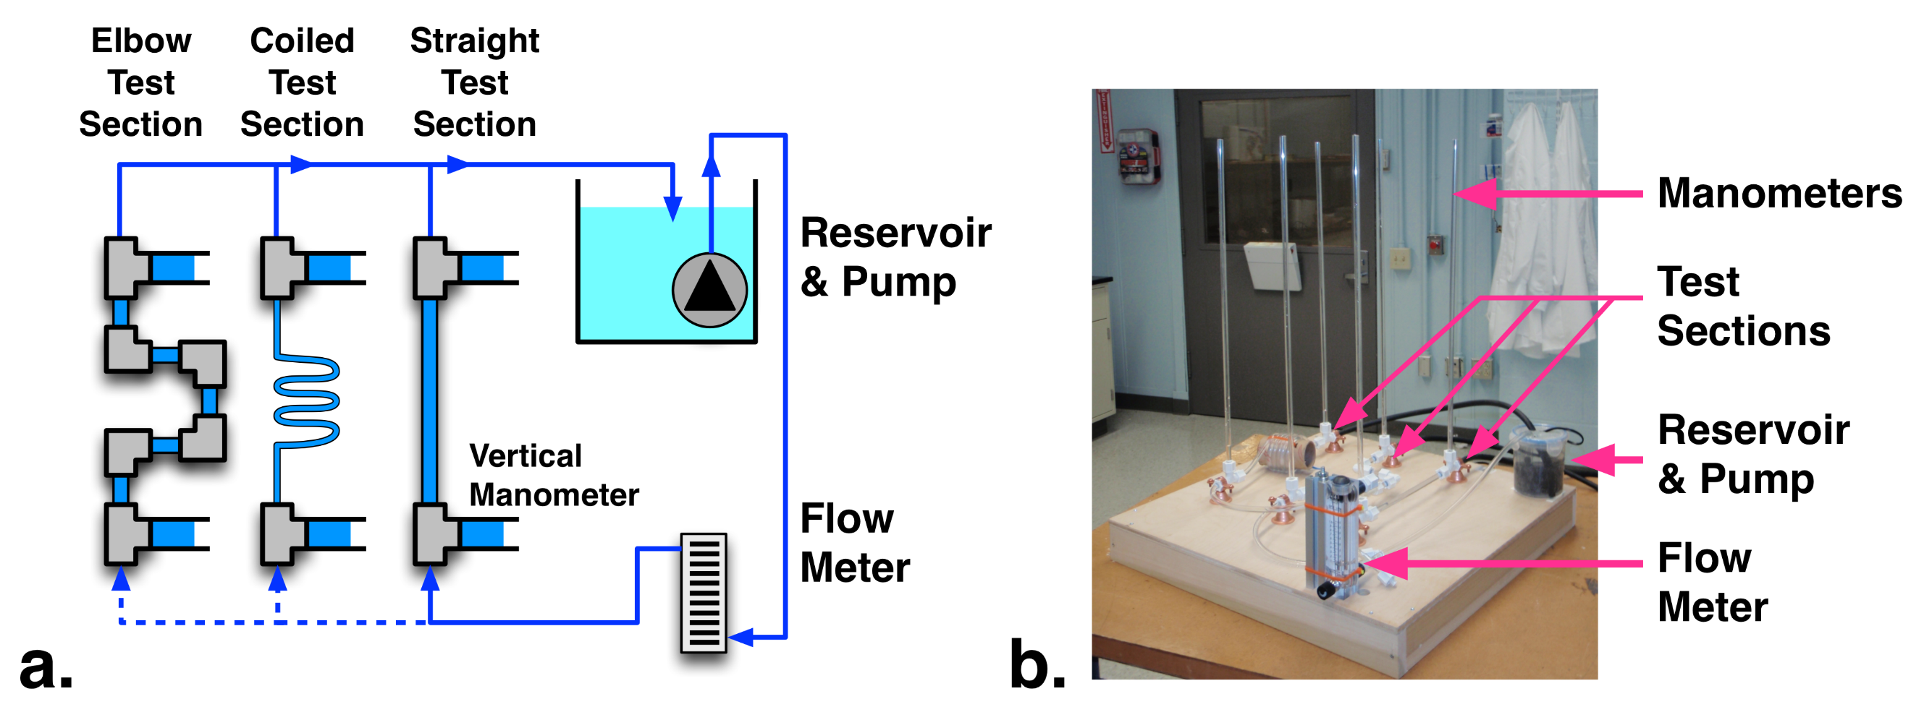
Figure 2

Slide 3
Figure 3

