Slide 1
Figure 1

Slide 2
Table 1

Slide 3
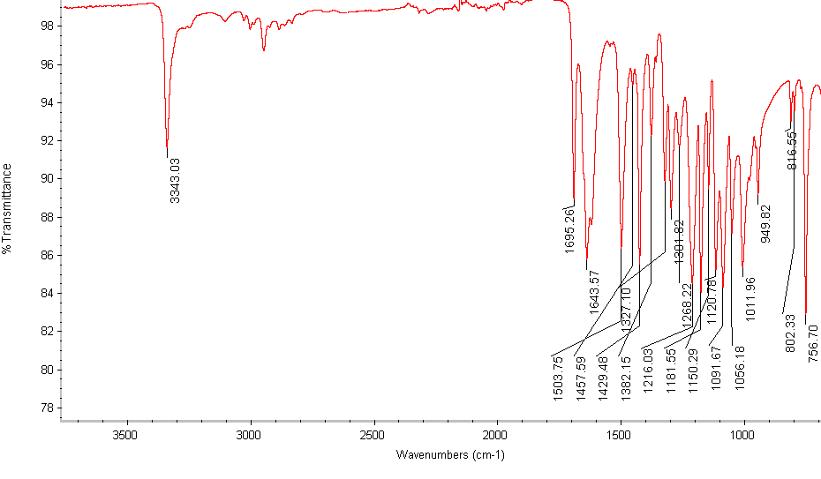
Figure 2

Slide 4
Figure 3

