Slide 1
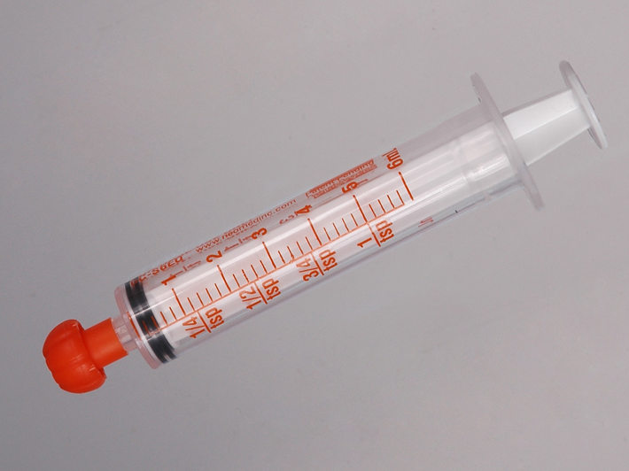
Correct Medication Dispensing Line

